Slide 1

6-8 Student Glossary for the 2017 Kansas Mathematics Standards

Slide 2
absolute value
4 3 2 1
-4 -3 -2 -1 0 1 2 3 4
1 2
|2| = 2 |-4| = 4 |0| = 0
the magnitude of a number without regard to its sign - it’s distance from zero
Notes:
MS – grade 6

Slide 3
additive identity property of zero
8 + 0 = 8
0 + ½ = ½
when you add 0 to any number you end up with that number
Notes:
Use in elementary starting in 1st but don’t need to know the name of the property until MS

Slide 4
additive inverse
(-5) + 5 = 0 x + (–x) = 0
additive inverse of -5 additive inverse of x
the number in the set of real numbers that when added to a given number will yield zero, also referred to as an opposite
Notes:
MS – grade 7

Slide 5
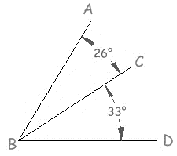
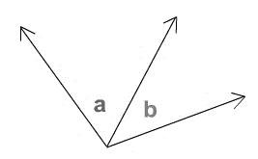
adjacent angles
two angles are adjacent when they have a common side and a common vertex, and they don’t overlap
Notes:
MS – grade 8

Slide 6
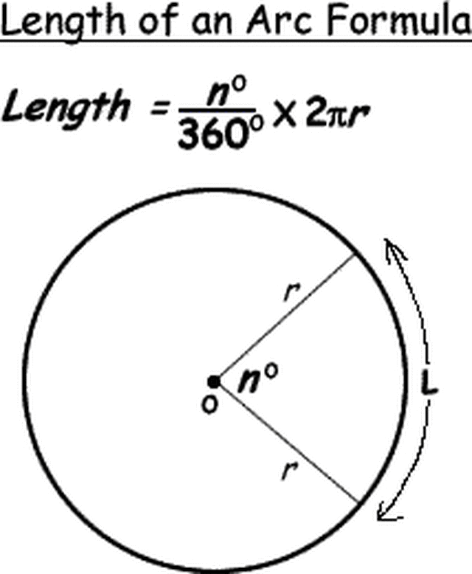
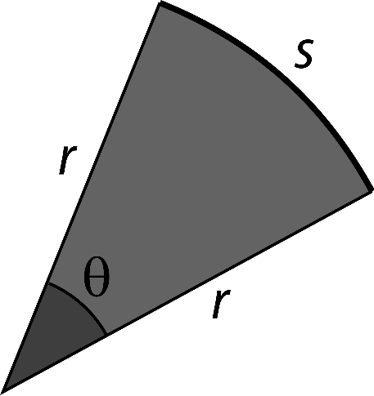
arc length
s = rθ
s = arc length
r = radius of the circle
θ = measure of the central angle in radians
the distance along a segment of the circumference of a circle or of any curve
Notes:
MS – grade 8

Slide 7
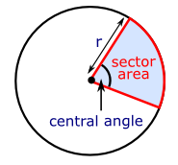
area of sector
the fractional part of the area of an entire circle
Notes:
MS – grade 8

Slide 8
base (polygon)
base
base
base
one of the sides of a plane figure
Notes:
MS 6th grade

Slide 9
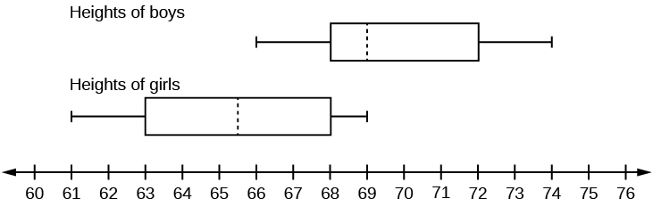
box plot
(box and whisker diagram)
1st quartile
3rd quartile
minimum
median
maximum
inches
a display of the distribution of a data set using the minimum, lower (1st) quartile, median, upper (3rd) quartile, and maximum
Notes:
MS – grade 6

Slide 10
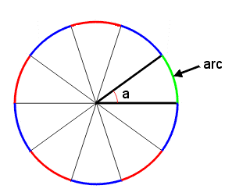
circular arc
a portion of the circumference of circle
Notes:
MS – grade 8

Slide 11
circumference
the distance around the outside (perimeter) of a circle
Notes:
MS – grade 7

Slide 12

clustering
There is clustering around the value 8.
when data seems to be "gathering" around a particular value
Notes:
MS – grade 8

Slide 13
coefficient
7n + 8 -4x - 7
7 is the coefficient
-4 is the coefficient
the number by which a variable is multiplied
Notes:
MS – grade 6

Slide 14
commutative property
5+3 = 3+5
½ x ¼ = ¼ x ½
numbers may be added or multiplied together in any order without changing the answer
Notes:
Use in Elem at 1st but don’t need to know term until MS

Slide 15
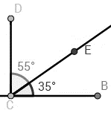
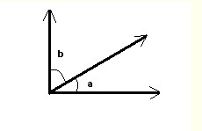
complementary
two angles whose sum is 90°
Notes:
MS – grade 8

Slide 16
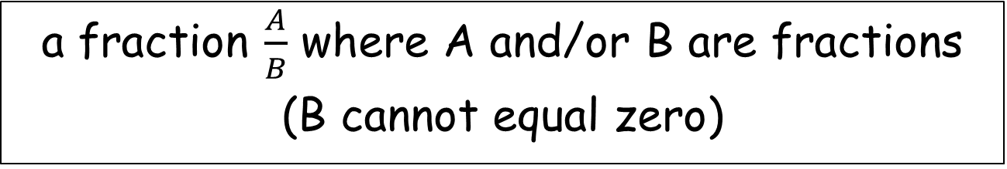


complex fraction
$$\frac{\frac{2}{5}}{\frac{3}{8}}$$
$$\frac{5}{\frac{1}{2}}$$
a fraction $\frac{A}{B}$ where A and/or B are fractions
(B cannot equal zero)
Notes:
MS – grade 7

Slide 17
compound events
Example: tossing a coin is a simple event, but rolling a die and tossing a coin is a combination of 2 simple events and therefore a compound event.
a combination of two or more simple events
Notes:
MS – grade 7

Slide 18
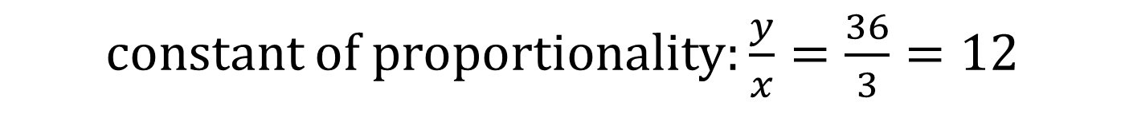
constant of proportionality
Chaperones | 1 | 2 | 3 | 4 | 5
Students | 12 | 24 | 36 | 48 | 60
constant of proportionality: $\frac{y}{x}=\frac{36}{3}=12$
in a proportional relationship, every pair of numbers has the same unit rate (referred to as the “constant of proportionality”)
Notes:
MS – grade 8

Slide 19
converse
Switching the hypothesis and conclusion of a conditional statement.
For example, the converse of "If it is raining then the grass is wet" is "If the grass is wet then it is raining”.
Notes:
New
MS – grade 8

Slide 20
converse of the
Pythagorean Theorem
3² + 4² = 5²
+ 16 = 25
It is a right triangle
5 cm
3 cm
4 cm
when a triangle has side lengths of a, b and c, and a² + b² = c², then the angle opposite the side of length c is a right angle
Notes:
MS – grade 8

Slide 21
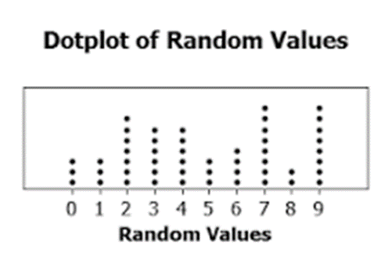
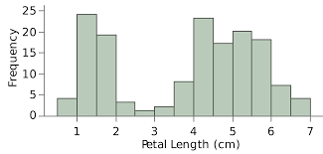
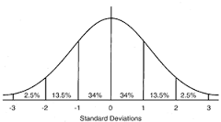
data distribution
graphical methods of organizing and displaying data
Notes:
MS – grade 7

Slide 22
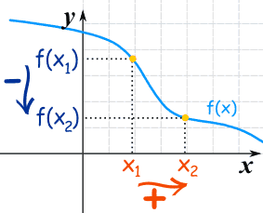
decreasing (function)
A function is ”decreasing" when the
y-value decreases as the x-value increases
Notes:
8th

Slide 23
diameter
diameter
a line segment that passes through
the center of a circle and has
endpoints on the circle
Notes:
Used in formulas grade 7 but not formally mentioned in standards until HS

Slide 24
distributive property of multiplication
over addition
4(2+3) = 4x2 + 4x3
123 = (1 x 100) + (2 x 10) + (3 x 1)
Notes:
Know how to use it in Elem in 3rd grade but don’t need to know the term until MS
MS – grade 6

Slide 25

dot plot
statistical chart consisting of data points plotted on a fairly simple scale, typically using filled in circles
Notes:
MS – grade 6

Slide 26
experimental probability
A student tosses a number cube 8 times and it lands on a four, 1 of those times.
Experimental Probability = 1 (# of times occurred)
of landing on a 4. 8 (# of times performed)
the ratio of the number of times an event occurs to the total number of trials or times the activity is performed
Notes:
MS – grade 7

Slide 27
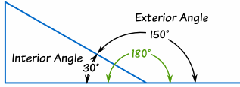
Exterior angle
The angle between any side of a shape, and a line extended from the next side.
Notes:
MS – grade 8
new

Slide 28
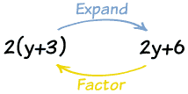
Factoring
Finding what to multiply to get an expression.
Example: 2y+6 = 2(y+3),
so the factors of 2y+6 are: 2 and (y+3)
Notes:
Process is used in grade 8 but not formally referred to as factoring until HS

Slide 29
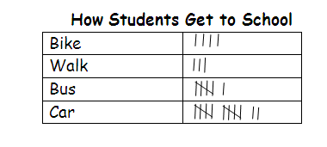
frequency table
a table that shows how often that
data point occurred
(tally marks are commonly used)
Notes:
MS 7th grade

Slide 30
Functional Relationships
Function example :
y= 2x
Input | Relationship | Output
0 | × 2 | 0
1 | × 2 | 2
7 | × 2 | 14
10 | × 2 | 20
... | ... | ...
A function is a special relationship where each input has a single output.
Notes:
MS – grade 8

Slide 31
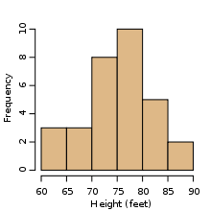
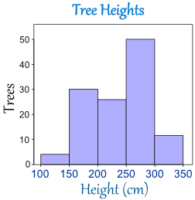
histogram
a graph consisting of adjacent rectangular bars with height proportional to the value of a variable and whose width is a consistent interval
Notes:
MS – grade 6

Slide 32
independent variable
Example:
Melissa and her friends are at an arcade and are redeeming their tickets for prizes. The number of tickets (t) they have won determines how many prizes (p) they can get.
(t) the number of tickets is the independent variable.
a variable (often x) whose value does not depend on that of another
Notes:
MS – grade 6

Slide 33
Interior angle
An angle inside a shape.
Notes:
New
Used at MS grade 8

Slide 34
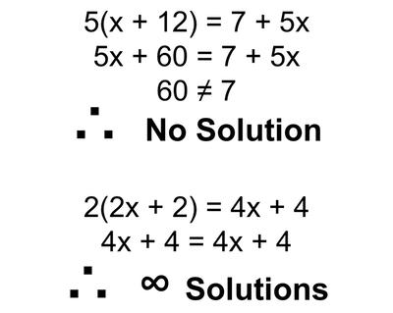
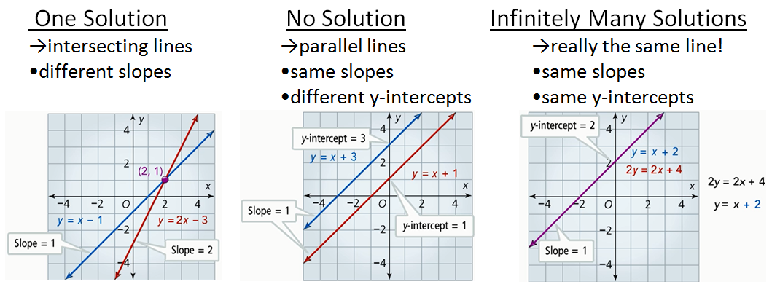
Infinitely Many Solutions
Infinite solutions would mean that any value for the variable would make the equation true.
If the variables disappear, and you get a statement that is always true, such as 0 = 0 or 3 = 3, then there are "infinite solutions", meaning, when graphed, the two equations would form the same line
Notes:
MS – grade 8

Slide 35
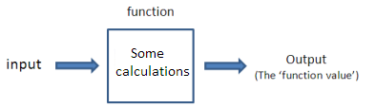
Input and Output
Y=3x+1
Y= 3(2) +1
X
x=2
Y
Y=7
Mathematical equations called functions use the input and output to replace the variables in an equation. The input is the known variable, while the output is the solution.
Inputs (x) are numeric values to which a procedure is applied, producing an output (y), which is also a numeric value.
Notes:
8th

Slide 36
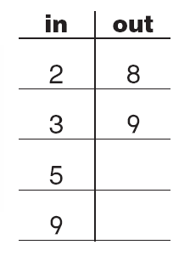
input/output table
a table that shows an output value for each input value
Notes:
Not a required term in Elem but used.
Required by 8th grade

Slide 37
integers
…-3, -2, -1, 0, 1, 2, 3…
the set of whole numbers and their opposites: . . . ,-2, -1, 0, 1, 2, . . .
Notes:
MS – grade 6

Slide 38
intersecting lines
lines that meet or cross
Notes:
MS – grade 8

Slide 39
interquartile range
Quartiles divide a rank-ordered data set into four equal parts. The values that divide each part are called the first, second, and third quartiles; and are denoted by Q1, Q2, and Q3, respectively.
Interquartile range is a measure of variation equal to Q3 minus Q1 and Q2 represents the median.
2, 3, 5, 5, 6, 6, 6, 8, 10, 12
Interquartile range: 8 – 5 = 3
the difference between the upper (third) quartile and lower (first) quartile in a set of data
Notes:
MS – grade 6

Slide 40
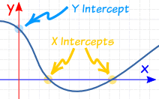
intercepts
X Intercept: where the graph of an equation crosses the x-axis
Y Intercept: where the graph of an equation crosses the y-axis
Notes:
New
MS – grade 8

Slide 41
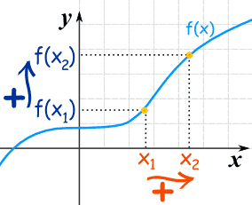
Increasing (function)
A function is "increasing" when the
y-value increases as the x-value increases
Notes:
New
8th

Slide 42

Irrational
A real number that can NOT be made by dividing two integers. (Note: integers have no fractions.)
The decimal goes on forever without repeating.
Notes:
MS – grade 8

Slide 43
least common multiple
Two methods to find the least common multiple include:
The least common multiple either way is 2 x 2 x 2 x 3 x 3 or 72
1. List the prime factors of each
2. Identify the groups of factors with greatest frequency for each
3. Multiply those groups of factors
Prime factors of 18: 2 x 3 x 3
Prime factors of 24: 2 x 2 x 2 x 3
Start listing multiples of each number
Identify the smallest multiple in common
Factors of 18: 18, 36, 54, 72, 90, …
Factors of 24: 24, 48, 72, 96, 120, …
the smallest positive value that is divisible by both original numbers
Notes:
MS – grade 6

Slide 44
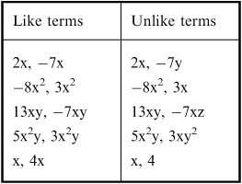
Like Terms
Terms whose variables (and their exponents such as the 2 in x²) are the same.
Example: 7x and 2x are like terms because the variables are both "x"
But 7x and 7x² are NOT like terms (they are Unlike Terms)
Notes:
MS – grade 6

Slide 45
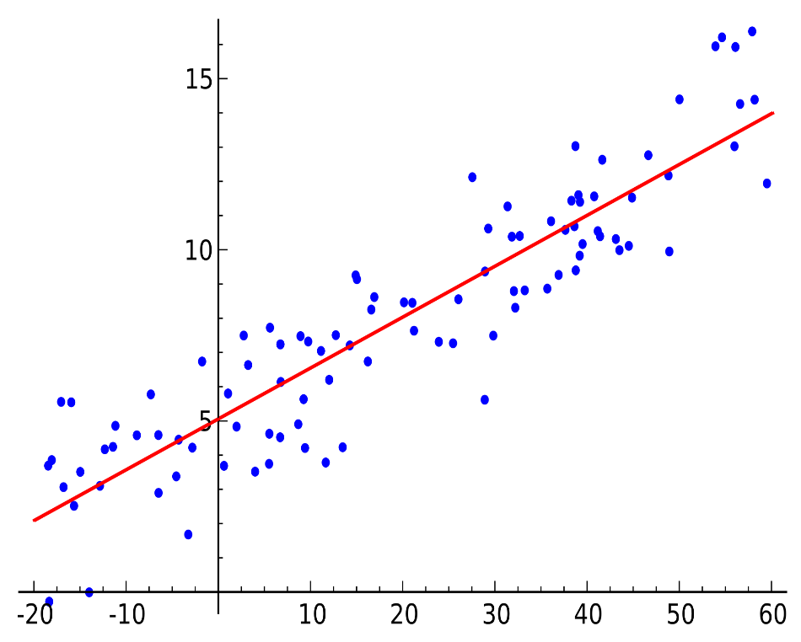
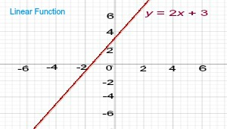
Linear
an equation or function that is the equation of a straight line and takes the form y = mx + b, where "m" is equal to the slope, and "b" is equal to the y-intercept. The degree on variable is always 1.
The rate of change is constant between any two points.
Notes:
MS – grade 7

Slide 46
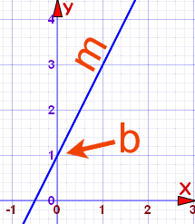
Linear Equations
An equation that makes a straight line when it is graphed.
Often written in the form: y = mx+b
Notes:
MS – grade 8

Slide 47
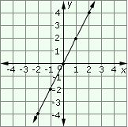
Linear functions
Example: y=2x
A linear function is any function that graphs to a straight line.
A linear function is a first degree polynomial of the form, y = m x + b, where m and b are constants and x is a real variable.
The constant m is called slope and b is called y-intercept.
Notes:
MS – grade 8

Slide 48
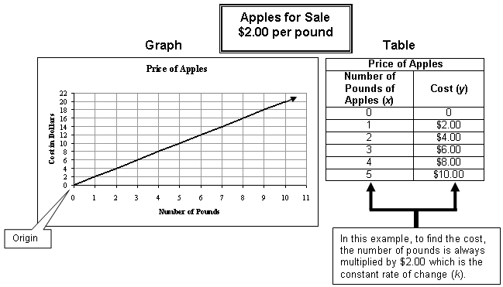
Linear Relationships
An equation with a pattern that includes a constant rate of change
There are only three criteria that equations must meet to qualify as a linear relationship.
1. The equation can have up to two variables, but it cannot have more than two variables.
2. All the variables in the equation are to the first power.
3. The equation must graph as a straight line.
Notes:
MS – grade 8

Slide 49
mathematical modeling
the process of developing a description of a system using mathematical concepts and language
Notes:
Not on assessment but all grades should be familiar with term.

Slide 50
mean
Set of Data: {2, 3, 5, 5, 6, 6, 6, 8, 10, 12}
Mean: (2+3+5+5+6+6+6+8+10+12)/10 = 6.3
the sum of a collection of numbers divided by the number of numbers in the collection
Notes:
MS – grade 6

Slide 51
mean absolute deviation
The steps to find the mean absolute deviation include:
1. find the mean
2. find the difference between each data value and the mean
3. take the absolute value of each difference
4. find the mean of these differences
the mean distance between each data value and the mean
Notes:
MS – grade 7

Slide 52
measure of center
2, 3, 5, 5, 6, 6, 6, 8, 10, 12
Mean: (2+3+5+5+6+6+6+8+10+12)/10 = 6.3
2, 3, 5, 5, 6, 6, 6, 8, 10, 12
Median: 6
2, 3, 5, 5, 6, 6, 6, 8, 10, 12
Mode: 6
the value representing the central position or middle value of a data set (usually the mean, median or mode)
Notes:
MS – grade 6

Slide 53
measures of spread (variability)
describe how varied or similar the set of observed values are to a particular data item…The statistics included are range, interquartile range, variance, and standard deviation.
Notes:
MS – grade 6 but it is referred to as measure of variability not measure of spread

Slide 54
measure of variation
2, 3, 5, 5, 6, 6, 6, 8, 10, 12
Range: 12 – 2 = 10
2, 3, 5, 5, 6, 6, 6, 8, 10, 12
Interquartile range: 8 – 5 = 3
the value representing the amount of spread or variability in a data set (usually the range or interquartile range)
Notes:
MS – grade 6

Slide 55
median
Set of Data: {2, 3, 5, 5, 6, 6, 6, 8, 10, 12}
Median: 6
Set of Data: {1, 2, 3, 6, 6, 6, 8, 10, 12}
Median: 6
the middle value in a list of numbers in numerical order
Notes:
MS – grade 6

Slide 56
mode
Set of Data: {2, 3, 5, 5, 6, 6, 6, 8, 10, 12}
Mode: 6
the value that appears most often in a set of data
Notes:
MS – grade 6

Slide 57
multiplicative identity property of one
7 x 1 = 7 12 x 1 = 12
n x 1 = n
when a number is multiplied by 1, the product is that number
Notes:
Know how to use this in Elem at 3rd but not know term until MS

Slide 58
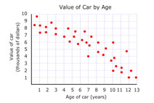
negative association
two variables have a negative association when the values of one variable tend to decrease as the values of the other variable increase
Notes:
MS – grade 8

Slide 59

negative numbers
numbers less than zero
Notes:
MS – grade 6

Slide 60
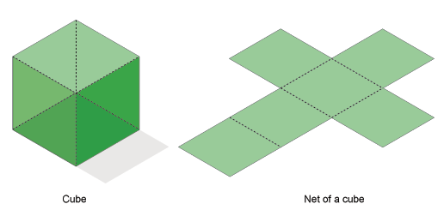
net
an arrangement of polygons joined at the edges which represent the faces of a 3-dimensional figure
Notes:
MS – grade 6

Slide 61
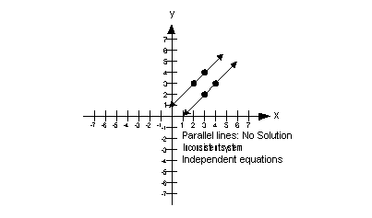
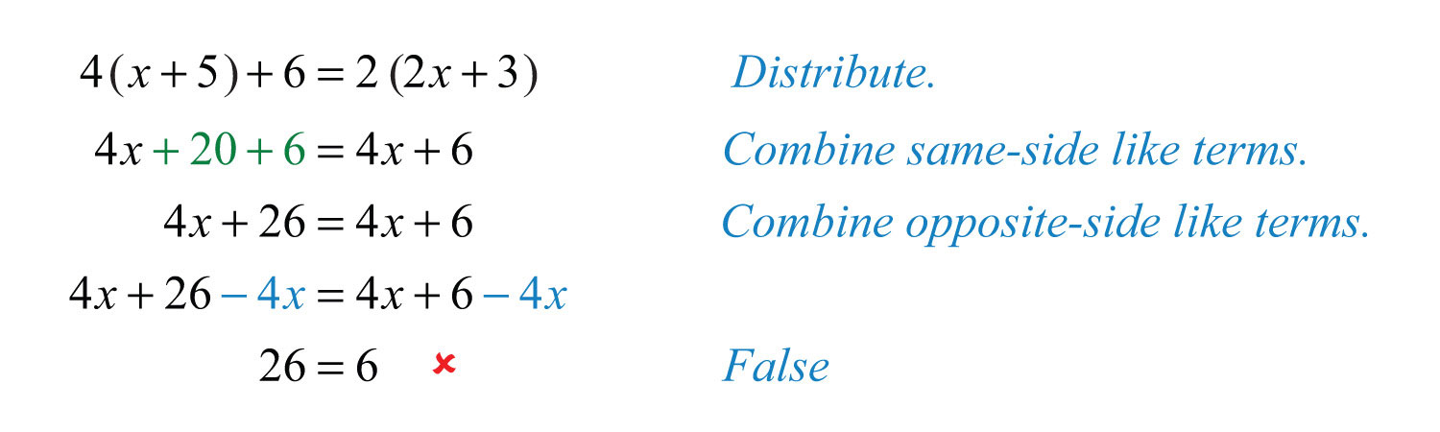
No Solution
No solution is an answer that means no matter what value is plugged in for the variable, you will ALWAYS get a contradiction. A visual representation on a graph would be two parallel lines - they would never intersect.
Notes:
MS – grade 8

Slide 62
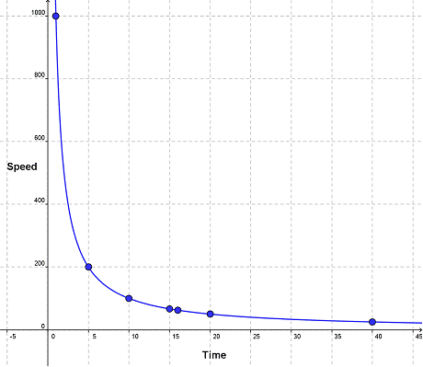
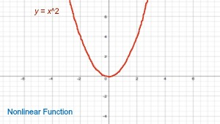
Nonlinear
Equation whose graph does not form a straight line (linear) is called a Nonlinear Equation
In a nonlinear equation, the variables are either of degree greater than 1 or less than 1, but never 1.
Notes:
MS – grade 8

Slide 63
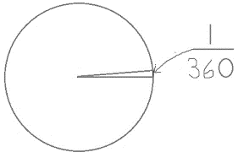

one degree angle
a unit for measuring the size of angles; a full rotation is 360 degrees, so a one degree angle is 1/360 of a circle
Notes:
MS – grade 8

Slide 64
outcome
a possible result of a probability experiment
Notes:
MS – grade 7

Slide 65
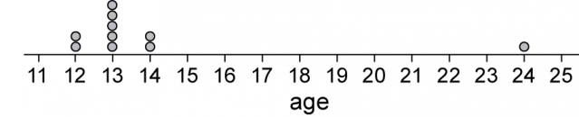
outlier
Set of data:
{12, 12, 13, 13, 13, 13, 13, 13, 14, 14, 24}
The outlier is 24
a value that is much smaller or larger than most other values in a set of data
Notes:
MS – grade 6

Slide 66
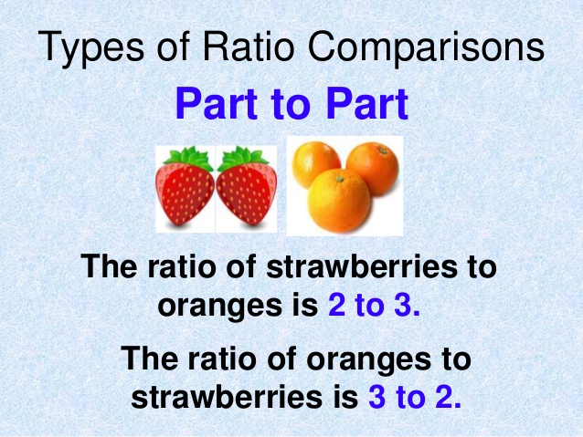
Part-to-Part Ratio
Can also be written 2/3 or 2:3
Can also be written 3/2 or 3:2
a comparison of two values where each is a part of the whole
Notes:
MS – grade 6

Slide 67
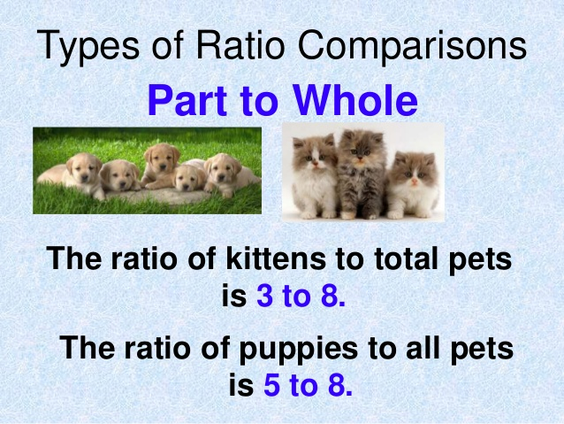
Part-to-Whole Ratio
Can also be written 3/8 or 3:8
Can also be written 5/8 or 5:8
a comparison of two values where one is a part of the whole and the other is the whole.
Notes:
MS – grade 6

Slide 68
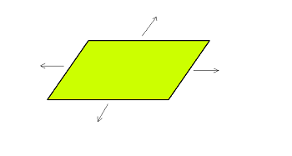
plane figures (2-D)
any 2-dimensional shape that lays in a single plane
a flat surface extending infinitely in all directions
Notes:
Elem – need to know 2-D shapes in 1st grade but don’t need to know the term plane figures until MS
MS – grade 7

Slide 69
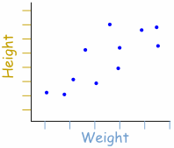
positive association
two variables have a positive association when the values of one variable tend to increase as the values of the other variable increase
Notes:
MS – grade 8

Slide 70
positive numbers
numbers that are greater than zero
Notes:
MS – grade 6

Slide 71
probability
P(A) = $\frac{number of outcomes in event A}{number of outcomes in the sample space}$
The likelihood of the occurrence of an event. The probability of event A is written P(A). Probabilities are always numbers between 0 and 1, inclusive.
Notes:
MS – grade 7

Slide 72
procedural fluency
refers to knowledge of procedures, knowledge of when and how to use them appropriately, and skill in performing them flexibly, accurately, and efficiently
Notes:
Not on assessment

Slide 73
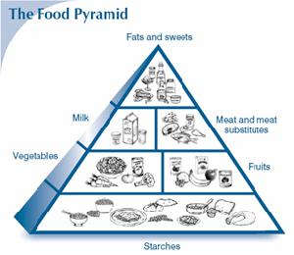
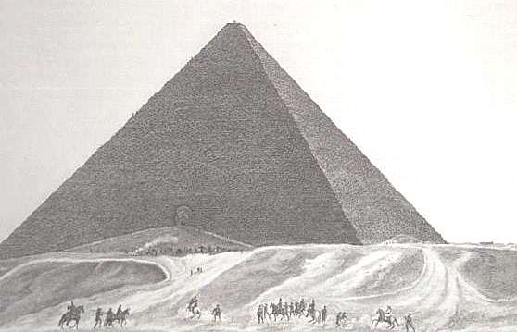
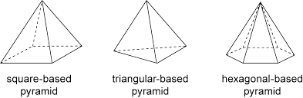
pyramid
a 3-dimensional figure whose base is a polygon and whose other faces are triangles that
share a common vertex
* A pyramid is named by its base.
Notes:
Start looking at this shape in elementary but don’t need to know term then.
MS – grade 8

Slide 74
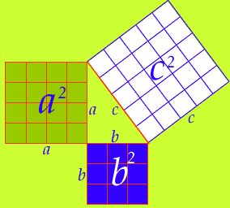
Pythagorean Theorem
a² + b² = c²
in a right triangle, the square of a hypotenuse is equal to the sum of the squares of the other two sides
Notes:
MS – grade 8

Slide 75
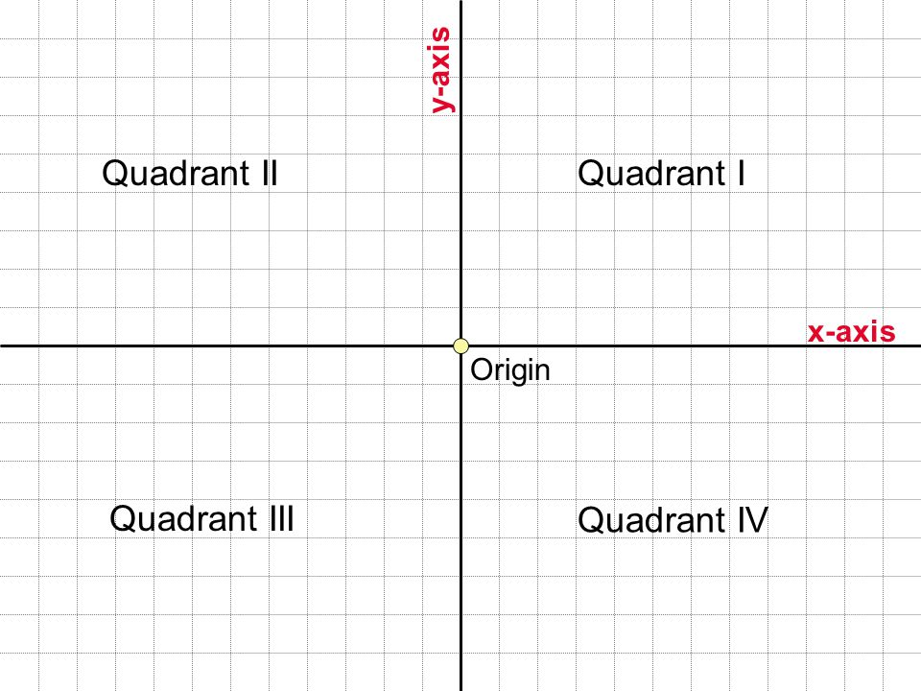
quadrant
one of four equal parts of a coordinate plane created by the intersection of the x and y axes
Notes:
Introduced in grade 5 but more fully integrated at MS grade 6

Slide 76
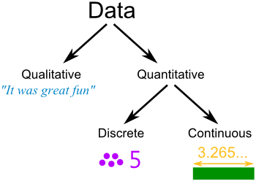
Qualitative
Qualitative data is information that describes something.
Examples:
• Your friends' favorite holiday destination
• The most common given names in your town
• How people describe the smell of a new perfume
Note: the other type of data is "Quantitative Data" which can be counted or measured.
Notes:
MS – grade

Slide 77
Quantitative
Data that can be:
• counted (called "discrete data") or
• measured (called "continuous data")
Notes:
MS – grade 8

Slide 78

Radical
a quantity expressed as a root of another quantity
Notes:
MS – grade 8

Slide 79
radius
radius
2 inches
the distance from the center of a circle to any point on a circle
Notes:
MS – grade 7

Slide 80
random sampling
Example: One might choose people by assigning each person a number or giving each person a ticket and then randomly selecting a number or drawing a ticket out of a hat.
a sampling method in which all members of a group have an equal and independent chance of being selected
Notes:
MS – grade 7

Slide 81
range
Set of data:
{89, 73, 84, 91, 87, 77, 94}
largest – smallest = 94 – 73 = 21
the difference between the largest and smallest values in a set of data
Notes:
MS – grade 6

Slide 82

Rate of Change
A ratio of the difference in the dependent variable over the different in the independent variable
SynonyMS
  Slope,
  rise/run,
  change in y/change in x
Notes:
MS – grade 8

Slide 83

ratio
Can be written with a fraction bar, colon or the word “to”
a comparison of two values using division
Notes:
MS – grade 6

Slide 84
rational number
1.5 -0.1 0.001
6 0.222….
a number that can be written as a ratio
Notes:
MS – grade 6

Slide 85
relative frequency
Example: Your team has won 9 games from a total of 12 games played.
Relative Frequency of winning is 9/12 = 75%
how often something happens divided by all outcomes
Notes:
MS – grade 7

Slide 86

reflection
A transformation in which each point of the original figure (pre-image) has an image that is the same distance from the line of reflection as the original point but is on the opposite side of the line. Remember that a reflection is a flip.
Notes:
NEW – 6th grade

Slide 87


right prism
a 3-dimensional figure with two identical, parallel faces (bases) that are polygons; the remaining faces are parallelograMS and are perpendicular to the faces (bases)
* A prism is named by its base. A triangular prism has a triangle as its base and a rectangular prism has a rectangle as its base.
Notes:
MS – grade 7

Slide 88


right rectangular pyramid
a 3-dimensional figure whose base is a rectangle and whose other faces are triangles that share a common vertex: if the vertex lies on the line perpendicular to the base at its center, the pyramid is called a right rectangular pyramid
Notes:
Pyramid is used at grade 8 but “right rectangular pyramid” does not appear in the document as a specific name

Slide 89


right triangle
a
b
c
a triangle that has one 90° angle
Notes:
Elem – 4th (leg and hypotenuse are not until 8th grade)

Slide 90
sample space
set of all possible outcomes
Notes:
MS – grade 7

Slide 91

scale drawing
a drawing that shows a real object with accurate sizes reduced or enlarged by a certain amount (called the scale)
Notes:
MS – grade 7

Slide 92
scatter plot
a graph of plotted points that show the relationship between two sets of data
Notes:
MS – grade 8

Slide 93

Scientific Notation
Where a number is written in two parts:
A decimal point is placed after the first non-zero digit. This is followed by: ×10 to a power that will put the decimal point back where it should be.
Notes:
MS – grade 8

Slide 94

Similar
In Geometry, two shapes are Similar when the only difference is size (and possibly the need to move, turn or flip one around).
These two shapes are Similar (one is smaller and flipped over, but otherwise the same)
Notes:
MS – grade 8

Slide 95

Skew
The distribution of data that is pulled to the left or pulled to the right from a symmetrical form.
Notes:
MS – grade 6

Slide 96

Slope
How steep a straight line is.
In this example the slope is 3/5 = 0.6
Also called "gradient".
Notes:
MS – grade 8

Slide 97
subset
quadrilaterals
rectangles
Rectangles are a subset of all quadrilaterals.
a set within a larger set
Notes:
Not on assessment

Slide 98


supplementary
two angles whose sum is 180⁰
Notes:
MS – grade 8

Slide 99




surface area
the total area of the surface of a three-dimensional object
Notes:
MS – grade 6

Slide 100



theorem
a statement that has been proved on the basis of previously established statements
Notes:
New
MS – grade 8 (specifically Pythagorean Theorem)

Slide 101
theoretical probability
Theoretical Probability of a number cube landing on a 4.
1 (# of 1’s on a number cube)
6 (total number of sides on a number cube)
the ratio of the number of ways the event can occur to the total number of possible outcomes (based on a probability model)
Notes:
MS – grade 7

Slide 102

transversal
a line that crosses at least two other lines
Notes:
MS – grade 8

Slide 103


unit rate
A 12-ounce can of corn costs $0.69
Cost per ounce is 0.69 ÷ 12 ≈ 0.06 or
6¢ per ounce
$\frac{\$0.69}{12 oz}=\frac{\$0.0575}{1 oz}$
a comparison of two quantities expressed with a denominator of one
Notes:
MS – grade 6

Slide 104
variable
5 + n = 7
n is the variable
a letter or symbol that represents a number
Notes:
MS – grade 6

Slide 105


vertical angles
the angles opposite each other when two lines cross, which are always equal
Notes:
MS – grade 8

Slide 106
zero pair
(-5) + 5 = 0 7 + (–7) = 0
zero pair zero pair
-5 and 5 7 and -7
a pair of numbers whose sum equals zero
Notes:
MS – grade 7

