Slide 1

K-5 Student Glossary for the 2017 Kansas Mathematics Standards

Slide 2
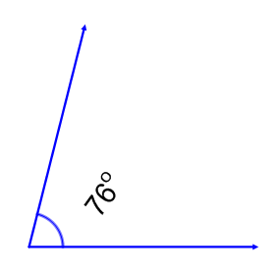
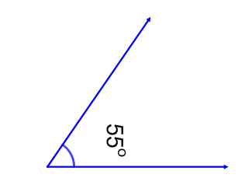
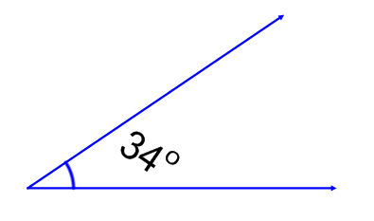
acute angle
an angle with a measure
less than 90°
Notes:
Elementary - 4

Slide 3
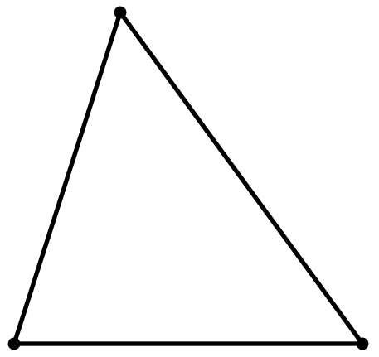
acute triangle
50°
75°
55°
a triangle with all interior angles measuring less than 90°
Notes:
Elementary - 4

Slide 4

addition
component parts: addend + addend = sum
+
=
2 + 2 = 4
an operation that combines two or more numbers or groups of objects
Notes:
Elementary – K word 1st grade the addition equation

Slide 5
additive identity property of zero
8 + 0 = 8
0 + ½ = ½
when you add 0 to any number you end up with that number
Notes:
Use in elementary starting in 1st but don’t need to know the name of the property until MS

Slide 6
angle
two rays or line segments that share an endpoint
Notes:
Elementary – 2nd (as an attribute to describe geometric figures)

Slide 7
area
The area of the TV screen is
15 square units.
the number of square units needed to cover a given surface
Notes:
Elementary – 3rd

Slide 8
array
a rectangular arrangement of objects with equal amounts in each row
Notes:
Elem – 2nd

Slide 9
associative property
(5+2)+8 = 5+(2+8)
(a •b)•c = a •(b •c)
in addition and multiplication, no matter how the numbers are grouped, the answer will always be the same
Notes:
GRADE 3

Slide 10
attribute
3
odd equal sides
a characteristic of a number, geometric figure, mathematical operation, equation, or inequality
Notes:
Elem - K

Slide 11
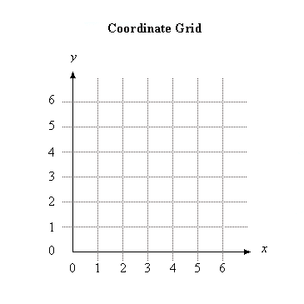
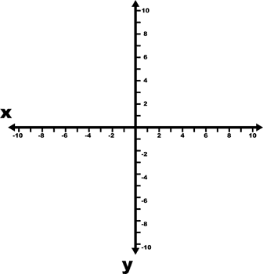
axis
axes
axes
any of the number lines that intersect to form a coordinate system
*the plural of axis is axes
Notes:
Elem – 5th

Slide 12
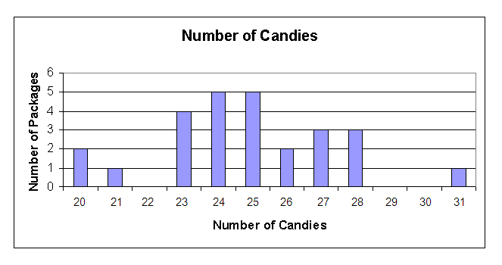
bar graph
a display that uses horizontal or vertical bars to represent data
Notes:
Elem – 2nd

Slide 13
base (solid figure)
base
base
the face that helps identify the figure (it does not always have to be on the bottom of the figure)
Notes:
Elem – 5th

Slide 14
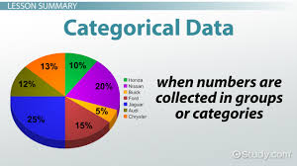
categorical data
data that can be divided into groups; i.e eye color, favorite college
Notes:
Elementary in K

Slide 15
chart
(table)
How Students Get to School
Bike | l l l l
Walk | l l l
Bus | l l l l l
Car | l l l l l l l l l l
information organized in columns and rows
Notes:
Elem – 1st

Slide 16
circle
a closed curve with all its points the same distance from the center
Notes:
Elem - K

Slide 17
commutative property
5+3 = 3+5
½ x ¼ = ¼ x ½
numbers may be added or multiplied together in any order without changing the answer
Notes:
Use in Elem at 1st but don’t need to know definition of term until MS

Slide 18
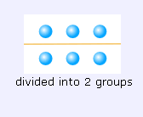
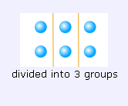
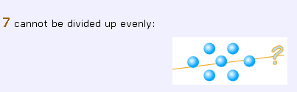
composite number
composite number NOT a composite number
7 cannot be divided into equal groups
factors of 6: 1, 2, 3, 6
factors of 7: 1, 7
a number that has more than two factors
Notes:
Elem – 4th

Slide 19
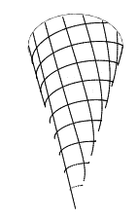
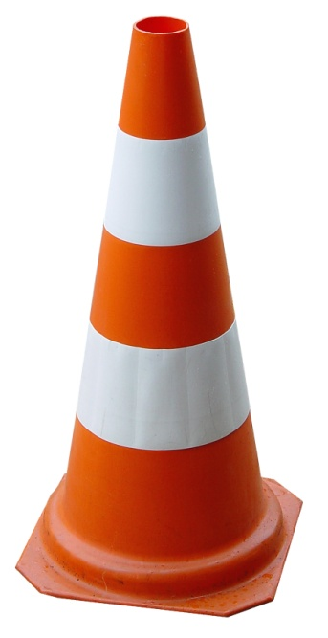
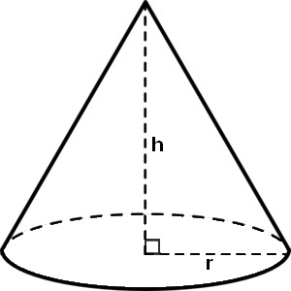
cone
a 3-dimensional figure with a curved surface, a flat circular base, and a vertex
Notes:
Elem - K

Slide 20
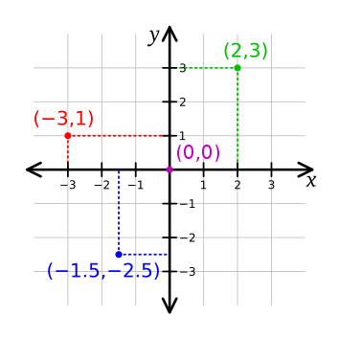
coordinates
X | Y
0 | 0
2 | 3
-3 | 1
-1.5 | -2.5
an ordered pair of numbers (x, y) that gives the location of a point on a coordinate plane
Notes:
Elem – 5th

Slide 21
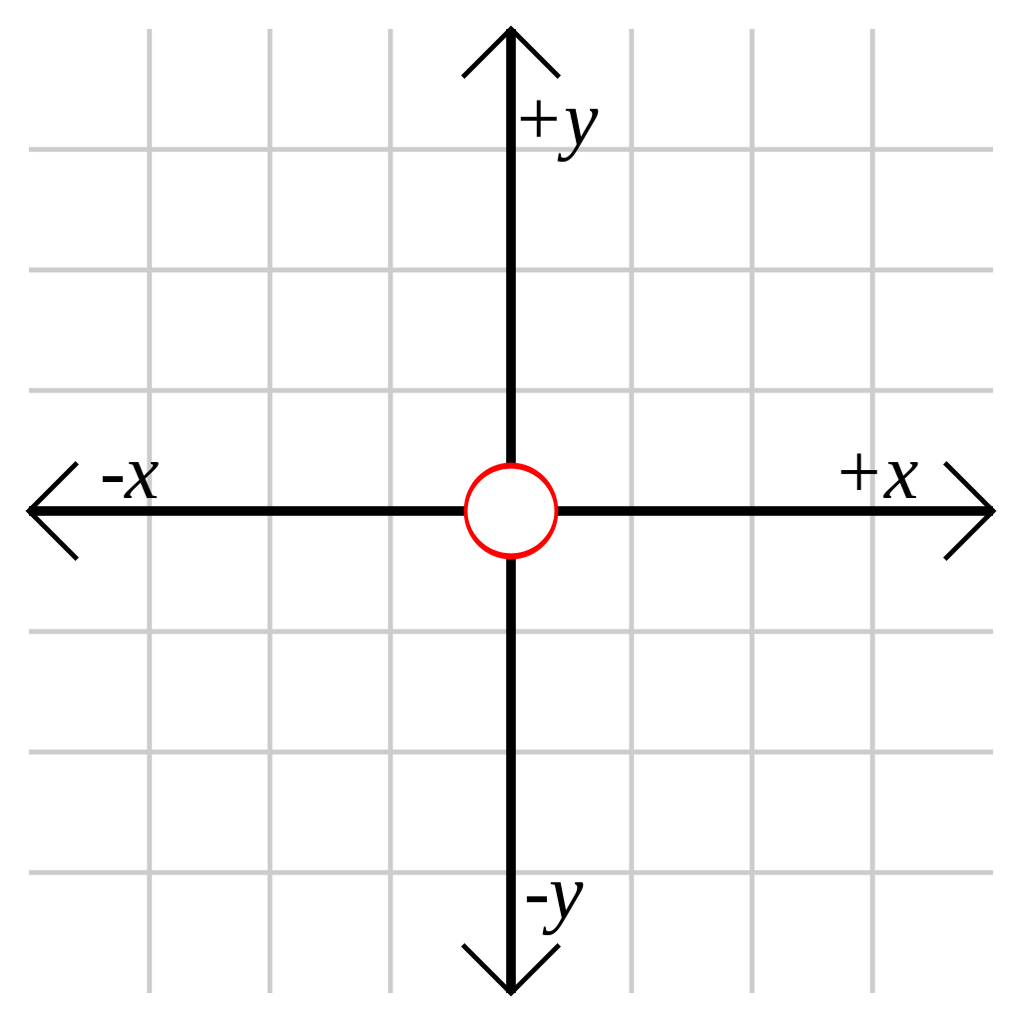
coordinate grid/plane
the plane formed by two perpendicular number lines intersecting at their zero points used for displaying the location of coordinates
Notes:
Elem – 5th (only w/ positive values)

Slide 22
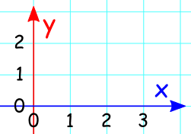
coordinate system
a plane formed by a horizontal number line, called the x-axis, and a vertical number line, called the y-axis which intersect at a point called the origin
Notes:
Grade 5

Slide 23
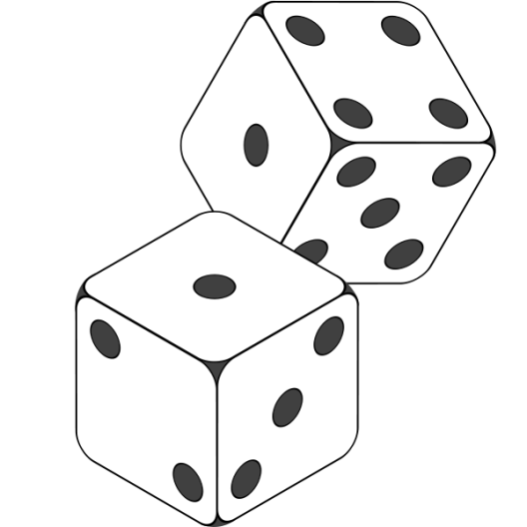
cube
a 3-dimensional figure with
six congruent square faces
Notes:
Elem - K

Slide 24

cylinder
a 3-dimensional figure with one curved surface and two parallel, congruent circular bases
Notes:
Elem - K

Slide 25


data
information that is collected by counting, measuring, asking questions, or observing that is usually organized for analysis
Notes:
Elem - K

Slide 26
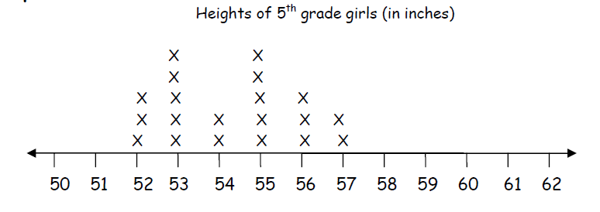
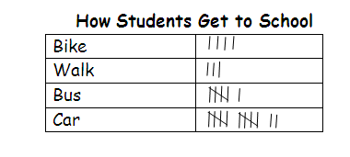
data display
Sides of Squares
# of sides | 4 | 8 | 12 | 16
# of squares | 1 | 2 | 3 | 4
a way to organize data
Notes:
Elem – 2nd

Slide 27
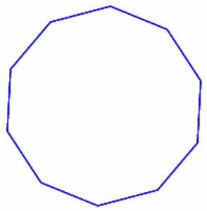
decagon
a polygon with 10 sides
Notes:
Elem – 3rd

Slide 28
decimal fraction
$23.75
.6 4.0
a number written in standard base-10 notation
Notes:
Elem – 4th

Slide 29

denominator
3
4 equal parts
0
1
the number of equal parts making up a whole
(the bottom number in a fraction)
Notes:
Elem – 3rd

Slide 30
difference
2
9
7
_2_
7 9
9 - 7 = 2
difference
the space between the value of two numbers
(the result of subtracting one number from another)
Notes:
Elem – 2nd

Slide 31
digit
digit
cards
4
2
0
Hundreds
Tens
Ones
any one of the ten symbols
0, 1, 2, 3, 4, 5, 6, 7, 8, 9
Notes:
Elem – 1st

Slide 32
distributive property of multiplication
over addition
4(2+3) = 4x2 + 4x3
123 = (1 x 100) + (2 x 10) + (3 x 1)
Notes:
Know how to use it in Elem in 3rd grade but don’t need to know definition of term term until MS
MS – grade 6

Slide 33
division
component parts: dividend ÷ divisor = quotient
6
3
= 2
6 ÷ 3 = 2
2
)
3
6
the operation of making equal groups to find out how many in each group or how many groups
Notes:
Elem – 3rd

Slide 34
edge
edge
where two faces of a solid shape intersect
Notes:
Elem – 5th

Slide 35
ellipse
Notes:
Elem – should be familiar with tern but will not be in assessment

Slide 36

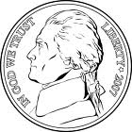

equal
=
2 + 4 = 13 - 7
having the same value
Notes:
Elem - K

Slide 37
equation
8 + 2 = 10
5 x 5 = 100 ÷ 4
20 = 18 + 2
a mathematical sentence where the left side of the equal sign has the same value as the right side of the equal sign
Notes:
Elem – begin to understand in K but don’t use until 2nd

Slide 38
equilateral
a polygon with all sides congruent
Notes:
Elem – 4th

Slide 39
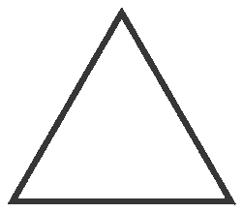
equilateral triangle
a triangle whose sides are all
the same length
Notes:
Elem – 4th

Slide 40
equivalent
7 + 2 = 10 - 1
.5 = ½
.5 = .50
having the same value
Notes:
Elem – start understanding term in 1st grade but don’t need to know until 3rd

Slide 41
estimate
About how many?
to find a number close to an exact amount
Notes:
Elem - K

Slide 42
even number
374
12 86,460
3,496
whole numbers that are divisible by 2 Hint: even numbers have 0, 2, 4, 6, or 8 in the ones place
Notes:
Elem – 2nd

Slide 43
expanded form (expanded notation)
493 = 400 + 90 + 3
493 = (4 x 100) + (9 x 10) + 3
a way to write numbers showing the place value of each digit
Notes:
Elem – 2nd

Slide 44
exponent
10⁵
10 x 10 x 10 x 10 x 10
exponent
a numeral telling how many times a factor is to be multiplied
Notes:
Elem - 5th grade

Slide 45
expression
6 x 9
(12 ÷ 3) + 2
20 - y
a mathematical phrase made up of numbers, variables, operational symbols, and/or parentheses
Notes:
An expression DOES NOT contain relation symbols such as =, <, >
Elem – 5th

Slide 46
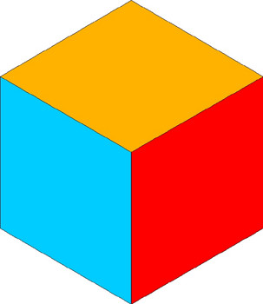
face
the flat surface of a solid figure
Notes:
Elem - K

Slide 47


fraction
1
3 is white
1
2 of the stars are circled
a part of a whole (region, line or set); the name for a number written in the form (e.g. ¼ )
A fraction may also be used to represent division.
Notes:
Elem – 3rd

Slide 48
growth pattern
1 2 4 8 16
This pattern is following a “x2” rule.
a type of pattern made by following a rule using operations
Notes:
Elem – 1st

Slide 49
height
height
the distance from the base to the top of an object or shape
Notes:
Elem – 1st

Slide 50
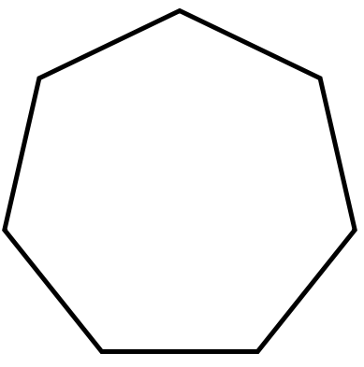
heptagon (septagon)
a polygon with 7 sides
Notes:
Elem – 3rd

Slide 51
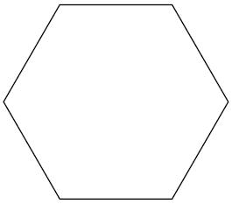
hexagon
a polygon with 6 sides
Notes:
Elem – 2nd

Slide 52
improper fraction
7
4
0
1
2
a fraction with a numerator that is greater than or equal to its denominator
Notes:
This is a term that is not needed according to the standards but we included it since so many different curricula have it – Elem 3rd grade starts with the understanding but the term is not required.
Should use the phrase “fractions larger than one” instead of this term.

Slide 53
inequality
4 + 3 < 5 + 7
2y > 14
a number sentence not equal in size, amount, or value
(usually one of the following symbols is used <, >, ≤, ≥, ≠)
Notes:
Elem – 1st start understanding but use the term in 3rd

Slide 54
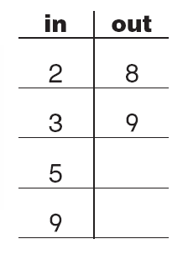
input/output table
a table that shows an output value for each input value
Notes:
Not a required term in Elem but used.
Required by 8th grade

Slide 55
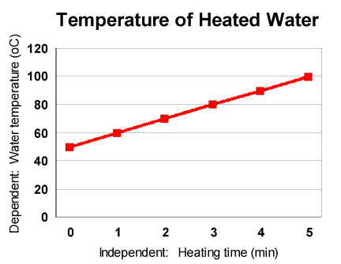
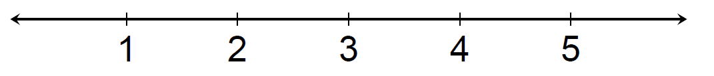
interval (linear)
{
{
interval
space between numbers on a number line or the grid lines of a graph
Notes:
Elementary – used to describe equal spacing on number line starting in 3rd grade

Slide 56

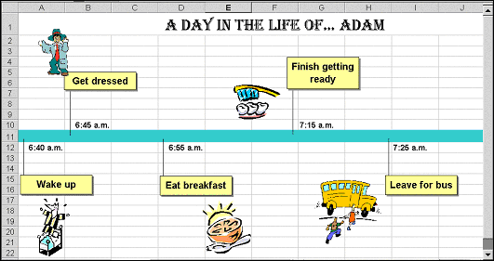
interval (time)
a space of time between events
Notes:
Elem – grade 4

Slide 57
irregular polygon
a polygon whose sides are
not all the same length
Notes:
Term does not need to be known for Elem but they understand the concept

Slide 58
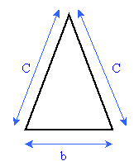
isosceles triangle
c
c
c
c
b
b
a triangle with 2 equal sides
Notes:
Elem – 4th

Slide 59
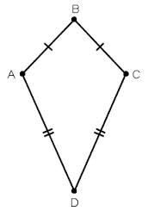
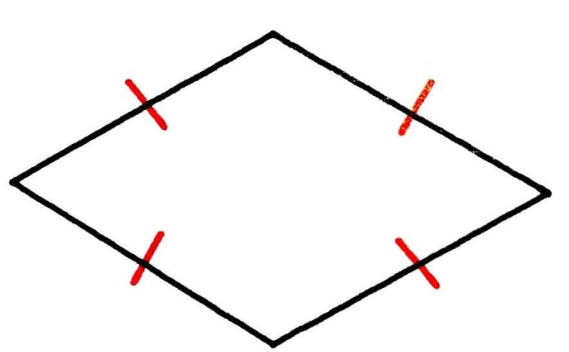
kite
a quadrilateral with two pairs of equal adjacent sides
Notes:
Elem – 3rd

Slide 60
length
Graphic here
the measure of one side of an object, typically the longer side
Notes:
Elem - K

Slide 61
line
an infinite set of points forming a straight path extending in two directions
Notes:
Elem – 4th

Slide 62
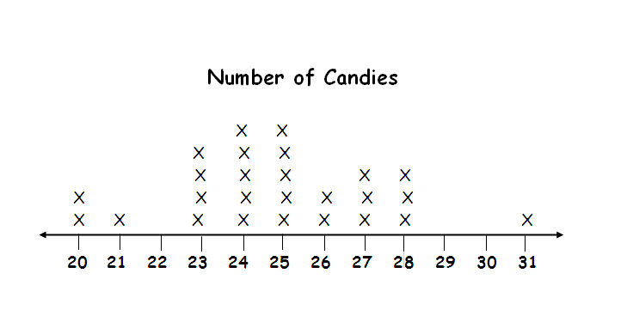
line plot
(dot plot)
a display using a number line with marks or dots that show frequency
Notes:
Elem – 3rd

Slide 63
line segment
a part of a line defined by
two endpoints
Notes:
Elem – 4th

Slide 64
liquid volume
(capacity)
the amount that a container can hold
common units of measure: cup, pint, gallon, liter, etc.
Notes:
Elem – 3rd

Slide 65
mathematical modeling
the process of developing a description of a system using mathematical concepts and language
Notes:
Not on assessment but all grades should be familiar with term.

Slide 66



mixed number
1
2
3
0
1
2
3
4
a quantity written with an integer and
a fraction
Notes:
Elem – 4th

Slide 67
multiple
multiples of 3
3, 6, 9, 12, 15, 18
multiples of 6
6, 12, 18, 24, 30
the product of any number and a counting number is a multiple of that number
Notes:
Elem 3rd

Slide 68
multiplication
Component Parts:
factor x factor = product
0 1 2 3 4 5 6 7 8 9 10 11 12
the operation of repeated addition
Notes:
Elem – 3rd

Slide 69

multiplicative comparison
The first flower is
2 times taller than
the second flower.
The walk was 3 times
longer today than it
was yesterday.
comparing the difference between values using multiplication
Notes:
Elem – 4th

Slide 70
multiplicative identity property of one
7 x 1 = 7 12 x 1 = 12
n x 1 = n
when a number is multiplied by 1, the product is that number
Notes:
Know how to use this in Elem at 3rd but not know term until MS

Slide 71
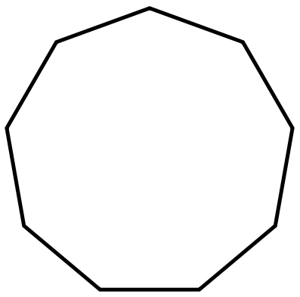
nonagon
a polygon with 9 sides
Notes:
Elem – 3rd

Slide 72
number forms
Standard form: 3045
Word form: three thousand, forty-five
Expanded form: 3000 + 40 + 5
(see expanded form card for more examples)
Unit form: 3 thousands 4 tens 5 ones
Notes:
Elem – 2nd

Slide 73
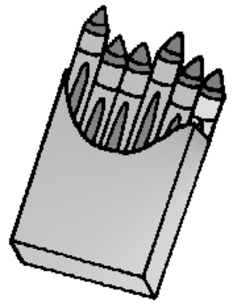
number model
2 x 6 = 12
2 groups of 6 crayons = 12 crayons
1 + 2 = 3
1 boy and 2 girls = 3 children
a mathematical representation of a situation
Notes:
Elem – 2nd

Slide 74
number sentence
5 + 3 = 8 7 > 4 x 1
5 + 2 < 8 5 + 3 ≠ 2 + 1
an equation (=) or inequality (<,>, ≤, ≥, ≠) with numbers
Notes:
Elem – 2nd

Slide 75
numerator
2
4
parts described
0
1
tells how many equal parts of a whole are being described
(the top number of a fraction)
Notes:
Elem – 3rd

Slide 76
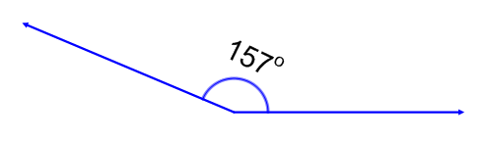
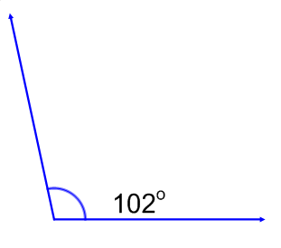
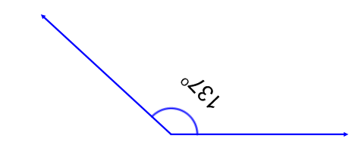
obtuse angle
an angle with a measure greater than 90° and less than 180°
Notes:
Elem – 4th

Slide 77

obtuse triangle
140 °
110 °
a triangle with an angle measuring more than 90°
Notes:
Elem – 4th

Slide 78
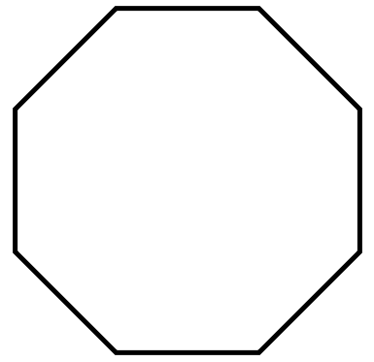
octagon
a polygon with 8 sides
Notes:
Elem – 3rd

Slide 79
odd number
4,283
21
11 283,005
whole numbers that cannot be divided into 2 equal groups of whole numbers
Hint: odd numbers have 1, 3, 5, 7, or 9 in the one’s place
Notes:
Elem – 2nd

Slide 80
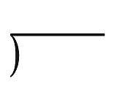
operational symbols
+
x
÷
-
*
●
symbols used to indicate computation
Notes:
Start understanding in 1st grade but not use until 3rd

Slide 81
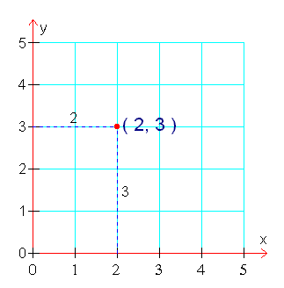
ordered pair
a pair of numbers that gives the coordinates of a point on a grid in this order:
(horizontal coordinate, vertical coordinate)
Notes:
Elem – 5th

Slide 82
orientation
rectangular prism
Square – even when rotated
position and direction in space
Notes:
Start understanding in Elem but not necessary to know the term

Slide 83
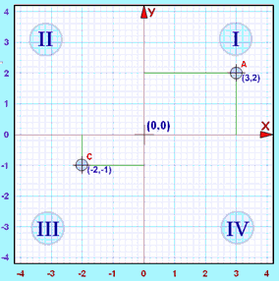
Origin
The starting point.
On a number line it is 0
On a two-dimensional graph it is where the X axis and Y axis cross, marked (0, 0) on the graph here:
In three dimensions it
is the point (0, 0, 0)
Often written as the letter O
Notes:
Elem – 5th

Slide 84
parallel lines
lines that are always the same distance apart and will never intersect
Notes:
Elem – 3rd

Slide 85
parallelogram
a quadrilateral with two pairs of parallel sides
Notes:
Elem – 3rd

Slide 86
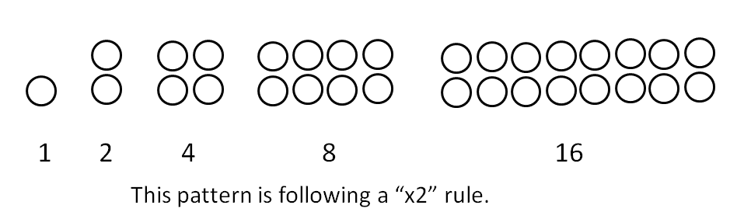
pattern
repeating growing
Core (or unit) of the repeating pattern.
a logical sequence of numbers, pictures, shapes, or symbols
Notes:
Elem – not necessary to know the term repeating since it is not a standards expectation. Growing patterns begin in 1st grade

Slide 87
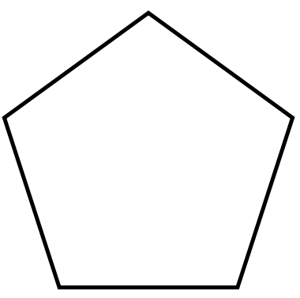
pentagon
a polygon with 5 sides
Notes:
Elem – 2nd

Slide 88
perimeter
the distance around a figure
Notes:
Elem – 3rd

Slide 89
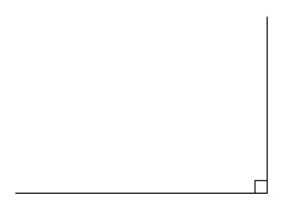
perpendicular lines
two lines that form a right angle where they intersect
Notes:
Elem – 4th

Slide 90
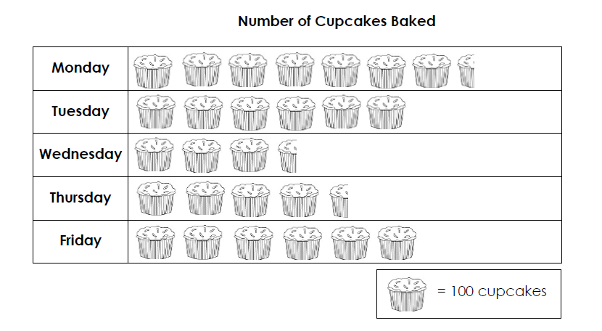
pictograph
a display that uses pictures or symbols to represent data
Notes:
Elem – 1st

Slide 91
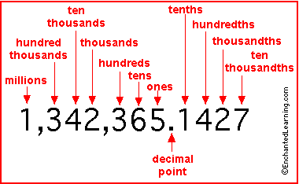
place value
2,365
3 units of size 100
30 units of size 10
300 units of size 1
the value of a digit depending on
its place in a number
Notes:
Elem – 2nd

Slide 92
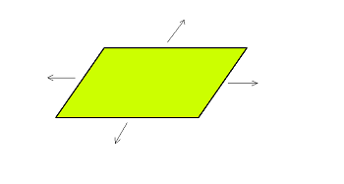
plane figures (2-D)
any 2-dimensional shape that lays in a single plane
a flat surface extending infinitely in all directions
Notes:
Elem – need to know 2-D shapes in 1st grade but don’t need to know the term plane figures until MS
MS – grade 7

Slide 93
plot
y
P (4,2)
x
to place (points or other figures) on a graph by means of coordinates
Notes:
Elem – 5th

Slide 94
point
an exact location in space
Notes:
Elem – 4th

Slide 95
polygon
a closed plane figure made from line segments that meet at endpoints and do not cross
Notes:
Elem – 3rd

Slide 96
prime number
prime number NOT a prime number
7 cannot be divided into equal groups
factors of 7: 1, 7
factors of 6: 1, 2, 3, 6
a counting number greater than 1 that has exactly two factors, itself and 1
Notes:
Elem – 4th

Slide 97

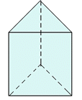
prism
a 3-dimensional figure with two identical, parallel faces (bases) that are polygons; the remaining faces are parallelograms
* A prism is named by its base.
Notes:
Elem – 5th

Slide 98
procedural fluency
refers to knowledge of procedures, knowledge of when and how to use them appropriately, and skill in performing them flexibly, accurately, and efficiently
Notes:
Not on assessment

Slide 99



pyramid
a 3-dimensional figure whose base is a polygon and whose other faces are triangles that
share a common vertex
* A pyramid is named by its base.
Notes:
Start looking at this shape in elementary but don’t need to know term then.
MS – grade 8

Slide 100

quadrant
one of four equal parts of a coordinate plane created by the intersection of the x and y axes
Notes:
Introduced in grade 5 but more fully integrated at MS grade 6

Slide 101

quadrilateral
square rectangle parallelogram rhombus kite
a polygon with 4 sides
Notes:
Elem – 2nd

Slide 102
ray
a part of a line that has one endpoint and extends forever in one direction
Notes:
Elem – 4th

Slide 103
rectangle
a quadrilateral with 4 right angles
Notes:
Elem – K

Slide 104
rectilinear polygon
a polygon whose edges meet at right angles
Notes:
Elem – 3rd

Slide 105

reflex angle
an angle that measures greater than 180°
Notes:
Elem – 4th

Slide 106
regular polygon
a polygon with all sides the same length and all angles the same measure
Notes:
Need to start understanding the qualities but don’t need to know the term in Elem

Slide 107
related equations
(fact families)
addition/subtraction
7 + 4 = 11 11 – 7 = 4
4 + 7 = 11 11 – 4 = 7
11 = 4 + 7 11 = 7 + 4
7 = 11 – 4 4 = 11 - 7
multiplication/division
3 x 4 = 12 12 ÷ 3 = 4
4 x 3 = 12 12 ÷ 4 = 3
12 = 3 x 4 12 = 4 x 3
3 = 12 ÷ 4 4 = 12 ÷ 3
a set of equations that all communicate the same relationship between three values, but in different ways
Notes:
Elem – 1st

Slide 108
relational symbols
=
<
≠
>
symbols used to show equalities and inequalities between quantities and values
Notes:
Start building understanding in K but don’t need to know term until 3rd

Slide 109
remainder
9 ÷ 2 = 4 r 1
amount leftover after dividing a number
Notes:
Elem – 4th

Slide 110
rhombus
a parallelogram with equal sides and opposite angles equal
Notes:
Elem – 3rd

Slide 111


right angle
an angle that measures 90°
Notes:
Elem – 3rd

Slide 112

right rectangular prism
a 3-dimensional figure with two identical, parallel faces (bases) that are rectangles; the remaining faces are parallelograms and are perpendicular to the faces (bases)
Notes:
Elem – 5th

Slide 113


right triangle
a
b
c
a triangle that has one 90° angle
Notes:
Elem – 4th (leg and hypotenuse are not until 8th grade)

Slide 114

rounding
34
rounds to
30
closer to 30
30
40
to adjust a number so it is easier to work with based on a given place value
Notes:
Elem – 3rd

Slide 115


scale
{
Graphic here
{
scale
scale
ordered marks at fixed intervals (graphing or measurement)
Notes:
Elem – start using this in 2nd grade but don’t need to know term until 3rd

Slide 116
scaling
resizing
this is ½ the size
of the original bear
this is 2 times the size of the original bear
original bear
expressing the amount of the enlargement or reduction
to the original
Notes:
Elem – 5th

Slide 117

scalene triangle
a triangle having no equal sides
Notes:
Elem – 4th

Slide 118
situation equation
solution equation
A boy had some balloons and his dad gave him 2 more so he has 8. How many balloons did he start with?
? + 2 = 8
8 – 2 = ?
an equation that models the situation in a real-life and/or word problem
an equation that models how the situation in a real-life and/or word problem can be solved
Notes:
Elem – start using term in 2nd grade but don’t need term until 3rd

Slide 119
solid figures (3-D)
a geometric figure with three dimensions (length, width, and height)
Notes:
Elem – start looking at these in K but don’t need to know term until 5th

Slide 120



sphere
a 3-dimensional figure that is perfectly round
Notes:
Elem - K

Slide 121
square
a parallelogram with equal sides and four right angles
Notes:
Elem – K

Slide 122

straight angle
an angle with a measure of 180°
Notes:
Elem – 4th

Slide 123
subset
quadrilaterals
rectangles
Rectangles are a subset of all quadrilaterals.
a set within a larger set
Notes:
Not on assessment

Slide 124
subtraction
component parts: minuend - subtrahend = difference
6 – 2 = 4
the difference between
6 and 2 is 4
an operation that gives the difference or comparison between two numbers
Notes:
Elem – 1st

Slide 125
symmetric property
of equality
80 + 20 = 100
100 = 80 + 20
the answer to an equation can be on
either side of the equal sign
Notes:
Start using this in Elem but don’t need to know term

Slide 126
symmetry
(line symmetry)
a line that divides a figure into
two congruent halves that are
mirror images of each other
Notes:
Elem – 4th

Slide 127

three dimensional
having three dimensions: length, width, and height
Notes:
Elem – start using this in K

Slide 128


time
the way we measure years, days, minutes, etc.
Notes:
Elem – 1st

Slide 129
trapezoid
a quadrilateral with at least one pair of parallel sides
Notes:
Elem – 1st

Slide 130
triangle
a polygon with 3 sides
Notes:
Elem - K

Slide 131
two dimensional
having two dimensions, length and width
Notes:
Elem – 1st

Slide 132
unit fraction
1
3
1
3
1
3
0
1
when a whole is divided into equal parts, a unit fraction is one of those parts.
(A unit fraction has a numerator that is 1.)
Notes:
Elem – 3rd

Slide 133


vertex
vertices
the point at which two line segments, lines, or rays meet to form an angle
Notes:
Start understanding this in Elem but not a required known term

Slide 134

volume
the number of cubic units it takes to fill a 3-dimensional figure
Notes:
Elem – 5th

Slide 135
weight mass
the measure of how heavy something is; the force of gravity on an object
the amount of matter
Notes:
Elem – start using weight in K and mass in 3rd

Slide 136
whole number
0, 1, 2, 3, 4, 5, 6, 7, 8, 9, 10, 11, 12, 13, 14…
counting numbers and zero
Notes:
Elem – 1st

Slide 137

width
the measure of one side of an object, typically the shorter side
Notes:
Elem – 1st

Slide 138
zero property
(multiplication property of zero)
Example:
0 x 3 = 0 3 x 0 = 0
Zero groups of 3 equals Zero
3 groups of zero equals zero
when a number is multiplied by 0, the product is always 0
Notes:
Elem start understanding in 3rd grade but don’t need to know term

