Slide 1
The Instructional Leader's Guide to Implementing K-8 Science Practices
Chapter 2 - A Framework for Supervision: The Continuum

Slide 2

Community Agreements
Stay engaged
Expect and accept a lack of closure
Speak your truth
Expect to experience discomfort
Bring your identity
Curiosity is what we need. We don’t have to let go of what we believe, but we do need to be curious about what someone else believes. We do need to acknowledge that their way of interpreting the world might be essential to our survival. - Margaret Wheatley, Willing to be Disturbed, 2002

Slide 3

Housekeeping
To reduce background noise, please stay on mute when not speaking.
Video is optional, but please know that all attire and backgrounds are accepted!
Familiarize yourself with the chat box. It’s a great place to ask questions and post comments.
Materials will be shared following the session.

Slide 4
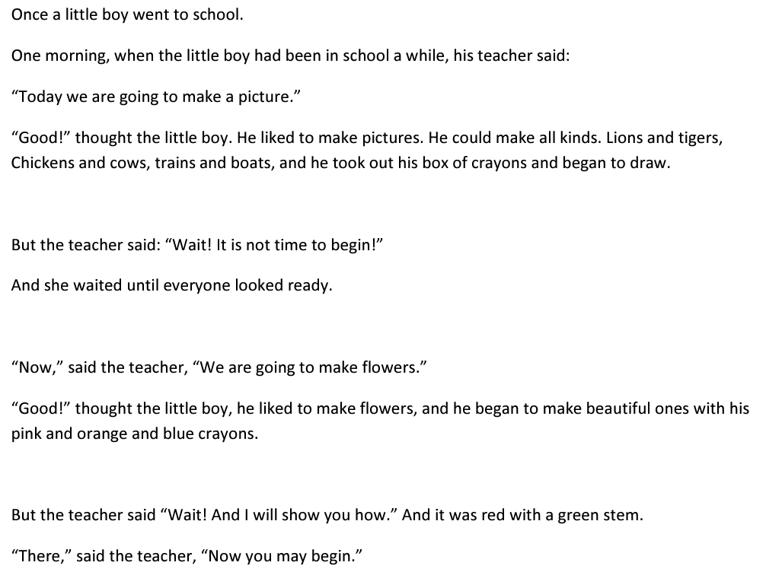
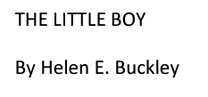
Notes:
The Little Boy, By Helen E. Buckley: http://www.ndlcpreschool.com/wp-content/uploads/2013/07/THE-LITTLE-BOY.pdf
How much of what we look for, or worry about during an observation is related to classroom "management" and how much is related to learning?

Slide 5
Instructional Levers
Grounded in Natural Phenomenon
Focused on building and critiquing ideas using evidence
Student-Directed and collaborative
If these are the levers; yet we have no direct time, how might these levers connect to other areas?

Slide 6

Science-Specific
In the text our authors suggest that there is a need for a "science-specific" evaluation framework.
Thinking about your space, how might administrators react to this idea?
How much administrative professional
development time is currently devoted to providing content specific feedback during observations?
  Why might it be important?
  How might this shift other professional metrics?

Slide 7
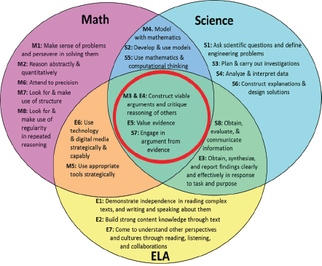
Intersections
Notes:
Download the book for free: Literacy for Science- exploring intersections of the NGSS and CLA standards: https://nap.nationalacademies.org/read/18803/chapter/3#8

Slide 8
SEPs Organized into Groups
Investigating Practices | Sensemaking Practices | Critiquing Practices
1. Asking Questions 3. Planning and Carrying Out Investigations 5. Using Mathematics and Computational Thinking | 2. Developing and Using Models 4. Analyzing and Interpreting Data 6. Constructing Explanations | 7. Engaging in Argument from Evidence 8. Obtaining, Evaluating and Communicating Information
Data
Explanation and/or Models
Natural World
Investigative Practices
Sensemaking
Practices
Critiquing Practices

Slide 9
Figure 2.1: A Continuum of Practices
 | Level 1 | Level 2 | Level 3 | Level 4
Investigating Practices
Sensemaking Practices
Critiquing Practices
Notes:
Significant in not only the ways we want students to progress through their use of the practices; but also the way we want to see teachers developing their uses

Slide 10
"The Shift"
Learning about
Figuring out
Data
Explanation and/or Models
Natural World
Investigative Practices
Sensemaking
Practices
Critiquing Practices

Slide 11
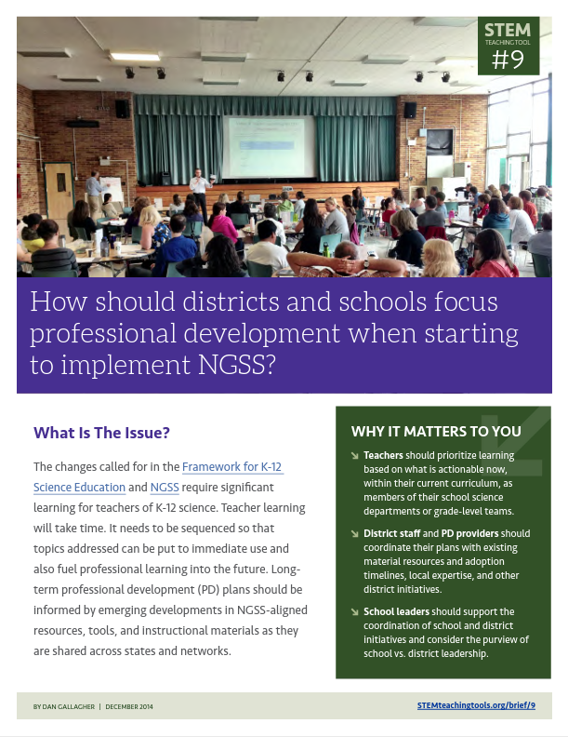
Instructional Elements- Science Practices
The text (p.31) calls out threw instructional elements;
Grounded in explaining natural phenomena
focused on critiquing ideas and using evidence
student-directive and collaborative
In break-out groups take a moment to reflect;
How are we / can we support this shift in
pedagogy?
Which comes first, the materials or the PD?
Notes:
STEM Teaching Tools #9: https://stemteachingtools.org/brief/9

Slide 12
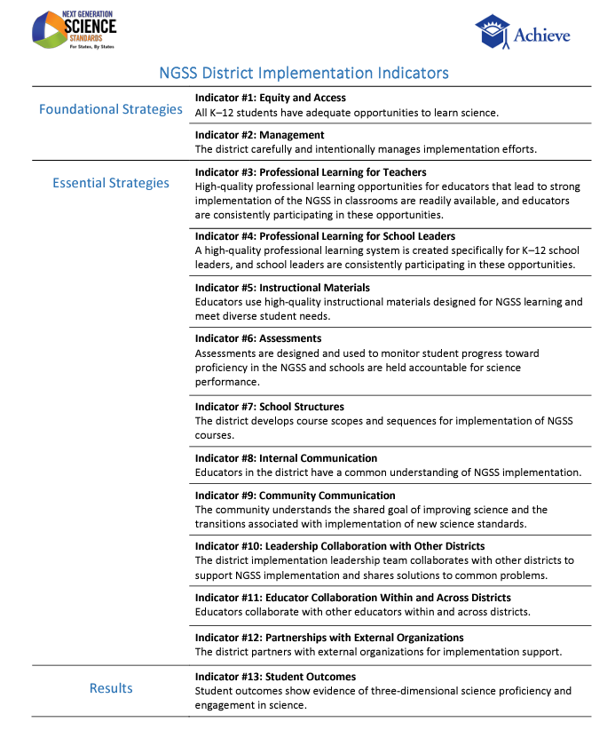
District Implementation
Indicators
Notes:
District Implementation Indicators: https://www.nextgenscience.org/sites/default/files/NGSS%20District%20Implementation%20Indicators%20-%20FINAL.pdf

Slide 13
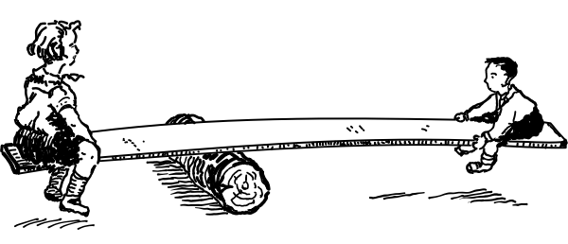
Levers
Asking Questions
Whether the teachers provides opportunities for students to ask scientific questions.
Whether the teacher provides opportunities for students to evaluate one anothers questions.
Why is the second lever so
important?

Slide 14
Figure 2.2: A Continuum for Asking Questions
 | Level 1 | Level 2 | Level 3 | Level 4
Asking Questions | The teacher does not provide opportunities for students to ask questions. | The teacher provides opportunities for students to ask both scientific and nonscientific questions (i.e. not answerable through the gathering of evidence about natural phenomena). | The teacher provides opportunities for students to ask scientific questions (i.e., answerable through the gathering of evidence about natural phenomena). Students do not evaluate the merits and limitations of the questions. | The teacher provides opportunities for students to ask scientific questions. Students evaluate the merits and limitations of the questions.

Slide 15
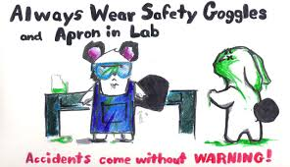
Levers
Planning and Carrying Out Investigations
How collaborative the investigation experience is for all students.
Whether the students are given the opportunities to plan and conduct investigations.
Why is the second lever so
important?

Slide 16
Figure 2.3: A Continuum for Planning and Carrying Out Investigations
 | Level 1 | Level 2 | Level 3 | Level 4
Planning and Carrying Out Investigations | The teacher does not provide opportunities for students to design or conduct investigations. | The teacher provides opportunities for students to conduct investigations to confirm ideas they have learned about but these opportunities are typically teacher-driven. Students do not make decisions about experimental variables or investigational methods (e.g. number of trials.) | The teacher provides opportunities for students to design or conduct investigations to gather data about how or why a natural phenomenon occurs. Students make decisions about experimental variables, controls, and investigational methods. | The teacher provides opportunities for students to design and conduct investigations to gather data about how or why a natural phenomenon occurs. Students make decisions about experimental variables, controls, and investigational methods.

Slide 17
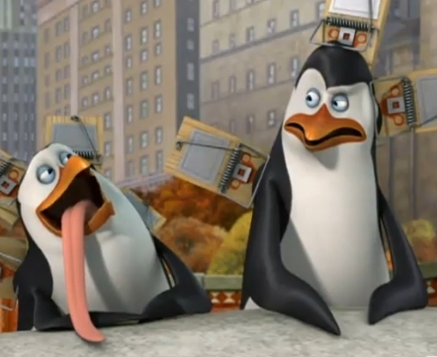

Levers
Planning and Carrying Out Investigations
How are students' arguments constructed?
Students are given more opportunities to construct arguments about natural phenomena.
How do these levers utilize / require
cross-curricular supports?

Slide 18
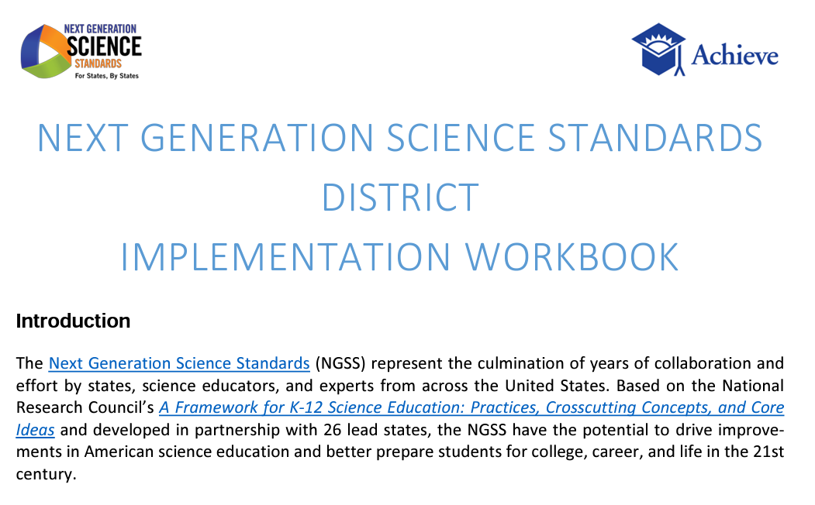
5 Minute Deep Dive
With your break out group, take 5 minutes to look at and bookmark this resource.
What might next steps look like?
How might we leverage this community to lighten the load?
Notes:
District Implementation Workbook Link: https://www.nextgenscience.org/news/ngss-district-implementation-workbook

Slide 19
Reflection Breakout
How is the shift toward science practices similar to and different from previous reforms in science education?
How can shifting toward science practices support more equitable opportunities for all students in science?
Think about the vignettes used in this chapter. How were students engaged in the science practices? How does that compare to previous science instruction?

Slide 20
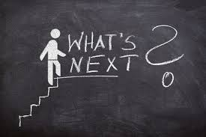
Practical Tips
Begin by digging into the continuum and science practice.
Reach a consensus about the continuum version you will use.
Meet and support teachers where they are on the continuum (use this as a lever for professional learning.)

Slide 21

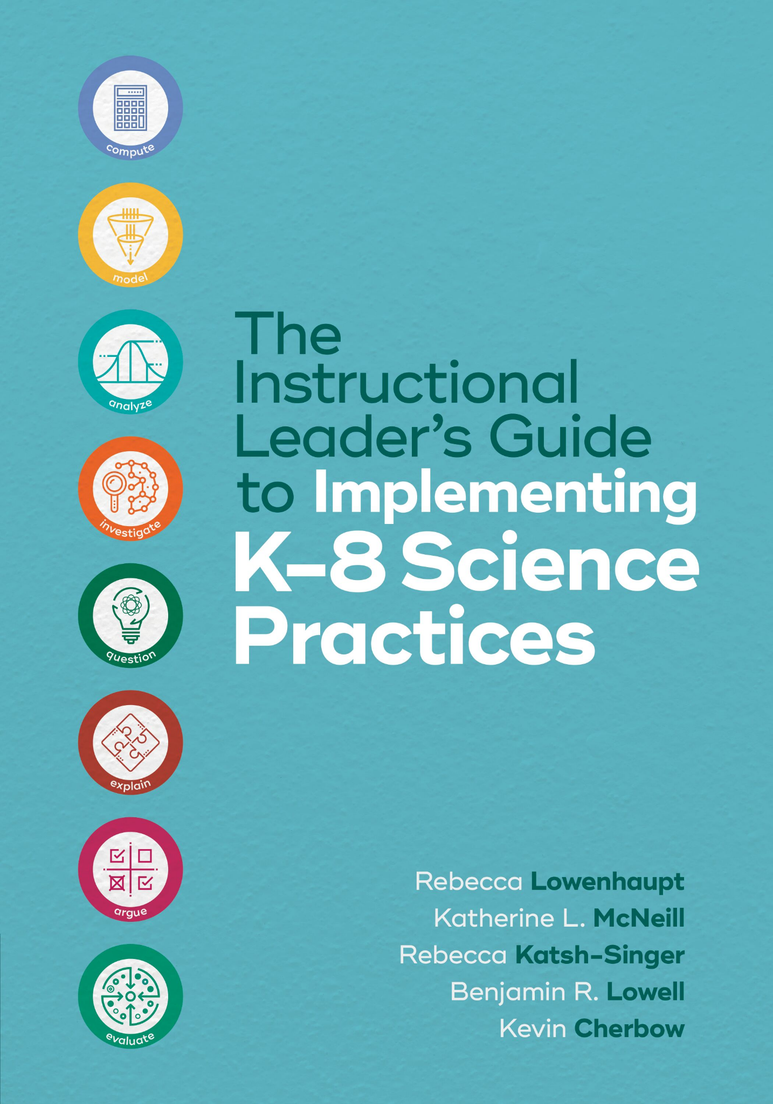
Thank you for attending Session 2!
Please provide us with feedback (Link)
Join us for Session 3 on October 3rd to reflect on Chapter 3 (The Supervision Cycle)
Notes:
Feedback Form: https://docs.google.com/forms/d/e/1FAIpQLScsAIhzGyQtzIKI-m78annk1pM9qSuFsiZScY-grnica2Vr6A/viewform?usp=sf_link

