Slide 1
The Instructional Leader's Guide to Implementing K-8 Science Practices
Chapter 1 - The Science Primer

Slide 2

Community Agreements
Stay engaged
Expect and accept a lack of closure
Speak your truth
Expect to experience discomfort
Bring your identity
Curiosity is what we need. We don’t have to let go of what we believe, but we do need to be curious about what someone else believes. We do need to acknowledge that their way of interpreting the world might be essential to our survival. - Margaret Wheatley, Willing to be Disturbed, 2002

Slide 3

Housekeeping
To reduce background noise, please stay on mute when not speaking.
Video is optional, but please know that all attire and backgrounds are accepted!
Familiarize yourself with the chat box. It’s a great place to ask questions and post comments.
Materials will be shared following the session.

Slide 4

Doing Science
In the text Ms. Chavez questions how the students are "doing science"
What does this currently look like in your space?
How might you want it to shift?

Slide 5
What are the Science Practices
"The practices are the language, tools, ways of knowing and social interactions that scientists use as they construct, evaluate and communicate science ideas."- p. 11
How familiar are stakeholders in your school (teachers, parents) or district (administrators) with the recent shifts in science education toward science practices?
What opportunities and challenges do you envision for supporting this shift?

Slide 6
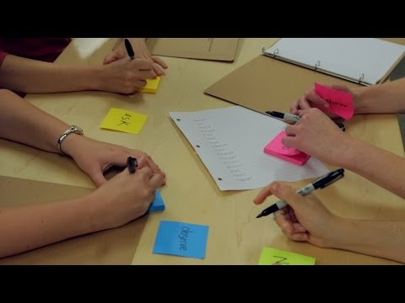
A Framework For Organizing Ideas
Verbs
Notes:
California Academy of Science PD Tools: https://www.calacademy.org/educators/ngss-demystified

Slide 7
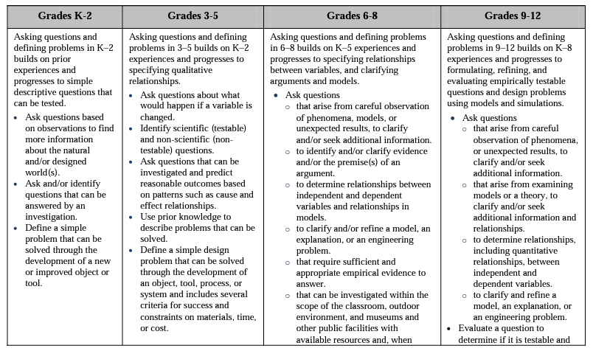
Appendix F: Science and Engineering Practices
Asking Questions:
Notes:
Appendix F: https://www.nextgenscience.org/sites/default/files/resource/files/Appendix%20F%20%20Science%20and%20Engineering%20Practices%20in%20the%20NGSS%20-%20FINAL%20060513.pdf

Slide 8
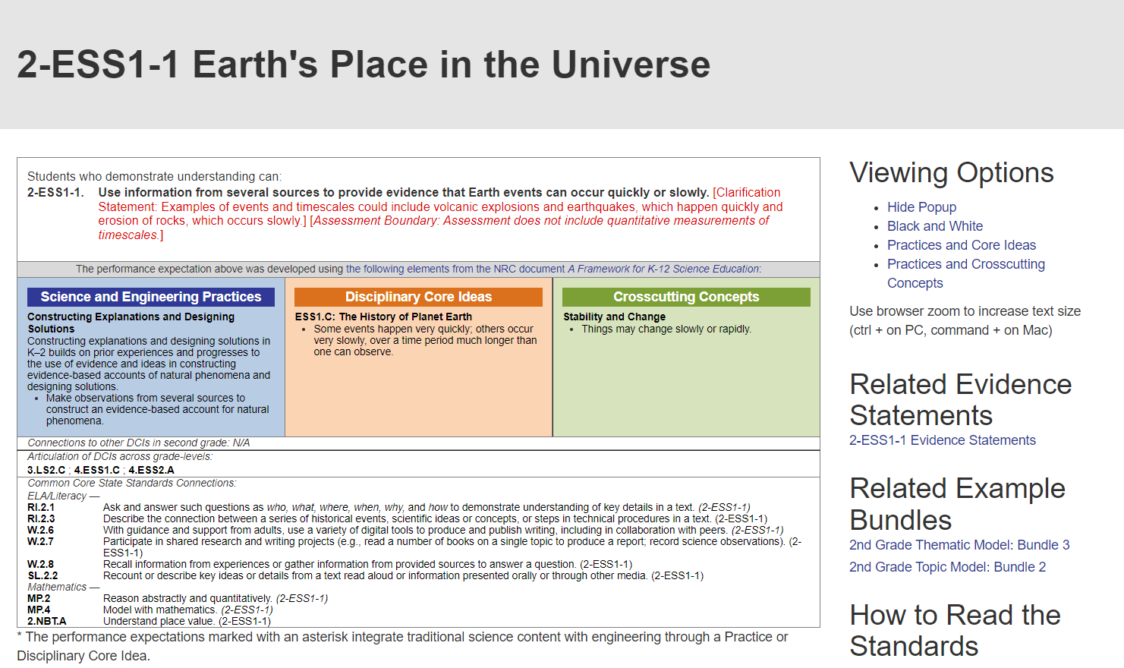

Slide 10
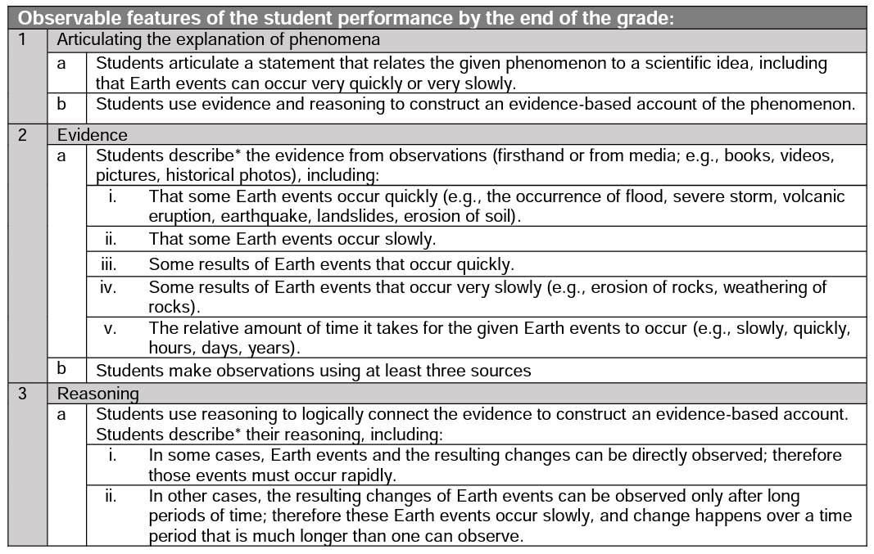

Slide 11
Chat it!
Do our teachers know that these tools/resources exist?
How can we better support them to know these tools / resources are out there?
The text suggests organizing…

Slide 12
SEPs Organized into Groups
Investigating Practices | Sensemaking Practices | Critiquing Practices
1. Asking Questions 3. Planning and Carrying Out Investigations 5. Using Mathematics and Computational Thinking | 2. Developing and Using Models 4. Analyzing and Interpreting Data 6. Constructing Explanations | 7. Engaging in Argument from Evidence 8. Obtaining, Evaluating and Communicating Information
Data
Explanation and/or Models
Natural World
Investigative Practices
Sensemaking
Practices
Critiquing Practices

Slide 13
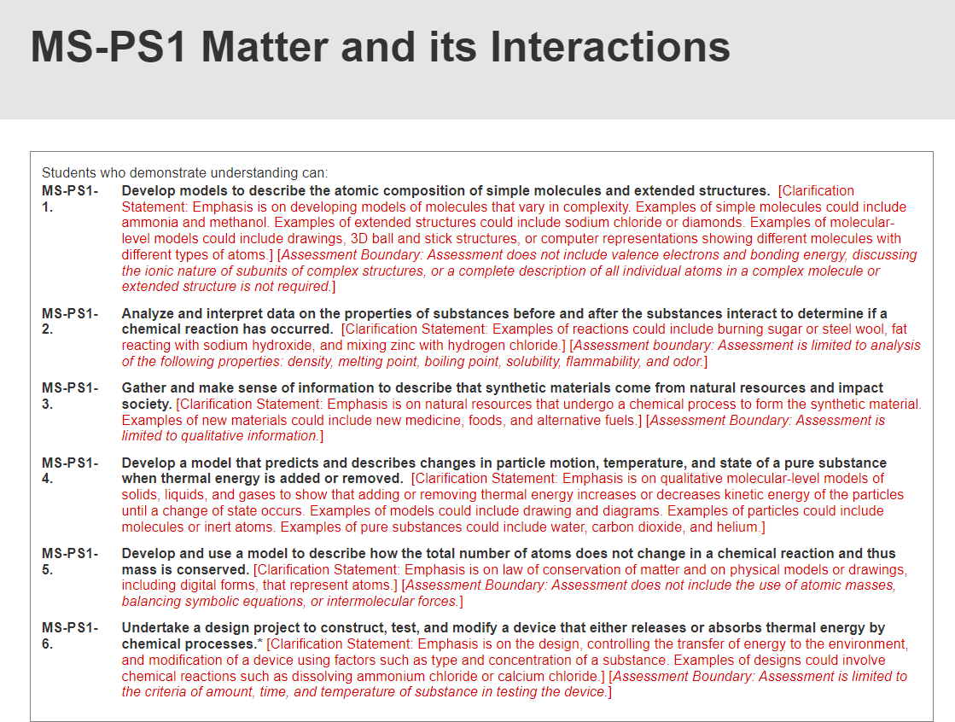

Slide 14
Group 3
Investigating Practices | Sensemaking Practices | Critiquing Practices
1. Asking Questions 3. Planning and Carrying Out Investigations 5. Using Mathematics and Computational Thinking | 2. Developing and Using Models 4. Analyzing and Interpreting Data 6. Constructing Explanations | 7. Engaging in Argument from Evidence 8. Obtaining, Evaluating and Communicating Information
Analyze and interpret data on the properties of substances before and after the substances interact to determine if a chemical reaction has occurred.
Develop and use a model to describe how the total number of atoms does not change in a chemical reaction and thus mass is conserved
Gather and make sense of information to describe that synthetic materials come from natural resources and impact society
Undertake a design project to construct, test, and modify a device that either releases or absorbs thermal energy by chemical processes.
Develop a model that predicts and describes changes in particle motion, temperature, and state of a pure substance when thermal energy is added or removed
Develop models to describe the atomic composition of simple molecules and extended structures.
Notes:
Drag and drop the boxes to the places they best belong. Add additional copies of this slide as needed for the number of groups you have.

Slide 15
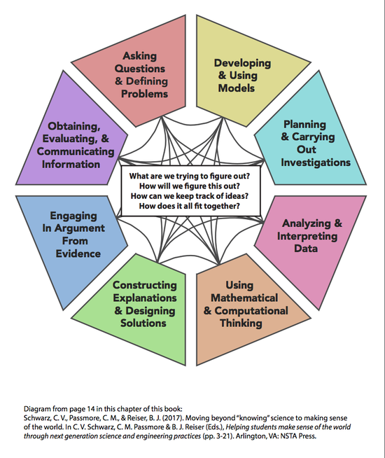

Slide 16
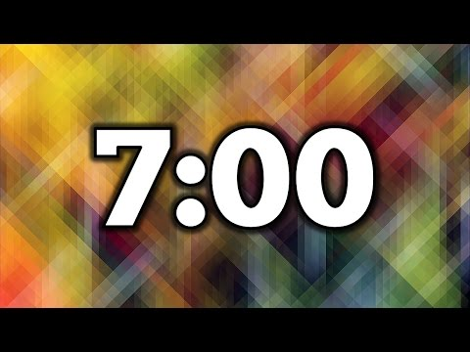
Breakouts
Group 1- p. 17 Investigating Practices
Group 2- p. 19 Sensemaking Practices
Group 3- p. 21 Critiquing Practices
For each vignette, consider what the educator's next steps might be and what clues might an administrator have about the practice being done in science?

Slide 17
Reflection Breakout
How is the shift toward science practices similar to and different from previous reforms in science education?
How can shifting toward science practices support more equitable opportunities for all students in science?
Think about the vignettes used in this chapter. How were students engaged in the science practices? How does that compare to previous science instruction?

Slide 18

Practical Tips
Familiarize Yourself with the Three Groups
Use the Three Groups to Analyze Curriculum and Instruction
Focus on One Group of SEPs at a Time as Part of Professional Learning

Slide 19
Application
How familiar are stakeholders in your school (teachers, parents) or district (administrators) with the recent shifts in science education toward science practices? What opportunities and challenges do you envision for supporting this shift?
It can be overwhelming to focus on all eight science practices at once. If you were to select one group of science practices (investigating, sensemaking, or critiquing) to be the focus of professional development for your teachers, which would you select and why?

Slide 20

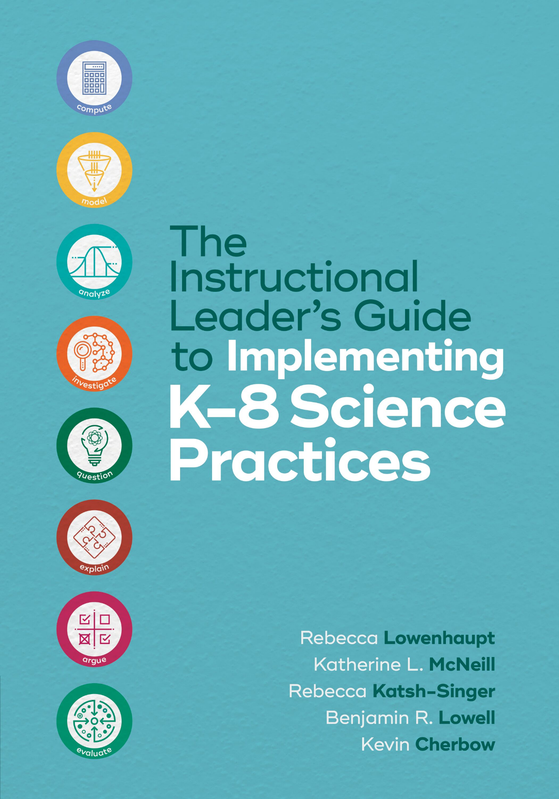
Thank you for attending Session 1!
Join us for Session 2 to reflect on Chapter 2 (A Framework for Supervision: The Continuum)
Notes:
Feedback Form: https://docs.google.com/forms/d/e/1FAIpQLScsAIhzGyQtzIKI-m78annk1pM9qSuFsiZScY-grnica2Vr6A/viewform?usp=sf_link

