Slide 1
The Instructional Leader's Guide to Implementing K-8 Science Practices
Chapter 5

Slide 2

Community Agreements
Stay engaged
Expect and accept a lack of closure
Speak your truth
Expect to experience discomfort
Bring your identity
Curiosity is what we need. We don’t have to let go of what we believe, but we do need to be curious about what someone else believes. We do need to acknowledge that their way of interpreting the world might be essential to our survival. - Margaret Wheatley, Willing to be Disturbed, 2002

Slide 3

Housekeeping
To reduce background noise, please stay on mute when not speaking.
Video is optional, but please know that all attire and backgrounds are accepted!
Familiarize yourself with the chat box. It’s a great place to ask questions and post comments.
Materials will be shared following the session.

Slide 4
Feedback
"The inclusion of observed areas of strength in the lesson is key to reducing anxiety for the teacher and creating a space for more critical feedback later on" p.77
Timely and specific

Slide 5
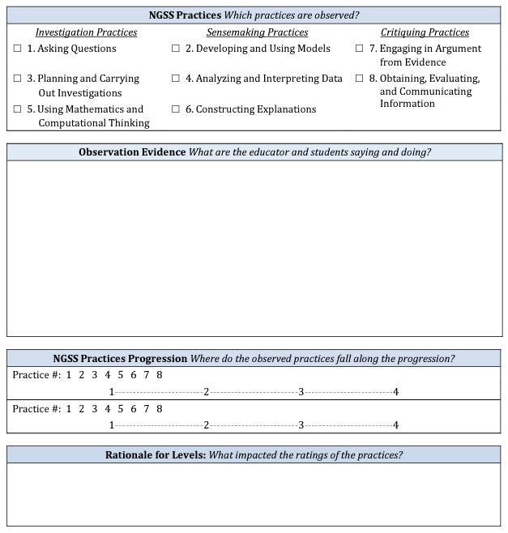
Feedback
Praise
Focal Science Practices
Probing Question
Key Levers
Future Plans

Slide 6
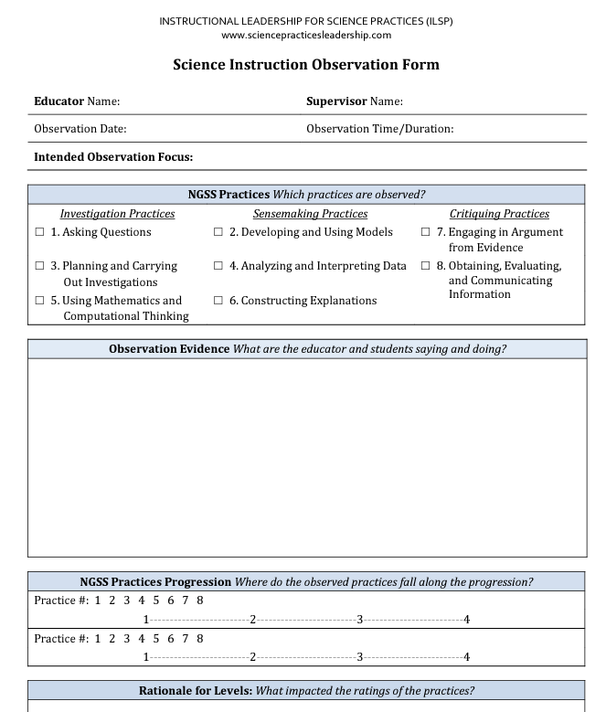
Practice
https://www.sciencepracticesleadership.com/video---grade-2.html

Slide 7
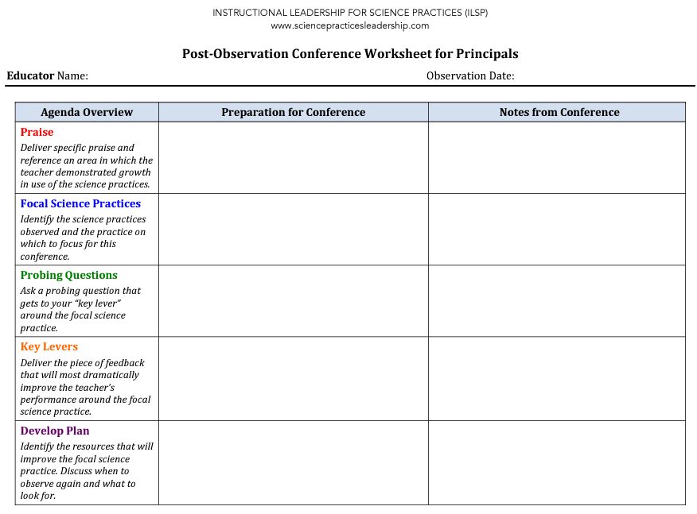

Slide 8

Multiple Practices?

Slide 9


Thank you for attending Session 5!
Please provide us with feedback (Link)
What would you like to see next?
Notes:
Feedback Form: https://docs.google.com/forms/d/e/1FAIpQLScsAIhzGyQtzIKI-m78annk1pM9qSuFsiZScY-grnica2Vr6A/viewform?usp=sf_link

