Slide 1
The Instructional Leader's Guide to Implementing K-8 Science Practices
Chapters 6 & 7

Slide 2

Community Agreements
Stay engaged
Expect and accept a lack of closure
Speak your truth
Expect to experience discomfort
Bring your identity
Curiosity is what we need. We don’t have to let go of what we believe, but we do need to be curious about what someone else believes. We do need to acknowledge that their way of interpreting the world might be essential to our survival. - Margaret Wheatley, Willing to be Disturbed, 2002

Slide 3

Housekeeping
To reduce background noise, please stay on mute when not speaking.
Video is optional, but please know that all attire and backgrounds are accepted!
Familiarize yourself with the chat box. It’s a great place to ask questions and post comments.
Materials will be shared following the session.

Slide 4
5 Critical Components of PD
Content focus | How might we advocate and leverage time in our communities to achieve this goal?
Active Learning | What does this look like in Science PL?
Coherence | Specifically in elementary spaces how do we support coherence across the different disciplines and grade levels?
Duration | Does the learning extend beyond the "seat time"?
Collective Participation | How do we differentiate for all learners?

Slide 5
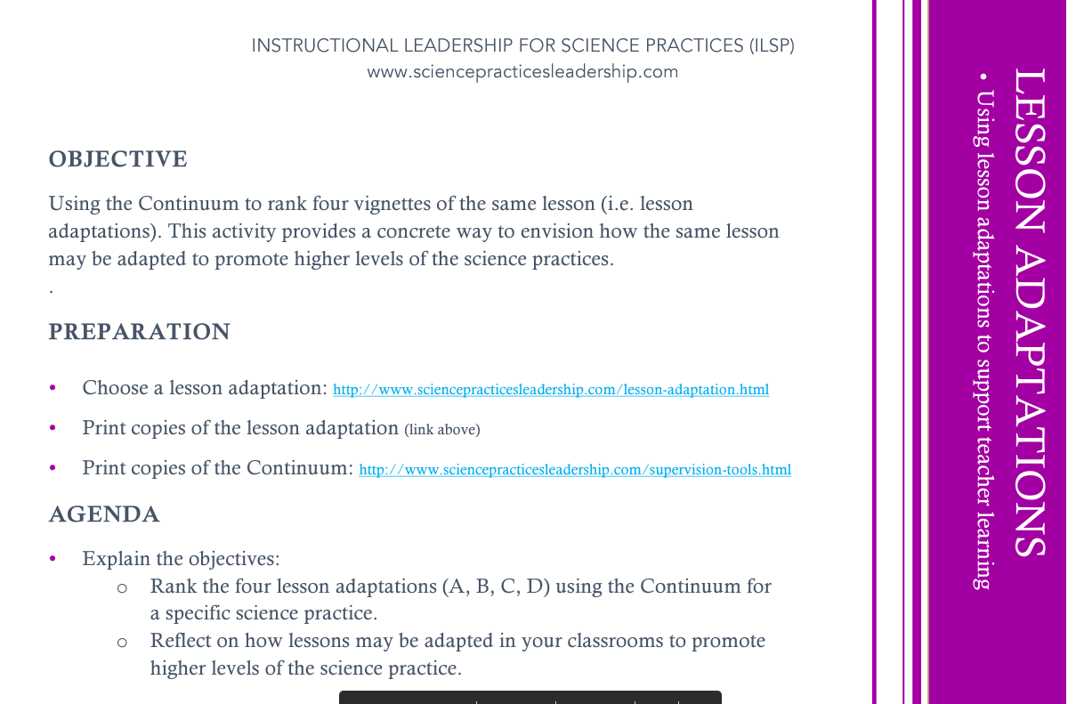

Slide 6
Practical Tips
Teachers respond better to PD run by people who share a lived experience.
"when teachers from different schools and grade levels work together and participate in regular meetings and professional development, they return to their schools and teams reinvigorated and eager to share and model what they've learned." p. 105
What are ways that we might accomplish this?

Slide 7

Reflection
Think of a time where you were able to engage in the type of professional learning described. What make it impactful on your practice?
How could the science practices be a lever for supporting educational reform?

Slide 8

Moving Forward
Individualize approach to implementation
Engage the entire school
District level
One step at a time…

Slide 9
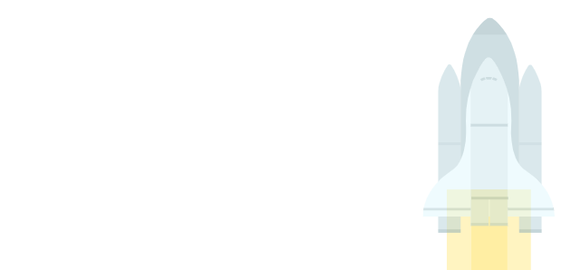

Thank you for attending Session 5!
Please provide us with feedback (Link)
What would you like to see next?
Notes:
Feedback Form: https://docs.google.com/forms/d/e/1FAIpQLScsAIhzGyQtzIKI-m78annk1pM9qSuFsiZScY-grnica2Vr6A/viewform?usp=sf_link

