Slide 1
The Instructional Leader's Guide to Implementing K-8 Science Practices
Chapter 3 - The Supervision Cycle

Slide 2

Community Agreements
Stay engaged
Expect and accept a lack of closure
Speak your truth
Expect to experience discomfort
Bring your identity
Curiosity is what we need. We don’t have to let go of what we believe, but we do need to be curious about what someone else believes. We do need to acknowledge that their way of interpreting the world might be essential to our survival. - Margaret Wheatley, Willing to be Disturbed, 2002

Slide 3
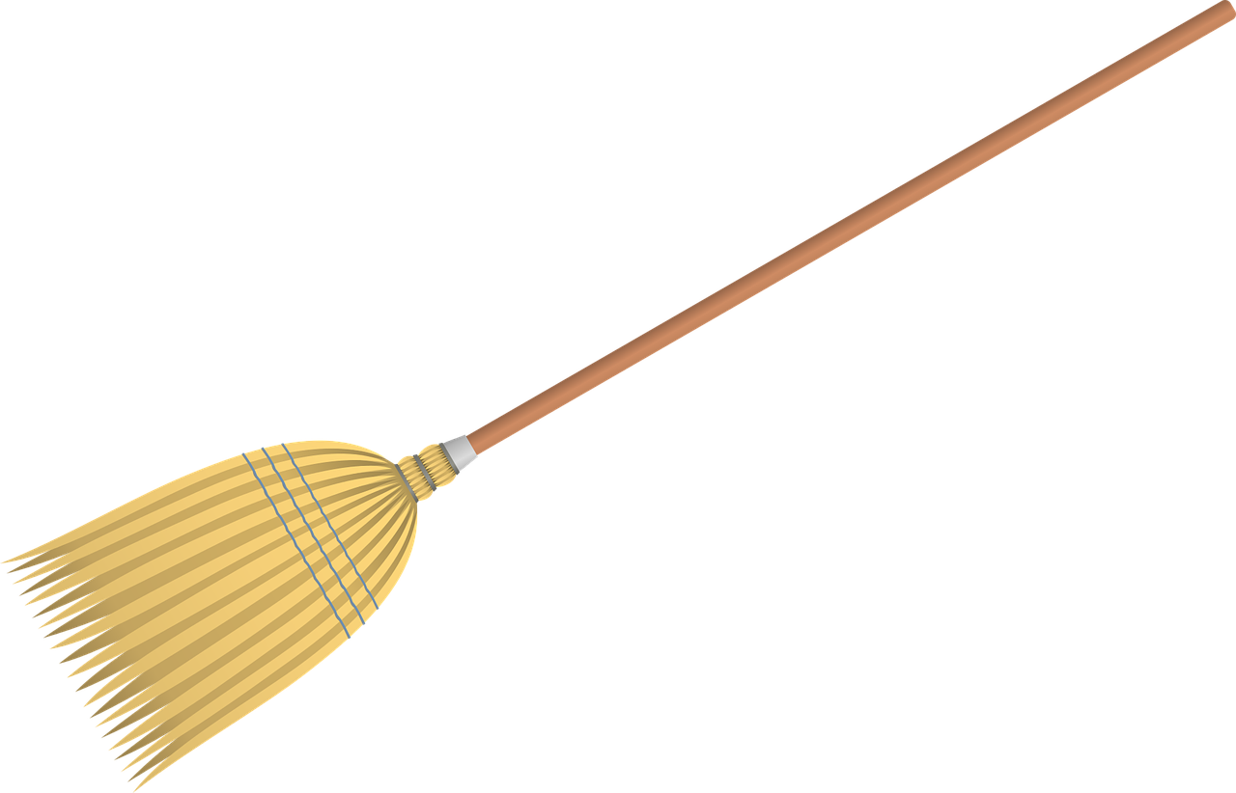
Housekeeping
To reduce background noise, please stay on mute when not speaking.
Video is optional, but please know that all attire and backgrounds are accepted!
Familiarize yourself with the chat box. It’s a great place to ask questions and post comments.
Materials will be shared following the session.

Slide 4
Figure 3.1: The Supervision Cycle
Observation
Professional Development
Feedback

Slide 5

Supervision Cycle
Crafting a Schoolwide Approach
Assessing Existing Resources
  What resources do you have in your space?
  How might this group work together to expand resources and capacity?
Schedule Each Step
Differentiate

Slide 6
High Skill High Will | High Skill Low Will
Low Skill High Will | Low Skill Low Will

Slide 7
High Skill High Will (goal?) | High Skill Low Will (goal?)
Low Skill High Will (goal?) | Low Skill Low Will (goal?)

Slide 8
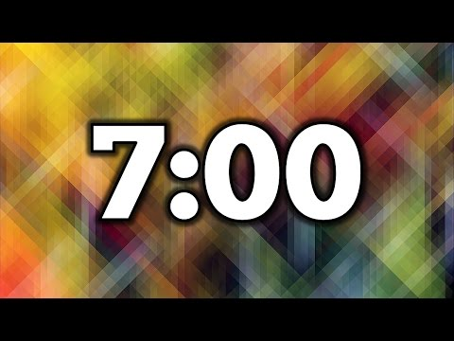
Coupling Teacher Evaluation and Professional Learning
How does this work in your system?
  I.E. How early is the PD/PL calendar developed?
  How might district leaders support this work to take place within teacher PLCs
If we cannot control the two above, how might we influence and be change agents in this area?

Slide 9
"The Shift"
Learning about
Figuring out

Slide 10
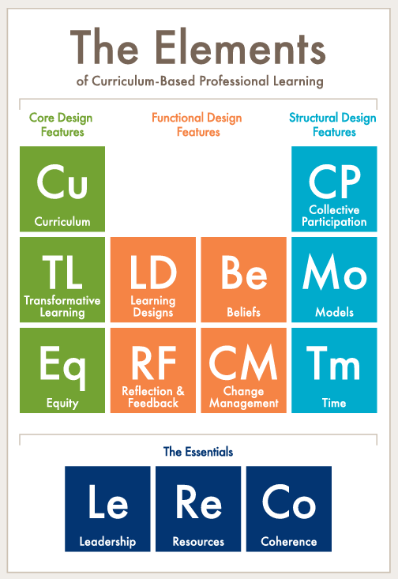
"The Shift"
Notes:
Carnegie Report: https://www.carnegie.org/our-work/article/elements-transforming-teaching-through-curriculum-based-professional-learning/

Slide 11
SEPs Organized into Groups
Investigating Practices | Sensemaking Practices | Critiquing Practices
1. Asking Questions 3. Planning and Carrying Out Investigations 5. Using Mathematics and Computational Thinking | 2. Developing and Using Models 4. Analyzing and Interpreting Data 6. Constructing Explanations | 7. Engaging in Argument from Evidence 8. Obtaining, Evaluating and Communicating Information
Data
Explanation and/or Models
Natural World
Investigative Practices
Sensemaking
Practices
Critiquing Practices

Slide 12

Elevating PLC Practices
Formal Planning Time
Access to instruction materials
Trust
Shift of accountability from individual teachers
to whole schools community
In break-out groups take a moment to reflect;
How do we establish and repair trust in our communities?
What does accountability look like with science content? How do vertical teams discuss content?
Notes:
STEM Teaching Tools #24: https://stemteachingtools.org/brief/24

Slide 13
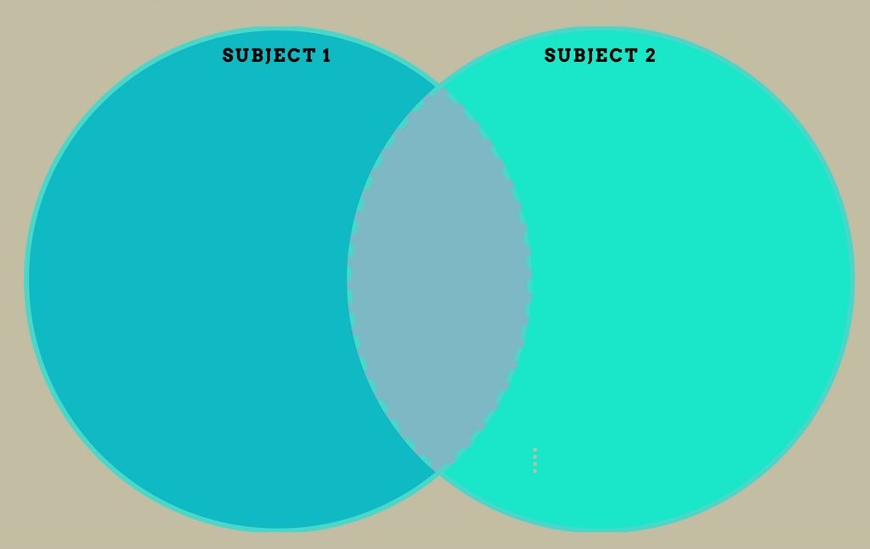
Reflection Breakout
Which parts of the supervision cycle are already in place in your system?
How is this similar? How is this different?

Slide 14
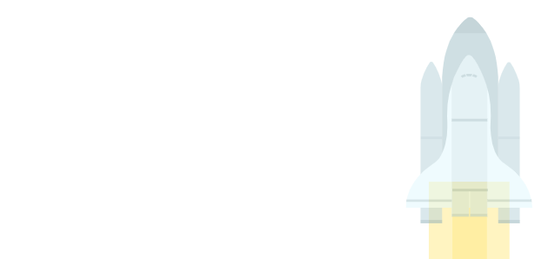
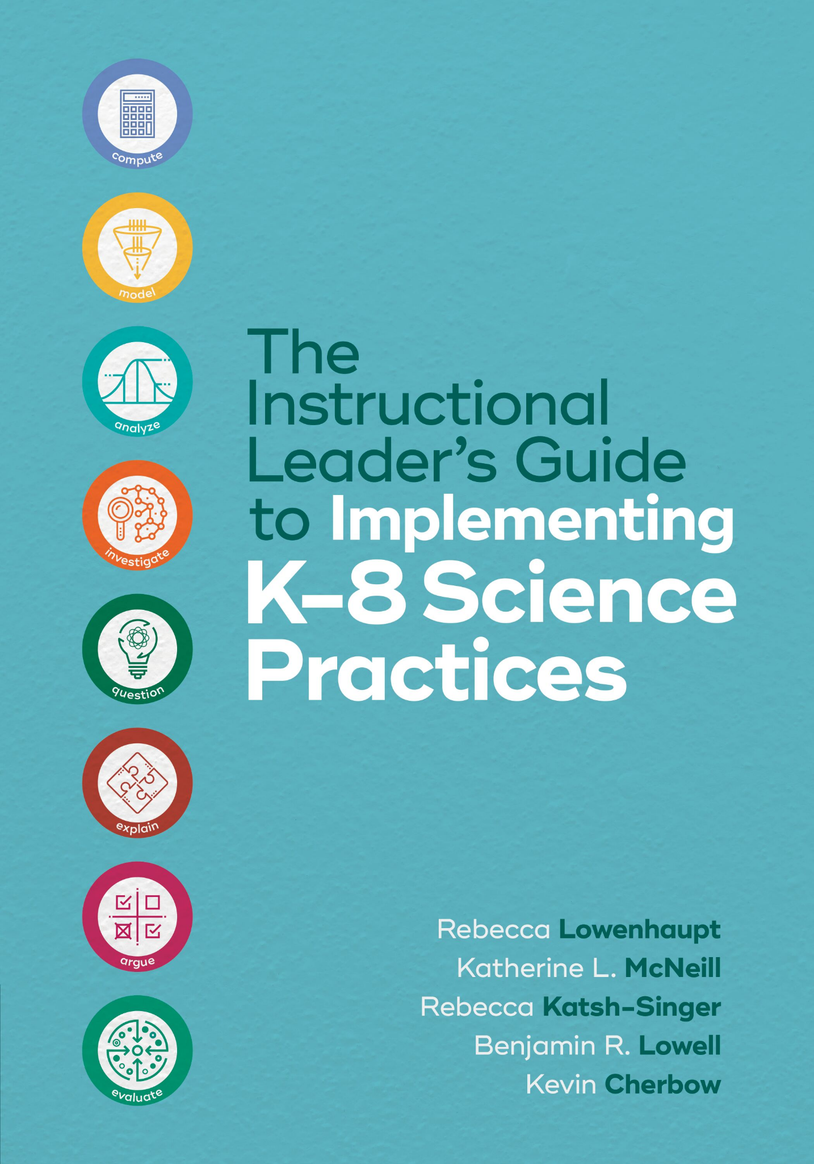
Thank you for attending Session 3!
Please provide us with feedback (Link)
Join us for Session 4 to reflect on Chapter 4 (Observation)
Notes:
Feedback Form: https://docs.google.com/forms/d/e/1FAIpQLScsAIhzGyQtzIKI-m78annk1pM9qSuFsiZScY-grnica2Vr6A/viewform?usp=sf_link

