Slide 1
Standards Workshop
Creating a Scope & Sequence of your Standards to Guide Curriculum, Instruction, and Assessment
Steps 6-9 in the “Guidance Document: Curriculum Writing”
CSAS| Kansas State Department of Education | Landon State Office Building
900 S.W. Jackson St., Suite 653, Topeka, KS 66612 | 785-296-1074 | sperryman@ksde.org
Notes:
This full day PD is meant to help a curriculum team start writing a sound and viable curriculum map that can be customized to work in any school/district.
An ELA Curriculum Writing Guide was recently published on the KSDE ELA Webpage. This workshop will walk you through steps 7-9.
https://community.ksde.org/LinkClick.aspx?fileticket=A6_fR_i9xgE%3d&tabid=5837&mid=15789
MATERIALS-
Poster Paper
LOTS of Post-Its
Whiteboard space or Butcher Paper
Technology so teachers can follow along in the presentation

Slide 2
Agenda-
8:30-8:45 Greetings
8:45-8:55 Objectives
8:55-9:05 Warm Up
9:05-9:35 Introduction
9:35-11:00 Activity 1
11:00-11:15 Break
11:15-11:45 Deeper Dive
11:45-12:45 Lunch
12:45-1:30 Activity 2
1:30-1:45 Break
1:45-2:45 Activity 3
2:45-3:00 Break
3:00-3:15 Debrief
3:15-3:30 Closing
Notes:
This PD is meant to be 5.25 hours of content plus 1 hour for lunch and three 15 minute breaks.
YOU WILL NEED 7 HOURS TOTAL.

Slide 3
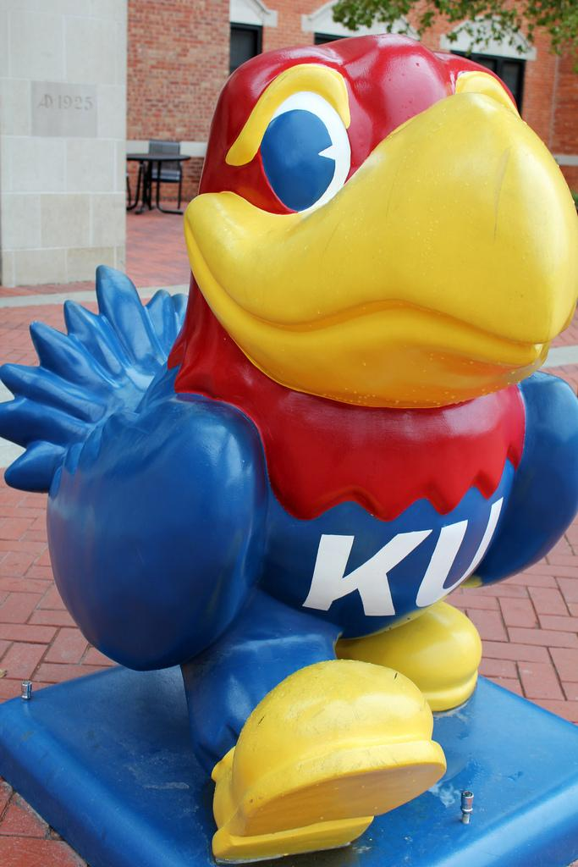
Introductions
Sarah Perryman
  UnderGrad- ELA
  Grad- C & I + ESOL & Edu Leadership
  5 Years at Topeka High School
    Sheltered ELA
  June 2018: KSDE
    Education Program Consultant: ELA
  March 2019: KSDE
    Redesign Coordinator

Slide 4
Kansas State Board of Education
Kansans can lead the world in the success of each student.
Vision- A successful high school graduate is/has…
Academically Prepared
Cognitively Prepared
Technical Skills
Employability Skills
Civically Engaged
Outcomes- Areas of focus
Kindergarten Readiness
Social & Emotional Learning
Individual Plans of Study
High School Graduation
Post-Secondary Success
Notes:
Learn more at https://www.ksde.org/Board/Kansas-State-Board-of-Education/Board-Goals-and-Outcomes

Slide 5
Redesign
Principles
Student Success Skills | Community Partnerships
There is an integrated approach to develop student social-emotional growth | Partnerships are based on mutually beneficial relationships and collaboration
Personalized Learning | Real World Applications
Teachers support students to have choice over their time, place, pace and path | Project-based learning, internships, and civic engagement makes learning relevant

Slide 6
Greeting Question
If you could be on a reality TV show, which one would you choose and why?
Notes:
It is always important to start the day by getting to know your audience. Depending on the size, you can do this icebreaker whole group or in small groups.

Slide 7
Agenda-
8:30-8:45 Greetings
8:45-8:55 Objectives
8:55-9:05 Warm Up
9:05-9:35 Introduction
9:35-11:00 Activity 1
11:00-11:15 Break
11:15-11:45 Deeper Dive
11:45-12:45 Lunch
12:45-1:30 Activity 2
1:30-1:45 Break
1:45-2:45 Activity 3
2:45-3:00 Break
3:00-3:15 Debrief
3:15-3:30 Closing
Notes:
This PD is meant to be 5.25 hours of content plus 1 hour for lunch and three 15 minute breaks.
YOU WILL NEED 7 HOURS TOTAL.

Slide 8
Objectives-
By the end of this workshop,
I can identify key leaps in our ELA standards and explain how those key shifts impact instruction.
I can create a scope and sequence of the ELA standards.
I can start creating instruction derived from the standards utilizing vocabulary, DOK analyses, and strategic questioning.
Notes:
We are creating a system for standards-based curriculum, instruction, and assessment. I am not here to prescribe practice or to mandate assessments. I am here to help you build a sound curricular foundation based on our Kansas ELA Standards. From this, you will then be able to create units of study with local resources, practices, and assessments.

Slide 9
Agenda-
8:30-8:45 Greetings
8:45-8:55 Objectives
8:55-9:05 Warm Up
9:05-9:35 Introduction
9:35-11:00 Activity 1
11:00-11:15 Break
11:15-11:45 Deeper Dive
11:45-12:45 Lunch
12:45-1:30 Activity 2
1:30-1:45 Break
1:45-2:45 Activity 3
2:45-3:00 Break
3:00-3:15 Debrief
3:15-3:30 Closing
Notes:
This PD is meant to be 5.25 hours of content plus 1 hour for lunch and three 15 minute breaks.
YOU WILL NEED 7 HOURS TOTAL.

Slide 10
Warm Up

Slide 11



Jot Thoughts
What words come to mind when you hear the word ‘standards’?
1- Write down individual words/phrases on post-it notes. (1 minute)
2- At your table, share your words/phrases and group them based on similarities. (2 minutes)
3- At your table, come up with a statement about the term ‘standards’. (3 minutes)
4- Share as a whole group.
Notes:
Should take less than 10 minutes
1 Minute to write down individual phrase
2 Minutes to share and group words/phrases
3 Minutes to create a statement
2-3 minutes to have each group share their statement (should go quick if each table just reads their statement)

Slide 12
Agenda-
8:30-8:45 Greetings
8:45-8:55 Objectives
8:55-9:05 Warm Up
9:05-9:35 Introduction
9:35-11:00 Activity 1
11:00-11:15 Break
11:15-11:45 Deeper Dive
11:45-12:45 Lunch
12:45-1:30 Activity 2
1:30-1:45 Break
1:45-2:45 Activity 3
2:45-3:00 Break
3:00-3:15 Debrief
3:15-3:30 Closing
Notes:
This PD is meant to be 5.25 hours of content plus 1 hour for lunch and three 15 minute breaks.
YOU WILL NEED 7 HOURS TOTAL.

Slide 13
Introduction

Slide 14
What are ‘standards’?
Standards are expectations for teaching and learning. Standards are not a curriculum.
Standards tell us what students should KNOW and be able to DO at each grade level.
  These should be mastered by the end of the course.
→ Where can our state standards for ELA be found?
https://community.ksde.org/Default.aspx?tabid=5559
Notes:
Your curriculum is built from the standards, but the standards themselves are not a curriculum. Standards will tell you WHAT needs to be taught and how rigorous the learning activities need to be, but the standards don’t tell you HOW to teach or with what you will be teaching.

Slide 15
Why do we have instructional standards?
“Having curricular standards is analogous to having building codes. In every jurisdiction, there are well-established codes that builders must adhere to. Despite the existence of these codes, not every building looks the same.” (Schimmer, 2016)
Notes:
Grading from the Inside Out (Schimmer, 2016)
Again, this workshop is meant to help you create a structure for your curriculum, instruction, and assessment that is built upon the standards. What that looks like will depend on your team.

Slide 16
How do our standards connect to the KAP?
Our state assessment is built from our state standards.
Our standards should function as instructional guidelines for educators.
  Thus, if teachers follow our standards, then students will be prepared for the state assessment.
  However, you must not just teach the standard, but you must teach it to the depth of knowledge at which it will be assessed.
“Test prep” should not come in place of quality instruction.

Slide 17
‘Priority Standards’
The ELA Standards do not have designated ‘priority standards’ or ‘focus standards’. In ELA, the only skill that must be mastered in order for other standards to be mastered is reading.
  Reading Foundation Standards end in 5th grade. If you have students in the secondary classroom who are reading at an elementary level, then you should become familiar with the Reading Foundation standards in order to scaffold reading supports for your students.
While some standards could logically precede others, mastery of one standard is not a prerequisite for any other.
Notes:
If our goal is to promote a ‘balanced literacy’ approach to ELA, then we will never have ‘priority standards’.
In ELA, the skills in our standards represent a variety of essential elements of knowledge and ability when it comes to interacting with, and growing within, the four domains of literacy (reading, writing, speaking and listening). Thus, because of each standard’s value in representing a key literacy skill, we do not distinguish standards as have more/less priority than others. While our standards complement one another, proficiency within one is not a contingency or guarantee of proficiency within another. For example, a student can demonstrate mastery of Reading Standard 2 (identifying main idea) without successfully demonstrating mastery of Reading Standard 6 (analyzing author’s purpose). While these two can be taught in tandem (and do support one another), one does not take priority over the other. This circumstance is not always true in mathematics which is why priority standards are an essential piece to their standards.
In ELA, we do have the caveat that students demonstrate mastery of these skills using grade-level texts or by composing grade-level work. Thus, the ‘priority’ would be working students up to grade level who are currently achieving below their grade. For reading, this might mean revisiting those reading foundations standards which end in 5th grade. While our standards do not necessarily build on one another within a grade, they do build on one another across grades.
When it comes to our state assessment, we purposefully removed the percents allocated to standards because we felt that the message was certain standards are more valuable and that is why they are tested more (and this is simply not the case). As you know, it is a lot easier to write state assessment questions for pulling out evidence than it is questions where students are expected to synthesize across texts. Because of that, RL1 is tested more than RL7. That is not because RL1 is more of a priority, but because it is easier to write questions for that standard. Thus, we decided to remove the percent column on our testing documents because it did not accurately reflect how we view our standards.
I would encourage you to think about which standards support others and use that conversation to guide your PLCs. Are there standards that will pop up regularly? Are there standards that once understood make others more accessible? How can you group reading, writing, and speaking standards into a unit? I think having those conversations about grouping and clustering are more valuable for you all to have as a staff than determining which are more important and should be a ‘priority’.

Slide 18
KAP Assessment Overview
What depth of knowledge does our exam require?
  Questions are written at Depth of Knowledge Levels 2 and 3.
    Students are assessed on their ability to apply knowledge, think strategically, and make connections. Students will not typically be asked Level 1-recall-questions.
  All passages on the exam are on grade level. Meaning, students will see passages within the appropriate Lexile/Flesch-Kincaid level for their grade.
    In the classroom, we want to support students by giving them on-level texts for practicing new skills or learning foundational information, but we also need to teach students how to work through complex, grade-level texts.
Notes:
2- Skills and Concepts (explaining how or why)
3- Strategic Thinking (abstract thinking; defending reasoning or justification)

Slide 19
KAP Assessment Overview
What do the levels mean?
  Level 1- A Level 1 student was not able to work with grade level content.
  Level 2- A student who scores a 2 demonstrated an understanding of grade level content.
    At this level, students worked with grade level content, but not well enough to demonstrate mastery.
  Level 3- These students have shown that they are able to work with grade level content.
    These students are then classified as “College and Career Ready”.
  Level 4- Level 4 students have shown that they are above a general level of mastery with the standards.
    They are also considered “College and Career Ready”.
Notes:
Learn more by visiting our assessment website and reading through the Target and Standard Performance Descriptors for your tested grade level. https://ksassessments.org/languagearts
What do the levels mean?
Level 1- A Level 1 student was not able to work with grade level content; they did not perform well enough to indicate that they were able to work with grade level content.
Level 2- A student who scores a 2 on the KAP assessment demonstrated an understanding of grade level content, but did not perform at a level to demonstrate mastery of grade level content.
This level was wrongly labelled as “on grade level”. This is not the case. At this level, students worked with grade level content, but not well enough to demonstrate mastery.
Level 3- These students have shown that they are able to work with grade level content and are proficient in the standards for their grade.
These students are then classified as “College and Career Ready” because their scores on the KAP indicate success on college entrance exams. They have mastered the content for their grade and are prepared to graduate ready for Post-Secondary Success.
Level 4- Level 4 students have shown that they are above a general level of mastery with the standards. They are also considered “College and Career Ready” because it is evident that they will be able to earn successful scores on college entrance exams.

Slide 20
What changes have been made to our standards?
From 2010 → 2017
Changes:
“Language” Category was removed. All Language Standards have now been added to the other domains: Reading, Writing, and Speaking and Listening.
Definitions/Examples have (for the most part) been removed.
  Examples were being taken as comprehensive lists which they were not.

Slide 21
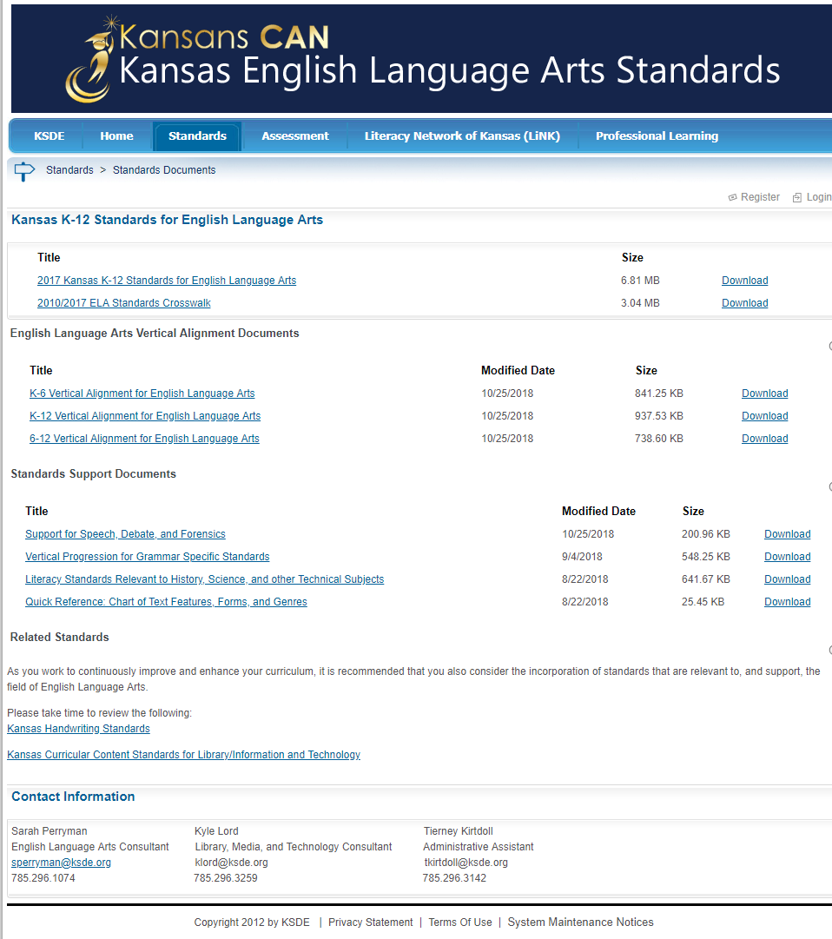
Standards Resources
2010/2017 Crosswalk (some errors)
Vertical Progression Documents
  Grammar Specific Document
Information Guide for Speech & Debate
Kansas Guide to Literacy
Best Practice Guide
Professional Learning PowerPoints
Elementary K-6 Pages
Assessment Resources for ELA
Notes:
Explore for 10-15 minutes before moving on to the first major activity (activity needs 45-55 minutes)

Slide 22
Agenda-
8:30-8:45 Greetings
8:45-8:55 Objectives
8:55-9:05 Warm Up
9:05-9:35 Introduction
9:35-11:00 Activity 1
11:00-11:15 Break
11:15-11:45 Deeper Dive
11:45-12:45 Lunch
12:45-1:30 Activity 2
1:30-1:45 Break
1:45-2:45 Activity 3
2:45-3:00 Break
3:00-3:15 Debrief
3:15-3:30 Closing
Notes:
This PD is meant to be 5.25 hours of content plus 1 hour for lunch and three 15 minute breaks.
YOU WILL NEED 7 HOURS TOTAL.

Slide 23
Activity 1

Slide 24
Part 1

Slide 25

Standards Examination- Leaps
What major leaps occur? When?
1- Divide into four work groups: RL, RI, W, & S/L
2- Examine the Vertical Progression for your Domain
3- Identify major leaps (Ex. RL1 gr 5 → gr 6 ‘quote’ to ‘cite’)
4- Create a list of ‘highlights’ that you will share with the whole group.
*Option- Complete this on Poster Paper
Notes:
10 mins to read through their section
10 mins to share within your group
5 mins for each group to share out their summary of ‘leaps’
25 MINUTES TOTAL

Slide 26
Part 2

Slide 27
Creating a Scope and Sequence
Divide into grade-level teams (or grade bands depending on the number of people).
Give each team copies of the Reading Literature Standards.
Using a whiteboard and post-it notes, have teachers sequence the standards.
  Which are ongoing?
  In what order will standards be mastered?
  What standards will act as supports for the ones being taught and assessed to mastery?
Then, go through and add Writing standards alongside followed by Speaking and Listening.
Compare the Scope and Sequences created across the teams.
Notes:
4 Groups (K-2, 3-5, 6-8, 9-12) Butcher paper with colored squares
20 mins to scope/sequence reading
15 to add in writing & speaking/listening
10 minute gallery walk jigsaw; notice trends
5 minutes debrief
50 MINUTES TOTAL

Slide 28
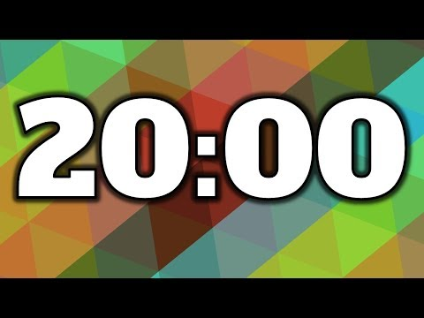
3. Sequence the RL Standards
Sequence the standards.
  Which are ongoing?
  In what order will standards be mastered?
  What standards will act as supports for the ones being taught and assessed to mastery?
You can use the standards as many times as is appropriate.
  However, you have to determine when they will be taught and assessed for mastery and when they are playing a supporting role.

Slide 29
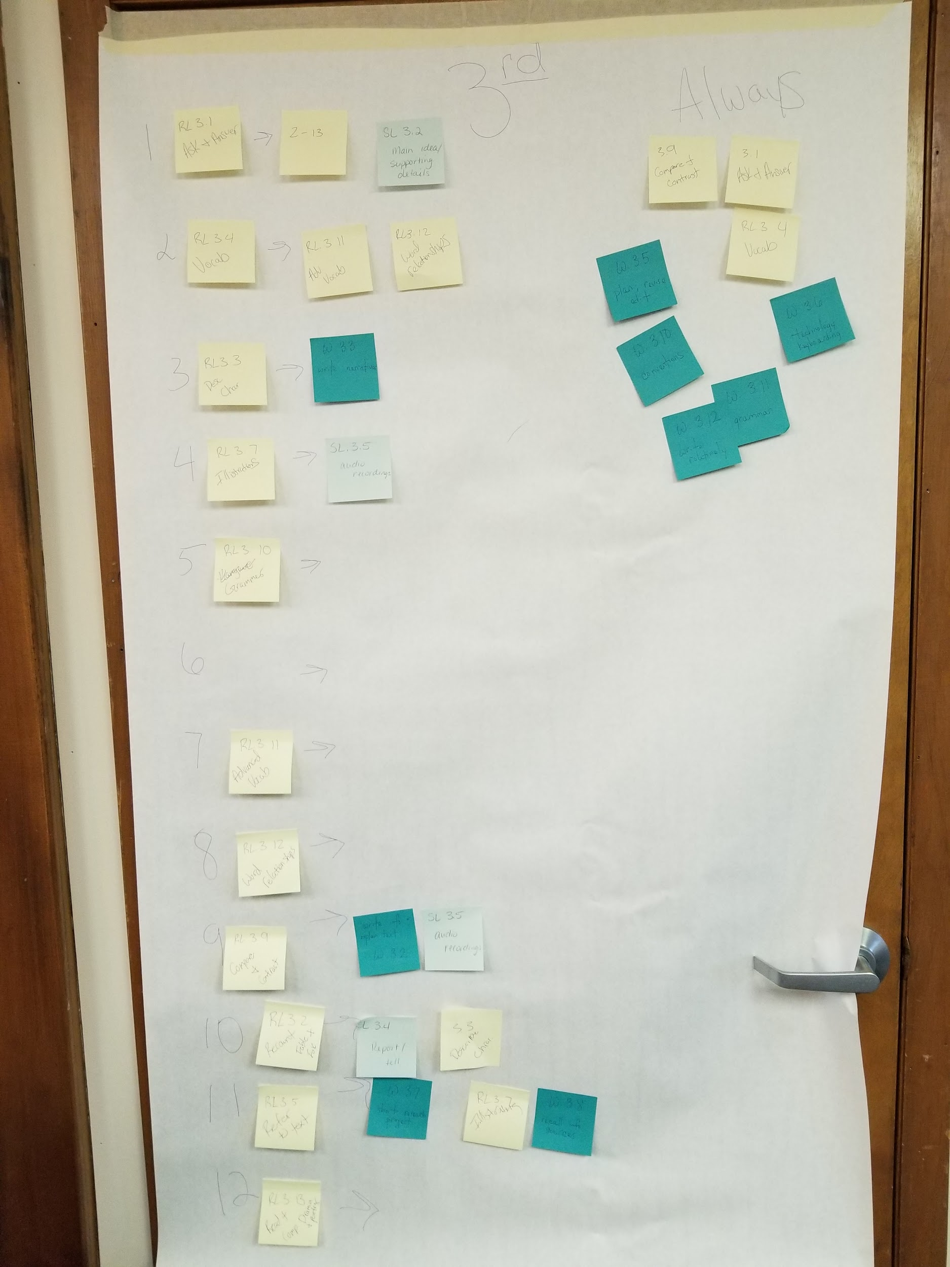
Sample
This was taken at a workshop in Council Grove, Kansas.
Here, the teachers used grade 3 standards. The yellow are their reading literature standards, and the blue and teal are their speaking/listening and writing standards respectively.
Each row reflects an instructional unit.
The standards grouped on the right would be taught throughout the year.

Slide 30

4. Add Writing and Speaking & Listening Standards
Now, take the writing standards and determine what type of writing would best assist you in assessing a student’s mastery of the reading literature standards and the content.
Try to assess W1-3 in a summative manner. Other writing standards can be formally assessed in summatives, but they can also be assessed throughout the process.
  W1-3 are product standards. (DOK 2 & 3- Critical Thinking)
  W4-1- are process standards. (DOK 1- Understanding)
Add Speaking/Listening standards. Where in the progression might students engage in presenting learning formally? How can you engage students in SL throughout?
  Where can you assess for mastery?
  How will they support instruction throughout? (Practice)

Slide 31
5. Compare Scope & Sequence
Jigsaw Gallery Walk-
Divide into mixed teams. (Jigsaw)
Conduct a Gallery Walk where your group will stop at each poster.
The person in your group who helped create the poster will explain it while the other group members take notes.
Note- Explore and Discover
  What points seem to “pop out”?
  What are the patterns, categories, and trends?
  What is surprising/unexpected?
  Are there other avenues to explore?
Notes:
2 minutes per stop + 30 second transition between posters
10 MINUTES TOTAL
Gallery Walk Protocol Resource- https://www.sps.org/site/handlers/filedownload.ashx?moduleinstanceid=3004&dataid=2754&FileName=Protocol%20for%20Examining%20Data.pdf

Slide 32
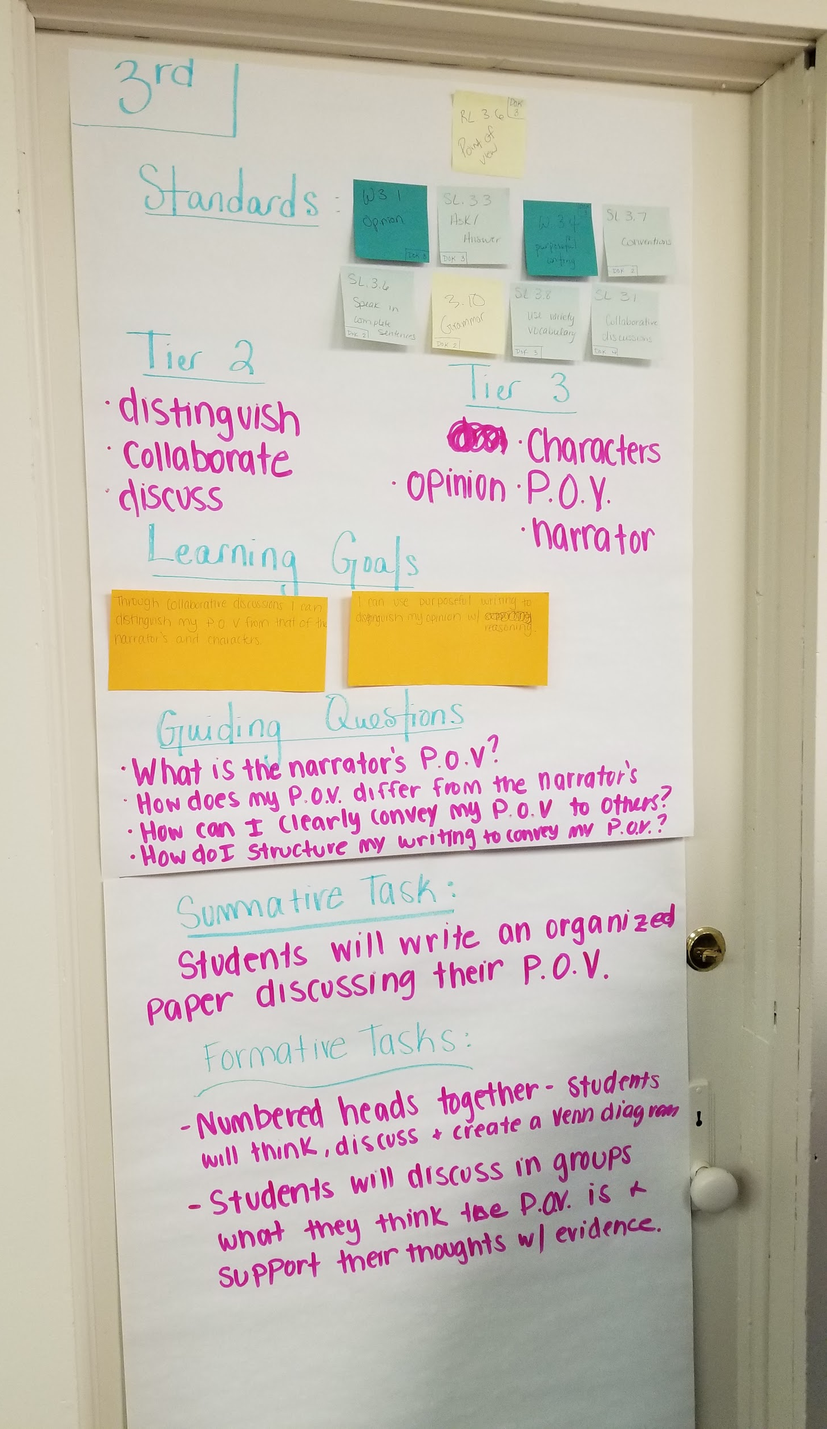
Sample
This was taken at a workshop in Council Grove, Kansas.
Here, the teachers finished their unit using the first row of their 3rd grade standards.
They also brought over some of their ‘ongoing’ standards.
This was their poster by the end of the day.

Slide 33

Debrief
What did you learn?
What did you notice?
What was in coherence?
What discrepancies existed?
What about this was helpful for you?
What do you think should happen next?
Notes:
5 MINUTES TOTAL

Slide 34

Break
15 Minutes

Slide 35
Agenda-
8:30-8:45 Greetings
8:45-8:55 Objectives
8:55-9:05 Warm Up
9:05-9:35 Introduction
9:35-11:00 Activity 1
11:00-11:15 Break
11:15-11:45 Deeper Dive
11:45-12:45 Lunch
12:45-1:30 Activity 2
1:30-1:45 Break
1:45-2:45 Activity 3
2:45-3:00 Break
3:00-3:15 Debrief
3:15-3:30 Closing
Notes:
This PD is meant to be 5.25 hours of content plus 1 hour for lunch and three 15 minute breaks.
YOU WILL NEED 7 HOURS TOTAL.

Slide 36
Deeper Dive
Notes:
60 minutes total for Deeper Dive

Slide 37
For this part, choose one ‘chunk’ of your standards that can function like a unit of study.
It should include RL, W, and SL standards.

Slide 38
Students at the Center (Kallick & Zmuda, 2017)
7 Key Elements of Student-Driven Practice
Goals
Inquiry/Idea Generation
Task and Audience
Evaluation
Cumulative Demonstration of Learning
Instructional Plan
Feedback
Notes:
Do these steps seem feasible for you? Which ones might you struggle with? How can you alleviate that struggle? (What help will you need to do that?)

Slide 39
Students at the Center
Goals- Subject-Specific and Cross-Disciplinary goals that align to your course standards
Goals can be about the product or the process.
    I can analyze how theme develops over the course of a text (RL2).
    I can compose a complete narrative (W3).
    SEL Standard- I can work collaboratively with my peers.
Notes:
Learn more about writing ‘Learning Targets’ here: http://www.ascd.org/publications/books/112002.aspx

Slide 40
Students at the Center
Inquiry/Idea Generation- Allowing students to use their voice, co-create, and discover their own learning related to the standards and material being covered
  In PBL, you create the Driving Question for the unit, and then, students’ inquiries drive the rest of the unit.
    However, teachers can usually anticipate these questions, and in doing so, they can plan out their project with time for content-specific instruction and formative assessments that will be used to facilitate students through completion of their project.
    You should also incorporate formal student reflection.
  You do not have to use PBL in order to use questions deeply in your classroom.
Notes:
Project Planner from PBL Works: https://my.pblworks.org/planner

Slide 41
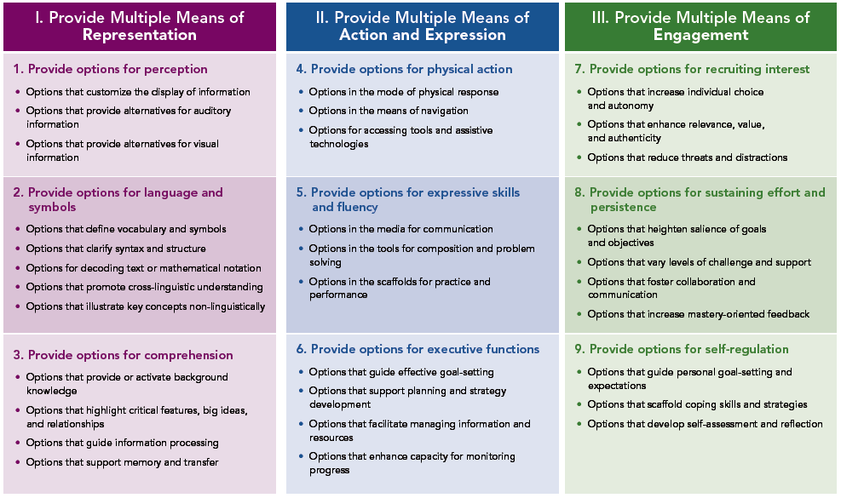
Students at the Center
Task and Audience- give students an opportunity to determine how they demonstrate their learning
  What MUST students learn? What COULD students choose to learn?
    Standards + Interest
  How can students demonstrating proficiency?
  With whom will they share their learning?
Notes:
This is the part of the curriculum writing process where we start moving from curriculum and into instruction. Your curriculum map does not have to incorporate instructional practice. When you get to part where you are ready to add in task expectations, you will want to consider your students. When you think about actually teaching this content, you will need to consider the elements of differentiation (UDL).

Slide 42
Students at the Center
Evaluation- have students self-assess before you assess them; allow student input on the rubric; incorporate Mastery Learning into your evaluation
  What is your current system of assessment?
    Pre-Test, Formatives, Interims, Summatives, Reflection
  Create Rubrics (built from your grade-level standards)
    Process- Teacher
    Product- Co-Create with Students
Notes:
Learn more by visiting our resources over Assessment from November: https://community.ksde.org/Default.aspx?tabid=6287

Slide 43
Students at the Center
Cumulative Demonstration of Learning- student grades reflect the growth of their learning across time and are not an average of total performance
  If your system of Curriculum, Instruction, and Assessment is derived from the standards, then anything you grade in class should be a reflection of mastery of the standards.
  Hybrid Grading (52): a combination of traditional and standards-based grading; you grade on a traditional scale, but all grades are determined using standards-based rubrics
    At the end of the semester, you can review the collection of evidence and make a final Grade Determination (SBG) instead of a Grade Calculation (AVG)
    “By allowing teachers to separate the determination of grades from the reporting of grades, the standards-based mindset encourages them to take a standards-based approach to evidence of learning and not definitively choose sides between traditional and standards-based reporting. Teachers can grade with a standards-based mindset even when the process of reporting hasn’t caught up; it simply changes how they determine single, traditional symbols,” (50).
Notes:
Learn more by visiting our resources over SBG from October: https://community.ksde.org/Default.aspx?tabid=6287

Slide 44
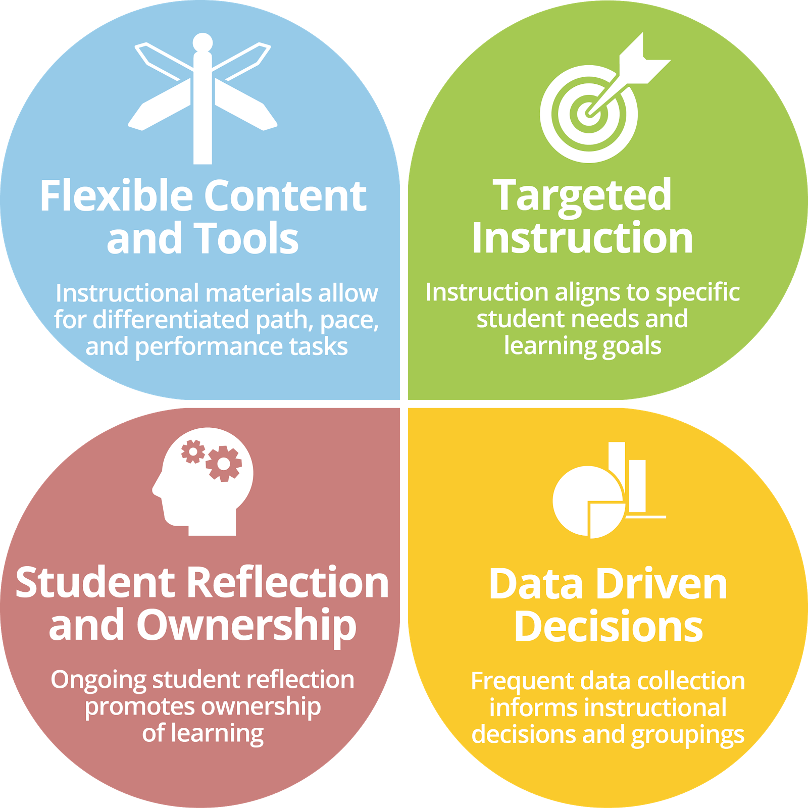
Students at the Center
Instructional Plan- work to give students a voice in when, what, and with whom they are learning
  Time, place, pace, and path
Notes:
Project Based Learning- Gold Standard Design https://my.pblworks.org/resource/document/gold_standard_pbl_essential_project_design_elements
Personalized Learning from Education Elements- https://www.edelements.com/hubfs/Core_Four/Education_Elements_Core_Four_White_Paper.pdf
Personalized Learning from Centers on Innovation in Learning- http://www.centeril.org/handbook/resources/fullchapter/Getting_Personal_SA.pdf

Slide 45
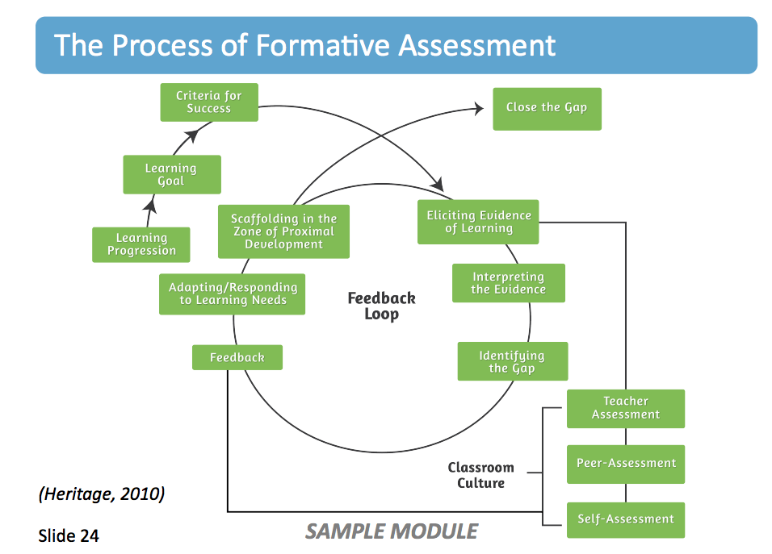
Students at the Center
Feedback- should be based on checkpoints where student and teacher work together to assess learning, gaps, and future steps
  What are your milestones?
  When will you assess process?
  When will you assess product?
  How/When will you provide time for critique, revision, and reflection?
Notes:
https://medium.com/stileeducation/the-power-of-formative-assessment-b14cbdc120a4

Slide 46
Students at the Center
7 Key Elements of Student-Driven Practice
Goals
Inquiry/Idea Generation
Task and Audience
Evaluation
Cumulative Demonstration of Learning
Instructional Plan
Feedback
Notes:
Do these steps seem feasible for you? Which ones might you struggle with? How can you alleviate that struggle? (What help will you need to do that?)

Slide 47
Agenda-
8:30-8:45 Greetings
8:45-8:55 Objectives
8:55-9:05 Warm Up
9:05-9:35 Introduction
9:35-11:00 Activity 1
11:00-11:15 Break
11:15-11:45 Deeper Dive
11:45-12:45 Lunch
12:45-1:30 Activity 2
1:30-1:45 Break
1:45-2:45 Activity 3
2:45-3:00 Break
3:00-3:15 Debrief
3:15-3:30 Closing
Notes:
This PD is meant to be 5.25 hours of content plus 1 hour for lunch and three 15 minute breaks.
YOU WILL NEED 7 HOURS TOTAL.

Slide 48

Lunch
1 Hour

Slide 49
Activity 2

Slide 50
Students at the Center
7 Key Elements of Student-Driven Practice
Goals
Inquiry/Idea Generation
Task and Audience
Evaluation
Cumulative Demonstration of Learning
Instructional Plan
Feedback
Notes:
We will now work through each key element of the ‘Student Driven Practices’ Protocol.

Slide 51
Students at the Center
Goals- Subject-Specific and Cross-Disciplinary goals that align to your course standards
Goals can be about the product or the process.
    I can analyze how theme develops over the course of a text (RL2).
    I can compose a complete narrative (W3).
    SEL Standard- I can work collaboratively with my peers.
Notes:
Learn more about writing ‘Learning Targets’ here: http://www.ascd.org/publications/books/112002.aspx

Slide 52
How do I derive my instruction from the standards?
“Standards give us a range of objectives and issues to consider, but they don’t easily translate into what we should do in our classrooms.” -Jim Burke
Standards tell us what students should KNOW and be able to DO.
To derive our instruction, we must identify the vocabulary and rigor inherent in the students.

Slide 53
Determine Tier 2 & 3
Vocabulary
Tier 1 = everyday words (basic interpersonal communication)
Tier 2 = words that are used in an academic context; words that are used in multiple topic and subject areas (cognitive academic language)
Tier 3 = words that are specific to a content area or area of study (cognitive academic language)
Notes:
https://community.ksde.org/LinkClick.aspx?fileticket=9rdfVmFYUzY%3d&tabid=5559&mid=15602
http://www.education.vic.gov.au/Documents/school/teachers/teachingresources/discipline/english/literacy/litfocusvocabchoose.docx

Slide 54
Determining Vocabulary (Example)
RL 2 (Grade 8)
Determine a theme or central idea of a text and analyze its development over the course of the text, including its relationship to the characters, setting, and plot; provide an objective summary of the text.
Tier 2 = determine, provide, analyze, development, objective, summary
Tier 3 = theme, central idea, development, summary

Slide 55
Brainstorm
If we have our instructional standards, and from those we have determined our vocabulary, how might I write my goal?
EXAMPLE- RL 2 (Grade 8) Determine a theme or central idea of a text and analyze its development over the course of the text, including its relationship to the characters, setting, and plot; provide an objective summary of the text.
Tier 2 = determine, provide, analyze, development, objective, summary
Tier 3 = theme, central idea, development, summary
GOAL EXAMPLE- I can determine the central idea and analyze its development.

Slide 56
Students at the Center
7 Key Elements of Student-Driven Practice
Goals
Inquiry/Idea Generation
Task and Audience
Evaluation
Cumulative Demonstration of Learning
Instructional Plan
Feedback
Notes:
(Kallick & Zmuda, 2017)

Slide 57
Students at the Center
7 Key Elements of Student-Driven Practice
Goals
Inquiry/Idea Generation
Task and Audience
Evaluation
Cumulative Demonstration of Learning
Instructional Plan
Feedback
Notes:
(Kallick & Zmuda, 2017)

Slide 58
Students at the Center
Inquiry/Idea Generation- Allowing students to use their voice, co-create, and discover their own learning related to the standards and material being covered
  In PBL, you create the Driving Question for the unit, and then, students’ inquiries drive the rest of the unit.
    However, teachers can usually anticipate these questions, and in doing so, they can plan out their project with time for content-specific instruction and formative assessments that will be used to facilitate students through completion of their project.
    You should also incorporate formal student reflection.
  You do not have to use PBL in order to use questions deeply in your classroom.
Notes:
Project Planner from PBL Works: https://my.pblworks.org/planner

Slide 59
“Improving the Instructional Core”
“There are only three ways to improve student learning at scale: You can raise the level of the content that students are taught. You can increase the skill and knowledge that teachers bring to the teaching of that content. And you can increase the level of students’ active learning of the content…
Standards only operate by influencing the level of content that’s being taught; their effect in actual classrooms depends on whether there are materials that reflect the standards, whether teachers know how to teach what the materials and standards require, and whether students find the work that they are being asked to do worthwhile and engaging.”
Elmore, 2008

Slide 60
Types of Questions
Essential Questions
  Overarching
  Topical
Guiding Questions
Leading Questions
Questions that Hook
Notes:
Learn more here: http://www.ascd.org/publications/books/109004/chapters/What-Makes-a-Question-Essential%A2.aspx

Slide 61
What makes an Essential Question?
1. Is open-ended; that is, it typically will not have a single,final, and correct answer.
2. Is thought-provoking and intellectually engaging, often sparking discussion and debate.
3. Calls for higher-order thinking, such as analysis, inference, evaluation, prediction. It cannot be effectively answered by recall alone.
4. Points toward important, transferable ideas within (and sometimes across) disciplines.
5. Raises additional questions and sparks further inquiry.
6. Requires support and justification, not just an answer.
7. Recurs over time; that is, the question can and should be revisited again and again.
Notes:
Wiggins and McTighe (Essential Questions, 2013)
EX: How can writing achieve various purposes?

Slide 62
What are Guiding Questions?
Questions that guide are broader, but are not truly open-ended or designed to cause in-depth inquiry like Essential Question.
These help teachers plan for the achievement of specific content outcomes.
Each of these questions is steering the student toward previously targeted knowledge and skill—to arrive at a definite answer.
  Yet the answer requires some inference, not simply recall.
  Ex. How might we write an argumentative essay?

Slide 63
Comparison
Essential Questions
Guided Questions
Asked to stimulate ongoing thinking and inquiry
Raise more questions
Spark discussion and debate
Asked and re-asked throughout the unit (and maybe the year)
Demand justification and support
"Answers" may change as understanding deepens
Asked to encourage and guide exploration of a topic
Point toward desired knowledge and skill (but not necessarily to a single answer)
May be asked over time (e.g., throughout a unit)
Generally require some explanation and support

Slide 64
Other Types of Questions
Leading Questions
Questions that Hook
Asked to be answered
Have a "correct" answer
Support recall and information finding
Asked once (or until the answer is given)
Require no (or minimal) support
Asked to interest learners around a new topic
May spark curiosity, questions, or debate
Often framed in engaging "kid language"
Asked once or twice, but not revisited

Slide 65
Adding Guiding Questions
Since we are not sure on themes or content, we can not start with our essential questions. These will need to be generated once resources are known.
However, we can go through and add in our guiding questions.
What are the learning outcomes? What questions will students be able to answer by the end of the unit covering your selected standards?
For example, if I had RL 2 (theme), RL 3 (character development), and W2 (informational writing) in one unit, I could ask the following:
  How do you determine a story’s theme? How do themes develop throughout the course of a story?
  How do characters grow and change throughout a story?
  How do you write a literature analysis?

Slide 66
Brainstorm
Start your Poster- What might students have to do in order to adequately demonstrate mastery of your standards by interacting with your guiding questions?
Example-
RL 2- Determine a story’s theme.
Know- Theme, Development, Relationship, Characters, Setting, Plot,
Summary
Do- Determine, Analyze, Provide
Goal- I can determine the central idea and analyze its development.
Guiding Question- How does theme develop throughout a story?

Slide 67
Students at the Center
7 Key Elements of Student-Driven Practice
Goals
Inquiry/Idea Generation
Task and Audience
Evaluation
Cumulative Demonstration of Learning
Instructional Plan
Feedback
Notes:
(Kallick & Zmuda, 2017)

Slide 68
Break
15 Minutes

Slide 69
Agenda-
8:30-8:45 Greetings
8:45-8:55 Objectives
8:55-9:05 Warm Up
9:05-9:35 Introduction
9:35-11:00 Activity 1
11:00-11:15 Break
11:15-11:45 Deeper Dive
11:45-12:45 Lunch
12:45-1:30 Activity 2
1:30-1:45 Break
1:45-2:45 Activity 3
2:45-3:00 Break
3:00-3:15 Debrief
3:15-3:30 Closing
Notes:
This PD is meant to be 5.25 hours of content plus 1 hour for lunch and three 15 minute breaks.
YOU WILL NEED 7 HOURS TOTAL.

Slide 70
Activity 3

Slide 71
Students at the Center
7 Key Elements of Student-Driven Practice
Goals
Inquiry/Idea Generation
Task and Audience
Evaluation
Cumulative Demonstration of Learning
Instructional Plan
Feedback
Notes:
(Kallick & Zmuda, 2017)

Slide 72
Students at the Center
Task and Audience- give students an opportunity to determine how they demonstrate their learning
  What MUST students learn? What COULD students choose to learn?
    Standards + Interest
  How can students demonstrating proficiency?
  With whom will they share their learning?
Notes:
This is the part of the curriculum writing process where we start moving from curriculum and into instruction. Your curriculum map does not have to incorporate instructional practice. When you get to part where you are ready to add in task expectations, you will want to consider your students. When you think about actually teaching this content, you will need to consider the elements of differentiation (UDL).

Slide 73
DOK: Quick Facts
Depth of Knowledge Levels:
  1- Recall and Reproduction
  2- Skills and Concepts
  3- Short-term Strategic Thinking
  4- Extended Thinking
The level of DOK is determined by the cognitive demand placed on the student in the learning environment. You must consider:
  The complexity of the task (mental processes needed to satisfy the requirements)
  Prior knowledge
  The ‘verb’ and ‘noun’ of the standard taught and assessed
Students DO NOT have to master one level before moving on to the next. They are not sequential!

Slide 74
Depth of Knowledge should be thought of as a ‘ceiling’ and not a ‘target’.
Thus, when you prepare your lessons, you should be thinking about the maximum depth a student will go to in their thinking. Where are you stopping?
Assessments occur up to and at the ‘ceiling’, but they are not limited to the ceiling, whereas a target would be limited.

Slide 75
DOK & Cognitive Rigor
Erik Francis defines Cognitive Rigor as “the extent to which students are challenged to demonstrate higher-order thinking and communicate depth of knowledge” (2016).
How do DOK and Cognitive Rigor work together?
  “Students still need to acquire and apply knowledge accurately. However, they must also be able to analyze and articulate knowledge authentically through critical thinking and problem solving, collaboration and communication, and creativity and innovation” (Francis, 2016)
    These can not happen unless we provide that level of opportunity for learning in our classrooms. We do this by raising the DOK ceiling.

Slide 76
Evaluating DOK:
While Bloom’s Taxonomy centers around the ‘verb’ within a standard, DOK looks at the verb and the complexity of learning task and content (the noun).
Example: RL.8.2
Determine a theme or central idea of a text and analyze its development over the course of the text, including its relationship to the characters, setting, and plot; provide an objective summary of the text.
  Key Verbs- Determine, Analyze, Provide
  Key Understandings- Theme, Development, Relationship, Characters, Setting, Plot, Summary

Slide 77
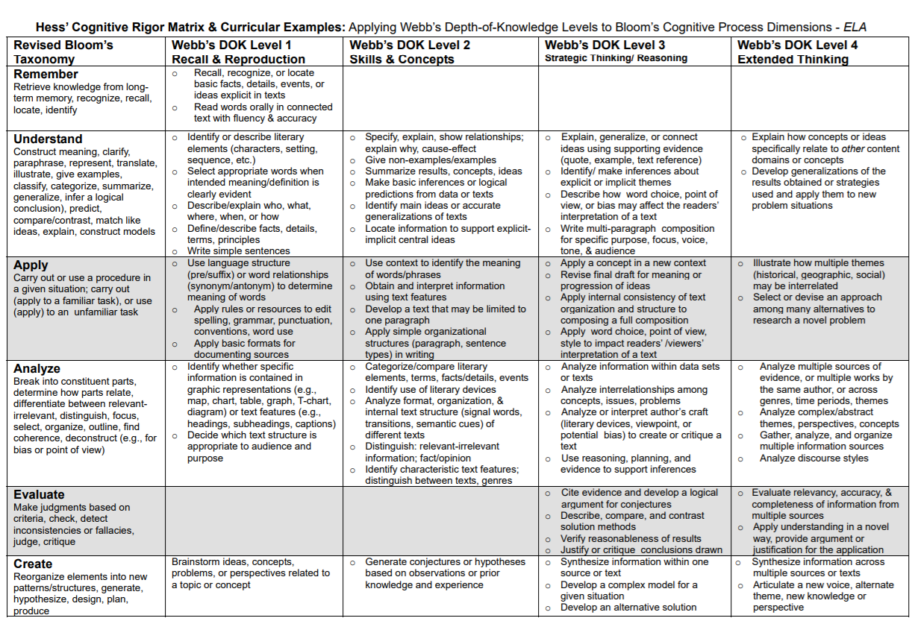
Karen Hess Matrix
Determine a theme or central idea of a text and analyze its development over the course of the text, including its relationship to the characters, setting, and plot; provide an objective summary of the text.

Slide 78
DOK Analysis
RL.8.2- Determine a theme or central idea of a text and analyze its development over the course of the text, including its relationship to the characters, setting, and plot; provide an objective summary of the text.
In order for a student to successfully work with this standard, they must work toward DOK 3. Thus, your context for learning should be set up so that students are working toward strategic thinking and reasoning.
  Every class activity should be pushing students toward that DOK 3 ‘ceiling’.
  Activities can build from one level to the next, but every activity should be building toward DOK 3.

Slide 79
Adding in Tasks
▪ELA Foundational Practices
1.Write, speak, read, and listen appropriately in all disciplines.
2.Seek out and work to understand diverse perspectives.
3.Use knowledge gained from literacy experiences to solve problems.
4.Create multimodal versions of texts for a range of purposes and audiences.
5.Self-regulate and monitor growth in writing, speaking, reading, and listening.

Slide 80
Brainstorm
What might students have to do in order to adequately demonstrate mastery of your standards by interacting with your guiding questions?
Example-
RL 2- Determine a story’s theme.
Know- Theme, Development, Relationship, Characters, Setting, Plot, Summary
Do- Determine, Analyze, Provide
Goal- I can determine the central idea and analyze its development.
GQ- How does theme develop throughout a story?
Task (Summative)- Students will write a literary analysis and then turn it into a video with commentary and scene analysis.
Task (Formative)- Students will write analysis paragraphs. Students will watch and review commentaries of text/film for guidance.
Notes:
Complete this on Poster Paper
WITH TASKS- Under your SUMMATIVE TASK, think about what formative tasks (or ‘project milestones’) students will complete on their way to completing the summative task successfully.

Slide 81
Students at the Center
7 Key Elements of Student-Driven Practice
Goals
Inquiry/Idea Generation
Task and Audience
Evaluation
Cumulative Demonstration of Learning
Instructional Plan
Feedback
Notes:
(Kallick & Zmuda, 2017)

Slide 82
Break
15 Minutes

Slide 83
Agenda-
8:30-8:45 Greetings
8:45-8:55 Objectives
8:55-9:05 Warm Up
9:05-9:35 Introduction
9:35-11:00 Activity 1
11:00-11:15 Break
11:15-11:45 Deeper Dive
11:45-12:45 Lunch
12:45-1:30 Activity 2
1:30-1:45 Break
1:45-2:45 Activity 3
2:45-3:00 Break
3:00-3:15 Debrief
3:15-3:30 Closing
Notes:
This PD is meant to be 5.25 hours of content plus 1 hour for lunch and three 15 minute breaks.
YOU WILL NEED 7 HOURS TOTAL.

Slide 84
Debrief

Slide 85
Debrief
Gallery Walk-
Explore and Discover
  What points seem to “pop out”?
  What are the patterns, categories, and trends?
  What is surprising/unexpected?
  Are there other avenues to explore?
Interpret & Analyze
  What conclusions might we draw from the results of our work today?
  What additional resources might we explore to complete our work?

Slide 86
Debrief
Reflection
What did you learn from listening to your colleagues that was interesting or surprising? What can you make use of in your classroom?
What questions about teaching and professional learning do you have after going through this process?
Are there things you would like to try in your classroom?
How well did the workshop protocols work?
What about the process helped you to see and learn interesting or surprising things?
What could be improved about this process?

Slide 87
Students at the Center
7 Key Elements of Student-Driven Practice
Goals
Inquiry/Idea Generation
Task and Audience
Evaluation
Cumulative Demonstration of Learning
Instructional Plan
Feedback
Notes:
(Kallick & Zmuda, 2017)

Slide 88
Next Steps: For Curriculum
Go through your unit ‘chunks’ that you created from the scope and sequence.
Go through and add in RI standards. You might also want to make revisions after the end of this workshop.
Once your scope and sequence is refined, go through your identified units and add in Guiding Questions, a DOK Analysis, and a Task Recommendation.

Slide 89
Next Steps: For Curriculum
Now that you have identified your standards, guiding questions, and learning targets, you are ready to flesh out the rest of your curriculum map.
Now, you can add the following:
  Thematic Essential Questions
  Resource Suggestions/Requirements
  Common Formative Assessments
  Recommended Pacing

Slide 90
Students at the Center
7 Key Elements of Student-Driven Practice
Goals
Inquiry/Idea Generation
Task and Audience
Evaluation
Cumulative Demonstration of Learning
Instructional Plan
Feedback
Notes:
(Kallick & Zmuda, 2017)

Slide 91
Students at the Center
Evaluation- have students self-assess before you assess them; allow student input on the rubric; incorporate Mastery Learning into your evaluation
  What is your current system of assessment?
    Pre-Test, Formatives, Interims, Summatives, Reflection
  Create Rubrics (built from your grade-level standards)
    Process- Co-Create with Students
    Product- Teacher
Notes:
Learn more by visiting our resources over Assessment from November: https://community.ksde.org/Default.aspx?tabid=6287

Slide 92
Students at the Center
Cumulative Demonstration of Learning- student grades reflect the growth of their learning across time and are not an average of total performance
  If your system of Curriculum, Instruction, and Assessment is derived from the standards, then anything you grade in class should be a reflection of mastery of the standards.
  Hybrid Grading (52): a combination of traditional and standards-based grading; you grade on a traditional scale, but all grades are determined using standards-based rubrics
    At the end of the semester, you can review the collection of evidence and make a final Grade Determination (SBG) instead of a Grade Calculation (AVG)
    “By allowing teachers to separate the determination of grades from the reporting of grades, the standards-based mindset encourages them to take a standards-based approach to evidence of learning and not definitively choose sides between traditional and standards-based reporting. Teachers can grade with a standards-based mindset even when the process of reporting hasn’t caught up; it simply changes how they determine single, traditional symbols,” (50).
Notes:
Learn more by visiting our resources over SBG from October: https://community.ksde.org/Default.aspx?tabid=6287

Slide 93
Students at the Center
Instructional Plan- work to give students a voice in when, what, and with whom they are learning
  Time, place, pace, and path
Notes:
Project Based Learning- Gold Standard Design https://my.pblworks.org/resource/document/gold_standard_pbl_essential_project_design_elements
Personalized Learning from Education Elements- https://www.edelements.com/hubfs/Core_Four/Education_Elements_Core_Four_White_Paper.pdf
Personalized Learning from Centers on Innovation in Learning- http://www.centeril.org/handbook/resources/fullchapter/Getting_Personal_SA.pdf

Slide 94
Students at the Center
Feedback- should be based on checkpoints where student and teacher work together to assess learning, gaps, and future steps
  What are your milestones?
  When will you assess process?
  When will you assess product?
  How/When will you provide time for critique, revision, and reflection?
Notes:
https://medium.com/stileeducation/the-power-of-formative-assessment-b14cbdc120a4

Slide 95
Next Steps: For Instruction & Assessment
Evaluation- create standards-based rubrics for assessing proficiency
Cumulative Demonstration of Learning- create ideas for what your authentic summative project/tangible will be
Instructional Plan- plan how students will go about demonstrating proficiency; what will need to be taught, learned independently, and assessed (and how often)
Feedback- how will you provide time for reflection, critique (meaningful feedback), and revision; what will it look like?
Notes:
(Kallick & Zmuda, 2017)

Slide 96
Resources for Moving Forward
Resource Review & Adoption
PBL Approach- Plan Your Project
  Design Rubric
Larry Ainsworth- Rigorous Curriculum Design
Learn about being Brain Friendly
Learn about Text Complexity
Read about the 5 Musts for Mastery
Personalization, Differentiation, & Individualization

Slide 97
Agenda-
8:30-8:45 Greetings
8:45-8:55 Objectives
8:55-9:05 Warm Up
9:05-9:35 Introduction
9:35-11:00 Activity 1
11:00-11:15 Break
11:15-11:45 Deeper Dive
11:45-12:45 Lunch
12:45-1:30 Activity 2
1:30-1:45 Break
1:45-2:45 Activity 3
2:45-3:00 Break
3:00-3:15 Debrief
3:15-3:30 Closing
Notes:
This PD is meant to be 5.25 hours of content plus 1 hour for lunch and three 15 minute breaks.
YOU WILL NEED 7 HOURS TOTAL.

Slide 98
Resources

Slide 99
Resources
See Enhancing Professional Practice: A framework for teaching (Danielson, 1996)
See Basic Principles of Curriculum and Instruction (Tyler, 1969)
See Essential Questions: Opening Doors to Student Understanding (McTighe and Wiggins, 2013)
See Align the Design (Mooney & Mausbach, 2008)
See Playbook for Redesigning Schools for the 21st Century (Cross and Martinez, 2016)
See How to Make Decisions with Different Kinds of Student Assessment Data (Brookhart, 2015)
See Teaching Literacy in the Visible Learning Classroom (Fisher, Frey, Hattie, and Thayer, 2017)
See Learning Targets (Moss & Brookhart, 2012)
See Using the Formative Assessment Rubrics, Reflection and Observation Tools to Support Professional Reflection and Practice (Wylie & Lyon, 2016)
See “Rigorous Curriculum Design: A Four-Part Overview” (Ainsworth, 2011)
See “Cognitive Rigor: Blending Strengths of Bloom’s Taxonomy and Webb’s Depth of Knowledge to Enhance Classroom-level Processes” (Hess, Jones, Carlock, and Walkup, 2009)
See- Hale, S., Dunn, L., Filby, N, Rice, J., & Van Houten, L. (2017). Evidence-based improvement: A guide for states to strengthen their frameworks and supports aligned to the evidence requirements of ESSA. San Francisco: WestEd
See Mapping the Big Picture (Hayes-Jacobs, 1997)
See Getting Results with Curriculum Mapping (Hayes-Jacobs, 2004)
See “Transformational Leadership Framework” (New Leaders, Inc, 2016)

Slide 100
Sarah Perryman, Redesign Coordinator
Kansas State Department of Education
900 SW Jackson St.
Suite 653
785-296-1074
sperryman@ksde.org
The Kansas State Department of Education does not discriminate on the basis of race, color, national origin, sex, disability, or age in its programs and activities and provides equal access to the Boy Scouts and other designated youth groups. The following person has been designated to handle inquiries regarding the nondiscrimination policies: KSDE General Counsel, Office of General Counsel, KSDE, Landon State Office Building, 900 S.W. Jackson, Suite 102, Topeka, KS 66612, (785) 296-3204

Slide 101
Joann McRell, English Language Arts Consultant
Kansas State Department of Education
900 SW Jackson St.
Suite 653
785-296-2144
jmcrell@ksde.org
The Kansas State Department of Education does not discriminate on the basis of race, color, national origin, sex, disability, or age in its programs and activities and provides equal access to the Boy Scouts and other designated youth groups. The following person has been designated to handle inquiries regarding the nondiscrimination policies: KSDE General Counsel, Office of General Counsel, KSDE, Landon State Office Building, 900 S.W. Jackson, Suite 102, Topeka, KS 66612, (785) 296-3204

