Slide 1
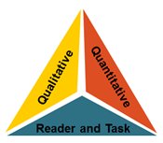

KCCS Text Complexity Team mcopeland@ksde.org
Text Complexity and the
Kansas Common Core Standards

Slide 2
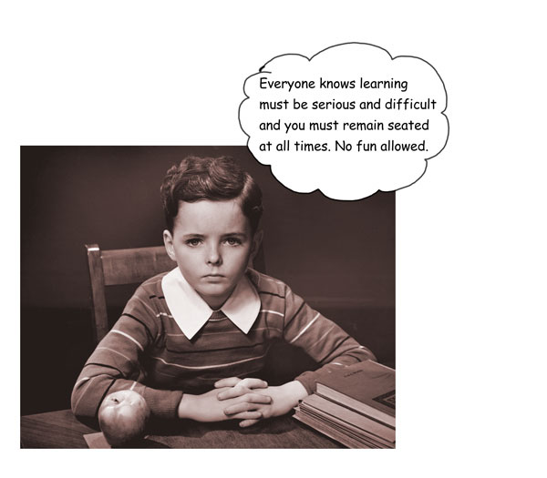
Notes:
Group Norms

Slide 3
Agreements
We will…
  Assume Responsibility
  Seek information
  Participate actively
  Integrate information
  Respond and act
  Exchange ideas

Slide 4
Outcomes
Understand reading standard #10.
Understand the CCSS text complexity model.
Practice using the quantitative measures tools.
Practice using the qualitative rubrics for both literary and informational texts.
Analyze reader and task considerations and scaffolding possibilities for texts.
Practice generating a final recommendation form (i.e., the “placemat”).

Slide 5

Materials
Electronic copies of all of today’s materials, including the handouts and PowerPoint, are available at the following URL:
www.ksde.org/Default.aspx?tabid=4778#TextRes

Slide 6
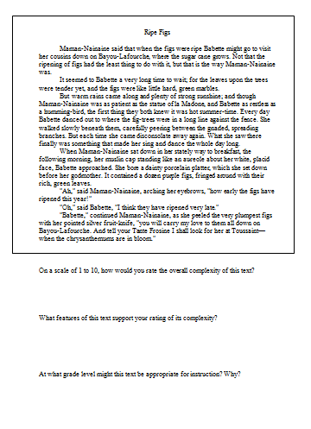
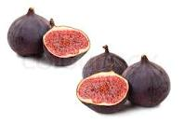
Activity #1
Ripe Figs
As a small group, read “Ripe Figs” and answer the three questions provided at the bottom of the page…
Notes:
“Ripe Figs” – Kate Chopin – 286 words – Lexile 1030 – upper end of Grade 6-8 band

Slide 7
Discussion
On a scale of 1 to 10, how would you rate the overall complexity of this text?
What features of this text support your rating of its complexity?
At what grade level might this text be appropriate for instruction? Why?

Slide 8

Video Overview of Text Complexity
Notes:
http://www.youtube.com/watch?v=Q0uZwDP6cGo&feature=related

Slide 9
Text Complexity – Why Is This Important?
Complexity of texts students are expected to read is below what is required to achieve college and career readiness:
  High school textbooks have declined in all subject areas over the last several decades
  Average length of sentences in K-8 textbooks has declined from 20 to 14 words
  Vocabulary demands have declined since the 1960s:
    8th grade textbooks = former 5th grade texts
    12th grade anthologies = former 7th grade texts
Complexity of college and career texts has remained steady or increased, resulting in a gap

Slide 10
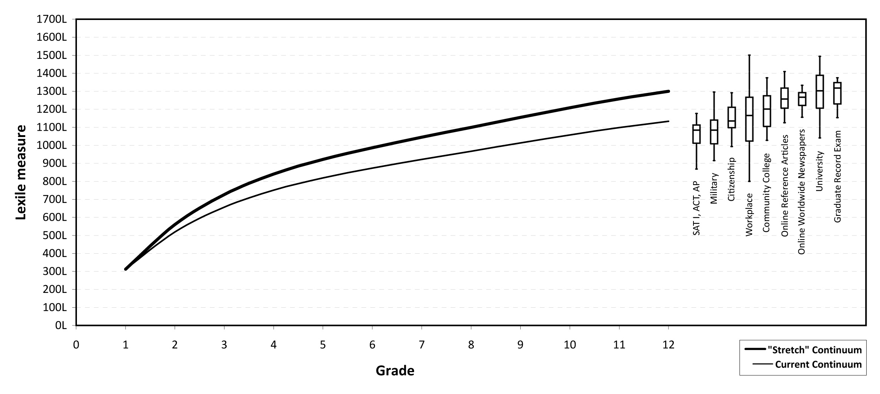
Text Complexity Gap

Slide 11
Why Should We Worry about This Gap?
Too many students are reading at too low a level (<50% of high school graduates can read sufficiently complex texts)
The complexity of what students can read and comprehend is the single greatest predictor of success in college (ACT study)
  Question type (main idea, word meanings, details) is NOT the chief differentiator
  Question level (higher order vs. lower order; literal vs. inferential) is NOT the chief differentiator either

Slide 12

Why Should We Worry about This Gap?

Slide 13
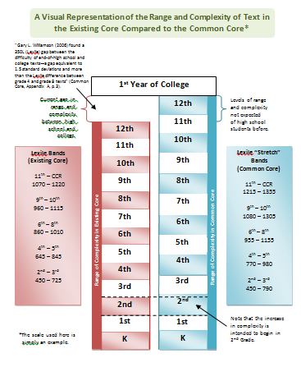
How Do We Address This Gap?

Slide 14
How Should Instruction Address Text Complexity?
RA! RA! RA! Reading!
Read Aloud
Modeling of decoding and fluency
Heavy scaffolding for vocabulary and comprehension
Read Along
Some scaffolding, as needed, for decoding, fluency, vocabulary, and comprehension
Read Alone
Independent, autonomous reading
Little to no scaffolding
Student Autonomy
Teacher Scaffolding
Gradual Release of Responsibility (I do, we do, you do)…

Slide 15

Text Complexity
“The Common Core Standards hinge on students encountering appropriately complex texts at each grade level in order to develop the mature language skills and the conceptual knowledge they need for success in school and life” (p. 3).

Slide 16
Areas of Emphasis for Instruction
Building knowledge through a balance of literary and informational texts.
Reading, writing, and discussion grounded in evidence from text, both literary and informational.
Regular practice (“productive struggle”) with complex text and its academic vocabulary.

Slide 17
Text Complexity
Specifically, reading standard #10:
Anchor Standard:
R.CCR.10 Read and comprehend complex literary and informational texts independently and proficiently.
Example Grade-level Standard (6th grade):
RI.6.10 By the end of the year, read and comprehend literary nonfiction in the grades 6-8 text complexity band proficiently, with scaffolding as needed at the high end of the range.
Notes:
Allow small groups to interpret and report out on their understandings of each of these two standard statements.

Slide 18
Activity #2: Discussion!
With an elbow partner, interpret these two standard statements:
  What does this mean to you?
  How does this affect our instruction and student learning?
Be prepared to share your thoughts…

Slide 19
Guiding Questions
So…
What do the Common Core State Standards mean by text complexity?
What is a text complexity band?
and
How do we ensure the texts our students are reading are in the appropriate text complexity band?
Notes:
This presentation seeks to answer these questions.

Slide 20
Overview of Text Complexity
CCSS Text Complexity Model
  Text complexity is defined by:
Quantitative measures – readability and other scores of text complexity often best measured by computer software.
Qualitative measures – levels of meaning, structure, language conventionality and clarity, and knowledge demands often best measured by an attentive human reader.
Qualitative
Quantitative
Reader and Task considerations – background knowledge of reader, motivation, interests, and complexity generated by tasks assigned often best made by educators employing their professional judgment.
Reader and Task

Slide 21
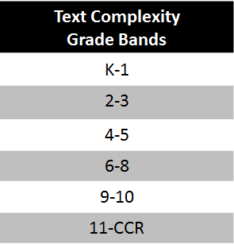
CCSS Text Complexity Model

Slide 22

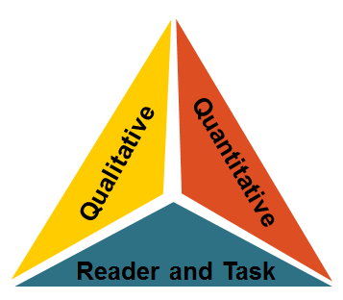
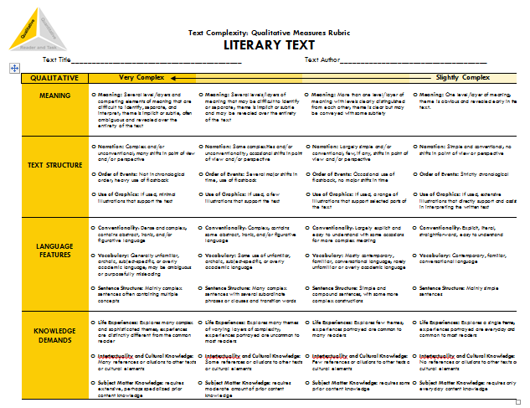
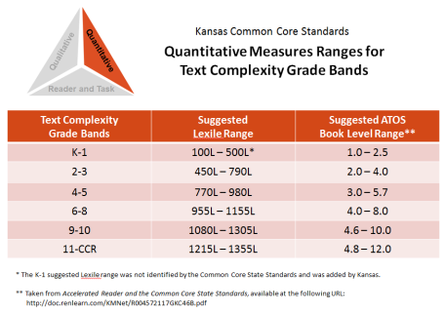
Where Do We Find Texts in the
Appropriate Text Complexity Band?
We could….
Choose an excerpt of text from Appendix B:
Use available resources to determine the text complexity of other materials on our own.
or…
Notes:
(Even choosing excerpts from Appendix B is less effective because it removes the reader and task considerations from the equation.)

Slide 23
Determining Text Complexity
A Four-step Process:
Determine the quantitative measures of the text.
Analyze the qualitative measures of the text.
Reflect upon the reader and task considerations.
Recommend placement in the appropriate text complexity band.
Notes:
Overview of the protocol

Slide 24
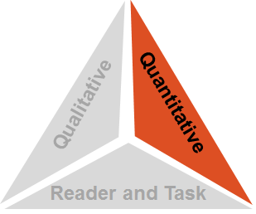
Step 1: Quantitative Measures
Measures such as:
  Word length
  Word frequency
  Word difficulty
  Sentence length
  Text length
  Text cohesion

Slide 25
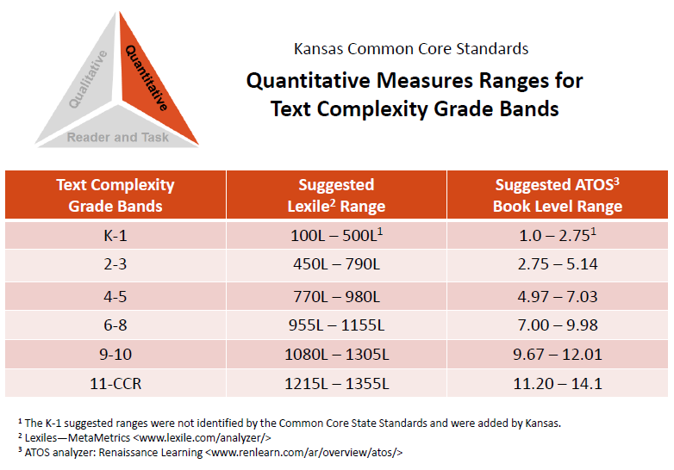


Step 1: Quantitative Measures
The Quantitative Measures Ranges for Text Complexity:
This document outlines the suggested ranges for each of the text complexity bands using:
Lexile Text Measures
---or---
ATOS Book Levels (Accelerated Reader)

Slide 26
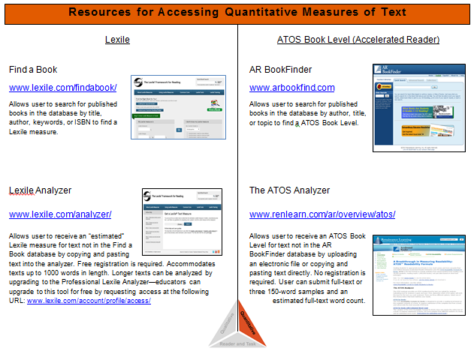
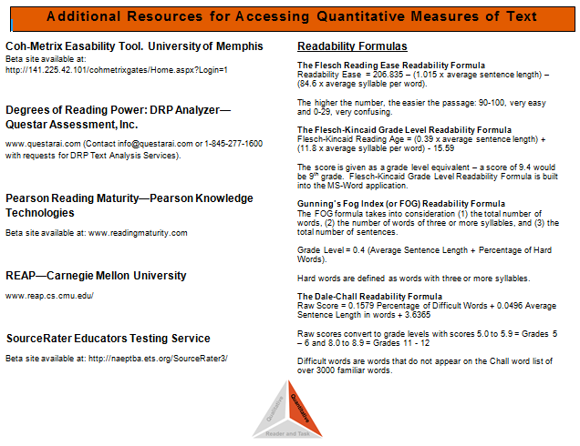
Step 1: Quantitative Measures
Resources for Accessing
Quantitative Measures of Text
Quick handout documenting the availability of resources. Including:
  Lexile
  ATOS book level
  Additional measures
  Readability formulas

Slide 27

Step 1: Quantitative Measures
Let’s imagine we want to see where a text falls on the quantitative measures “leg” of the text complexity triangle, using either the Lexile text measure or the ATOS book level (or both).
For illustrative purposes, let’s choose Harper Lee’s 1960 novel To Kill a Mockingbird.

Slide 28
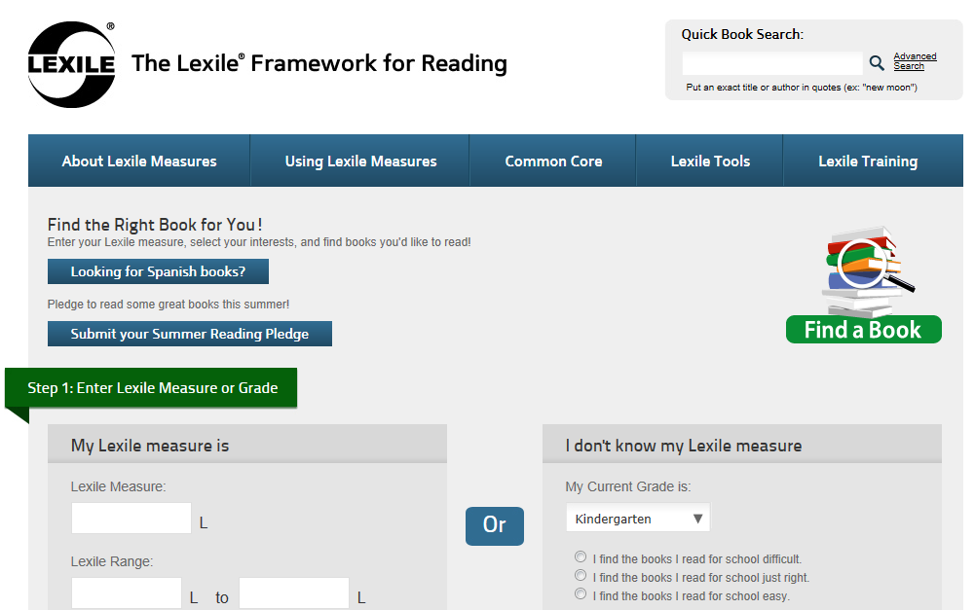
Step 1: Quantitative Measures
Finding a Lexile Measure for Text: http://www.lexile.com/findabook/

Slide 29
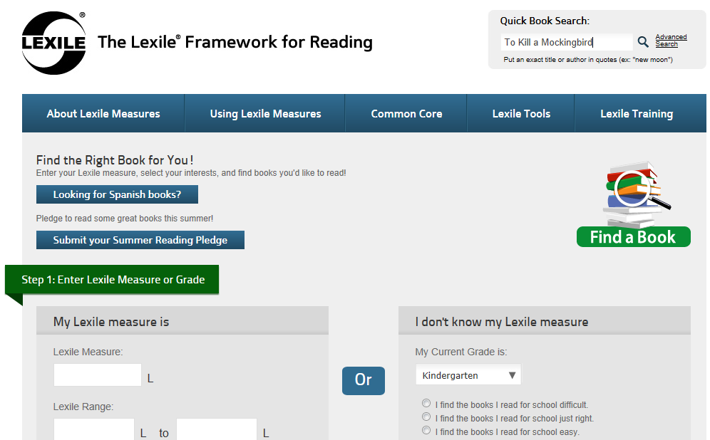
Step 1: Quantitative Measures

Slide 30
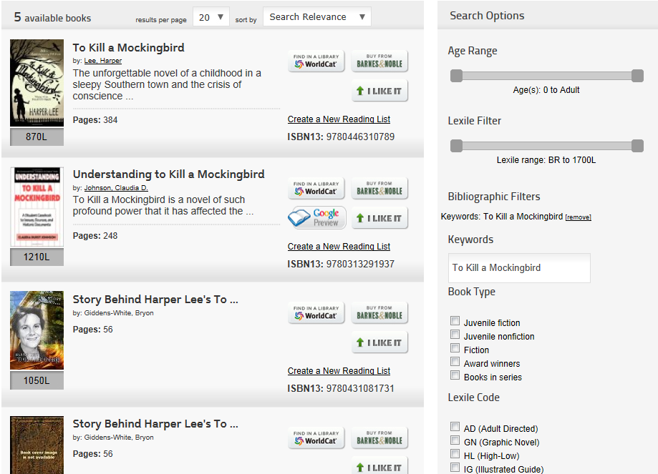
Step 1: Quantitative Measures

Slide 31
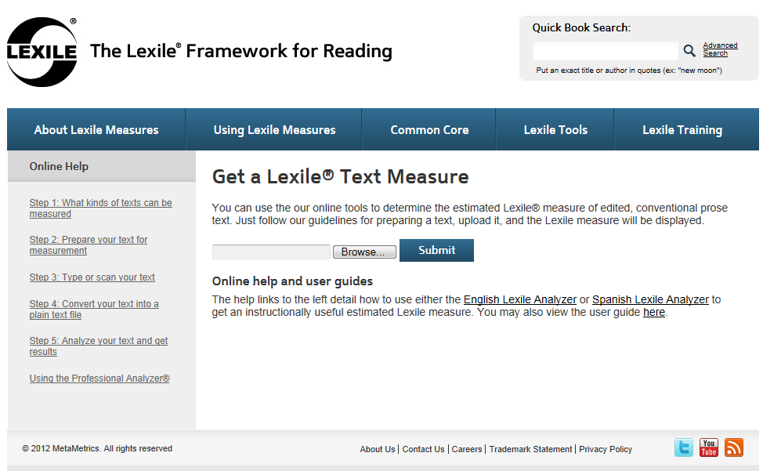
Step 1: Quantitative Measures
For texts not in the Lexile database, consider using the Lexile Analyzer: http://www.lexile.com/analyzer/
Registration is required (free) http://www.lexile.com/account/register/
Allows user to receive an “estimated” Lexile score
Accommodates texts up to 1000 words in length
Texts of any length can be evaluated using the Professional Lexile Analyzer—educators can upgrade to this tool for free by requesting access http://www.lexile.com/account/profile/access/

Slide 32

Step 1: Quantitative Measures
Finding a ATOS Book Level for Text: http://www.arbookfind.com/

Slide 33

Step 1: Quantitative Measures

Slide 34

Step 1: Quantitative Measures

Slide 35
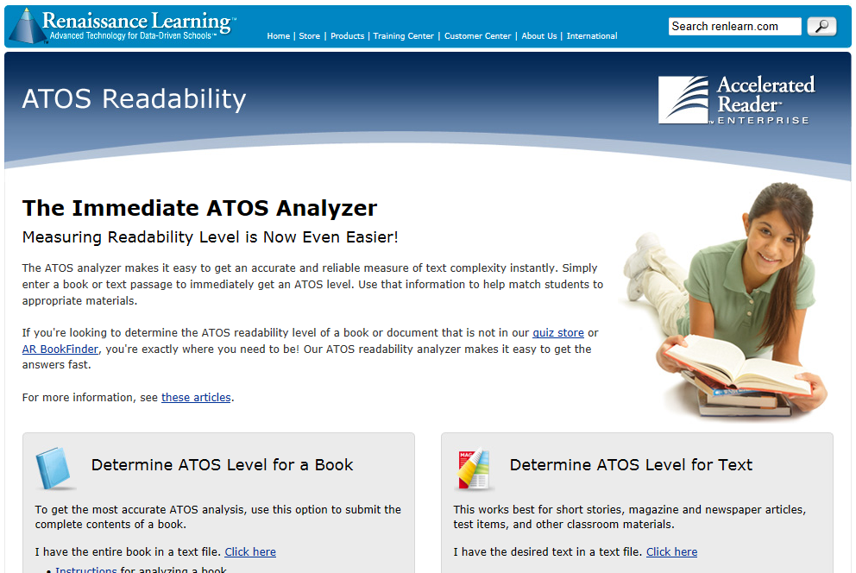
Step 1: Quantitative Measures
For texts not in the AR Bookfinder database, consider using The ATOS Analyzer: http://www.renlearn.com/ar/overview/atos/
No registration is required (however, you must provide an email address to receive results)
Three methods of analysis are available:
ATOS for Books – for submitting complete text of a book
ATOS for Books with Estimated Word Count – does not require full text, just three 150-word passages
ATOS for Text– works well for short, full-text submissions (short stories, magazine/newspaper articles, etc.)

Slide 36
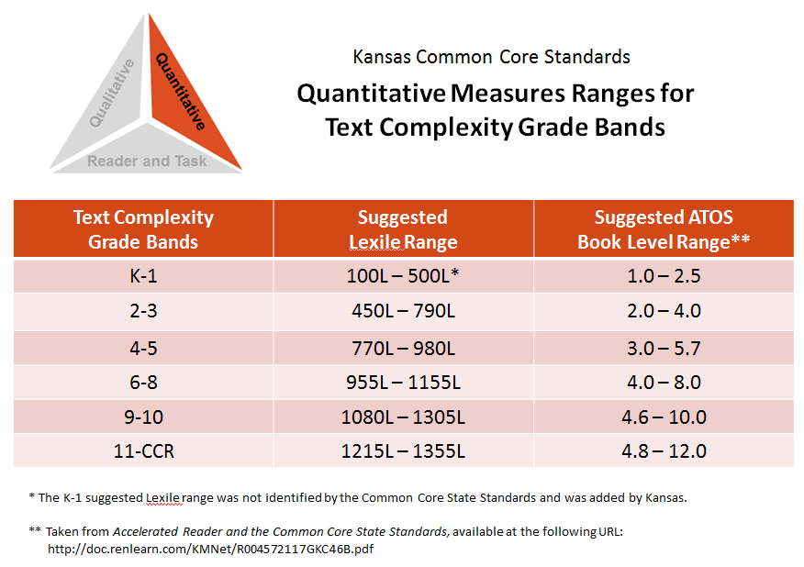
Step 1: Quantitative Measures
Lexile Text Measure:
870L
ATOS Book Level:
5.6
In which of the text complexity bands would this novel fall?

Slide 38
Step 1: Quantitative Measures
Remember, however, that the quantitative measures is only the first of three “legs” of the text complexity triangle.
Our final recommendation may be validated, influenced, or even over-ruled by our examination of qualitative measures and the reader and task considerations.
Notes:
Pause here for questions regarding Step 1

Slide 39
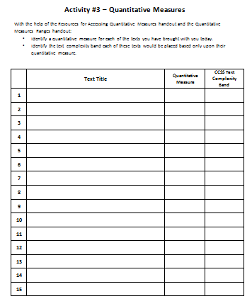
Step 1: Quantitative Measures
Activity #3: Your Turn!
Using one (or more) of the tools described:
Identify a quantitative measure for each of the texts you have brought with you today.
Identify the text complexity band each of these texts would be placed based only upon their quantitative measure.
Discuss your results as a small group.

Slide 40
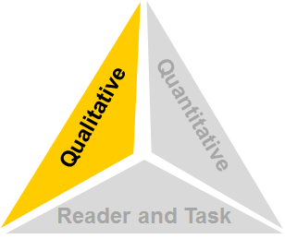
Step 2: Qualitative Measures
Measures such as:
  Levels of meaning
  Levels of purpose
  Structure
  Organization
  Language conventionality
  Language clarity
  Prior knowledge demands

Slide 41
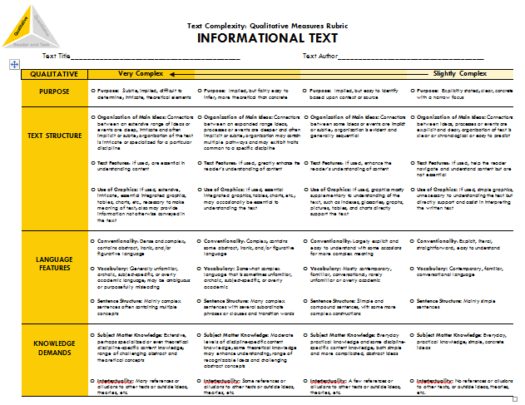
Step 2: Qualitative Measures
The Qualitative Measures Rubrics
for Literary and Informational Text:
The rubric for literary text and the rubric for informational text allow educators to evaluate the important elements of text that are often missed by computer software that tends to focus on more easily measured factors.

Slide 42
Step 2: Qualitative Measures
Because the factors for literary texts are different from information texts, these two rubrics contain different content. However, the formatting of each document is exactly the same.
And because these factors represent continua rather than discrete stages or levels, numeric values are not associated with these rubrics. Instead, four points along each continuum are identified: high, middle high, middle low, and low.

Slide 43
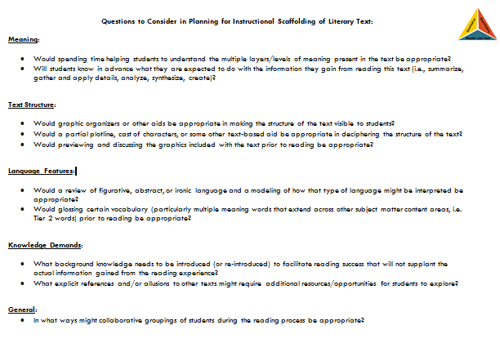
Step 2: Qualitative Measures
Questions to Consider in Planning for Instructional Scaffolding
On the back side of each rubric is list of springboard questions to help educators begin thinking about the kinds of instructional scaffolding the text may also require.

Slide 44
Step 2: Qualitative Measures
So…
How is the rubric used?
And how would To Kill a Mockingbird fare when analyzed through the lens of the Literary Text Rubric?

Slide 45
Notes:
Users read across the four columns for each row of checkboxes on the rubric, identifying which descriptors best match the text by marking a particular checkbox.
As Appendix A states, “Few, if any, authentic texts will be low or high on all of these measures.” The goal is not for all of the checkmarks to be in a single column; the goal is to accurately reflect these factors of the text.
The marked rubric can then serve as a guide as educators re-evaluate the initial placement of the work into a text complexity band. Such reflection may validate the text’s placement or may suggest that the placement needs to be changed.
In fact, this marked rubric represents the evaluation of To Kill a Mockingbird completed by a committee of teachers.

Slide 46
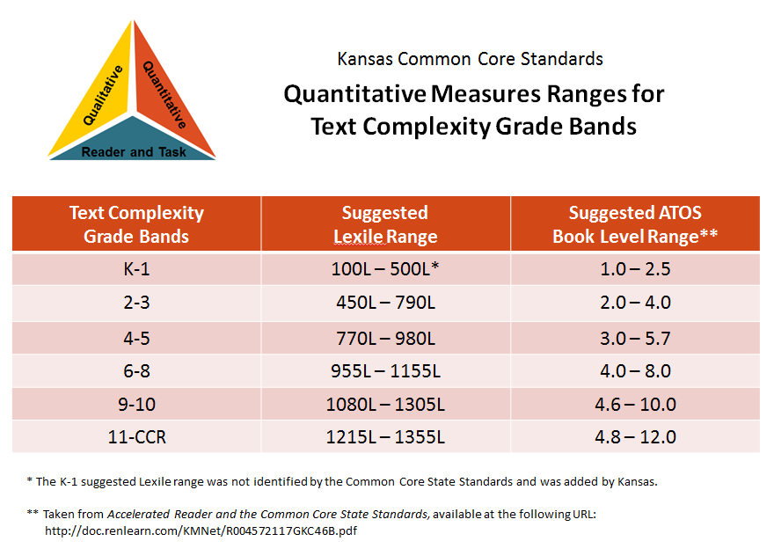
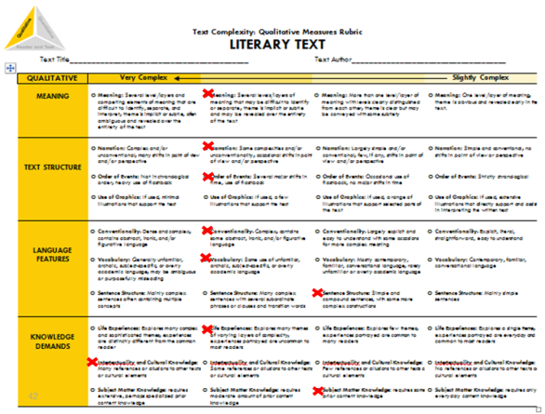
Step 2: Qualitative Measures
From examining the quantitative measures, we knew:
Lexile Text Measure:
870L
ATOS Book Level:
5.6
But after reflecting upon the qualitative measures, we believed:

Slide 47
Step 2: Qualitative Measures
Our initial placement of To Kill a Mockingbird into a text complexity band changed when we examined the qualitative measures.
Remember, however, that we have completed only the first two legs of the text complexity triangle.
Qualitative
Quantitative
The reader and task considerations still remain.
Reader and Task
Notes:
Pause for questions.

Slide 48
Step 2: Qualitative Measures
Activity #4: Your Turn!
Using the rubrics for literary and informational text, analyze the qualitative measures of the following titles:
  “Ripe Figs” (literary text)—1030L
  “The Gettysburg Address” (informational text)—1340L
Discuss your results as a small group.
You will be sharing your marked rubric with the
larger group in the next activity!

Slide 49

Step 2: Qualitative Measures
Activity #5: Gallery Walk!
After displaying your marked rubrics for the larger group, tour the room and review the marked rubrics of other groups.
Place a sticky note on those rubrics that display very similar results to your own.

Slide 50
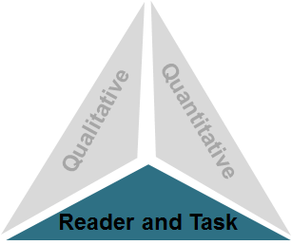
Step 3: Reader and Task Considerations
Considerations such as:
Motivation
Knowledge and experience
Purpose for reading
Complexity of task assigned regarding text
Complexity of questions asked regarding text

Slide 51
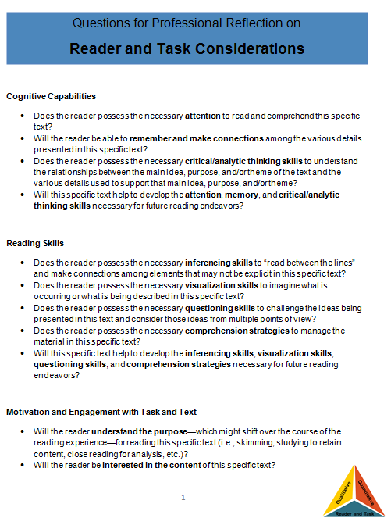
Step 3: Reader and Task Considerations
Questions for Professional Reflection on Reader and Task Considerations:
The questions provided in this resource are meant to spur teacher thought and reflection upon the text, students, and any tasks associated with the text.

Slide 52
Step 3: Reader and Task Considerations
The questions included here are largely open-ended questions without single, correct answers, but help educators to think through the implications of using a particular text in the classroom.

Slide 53
Step 3: Reader and Task Considerations
What aspects of the text will likely pose the most challenge for my students?
    Content or theme concerns or challenges?
    Text structure challenges?
    Language feature challenges?
    Knowledge and experience demands?
    Motivation for and interest in the text?

Slide 54
Step 3: Reader and Task Considerations
What Common Core State Standards should I focus on when teaching this text?
  What are natural areas of focus for this text?
  With what standards do my students need the most practice?
Will the complexity of any before, during and after reading tasks or the complexity of any questions asked about the text interfere with the reading experience?
What supports do I need to provide so that all of my students (even those who are struggling readers) can access the text?

Slide 55
How Should Instruction Address Text Complexity?
RA! RA! RA! Reading!
Read Aloud
Modeling of decoding and fluency
Heavy scaffolding for vocabulary and comprehension
Read Along
Some scaffolding, as needed, for decoding, fluency, vocabulary, and comprehension
Read Alone
Independent, autonomous reading
Little to no scaffolding
Student Autonomy
Teacher Scaffolding
Gradual Release of Responsibility (I do, we do, you do)…

Slide 56
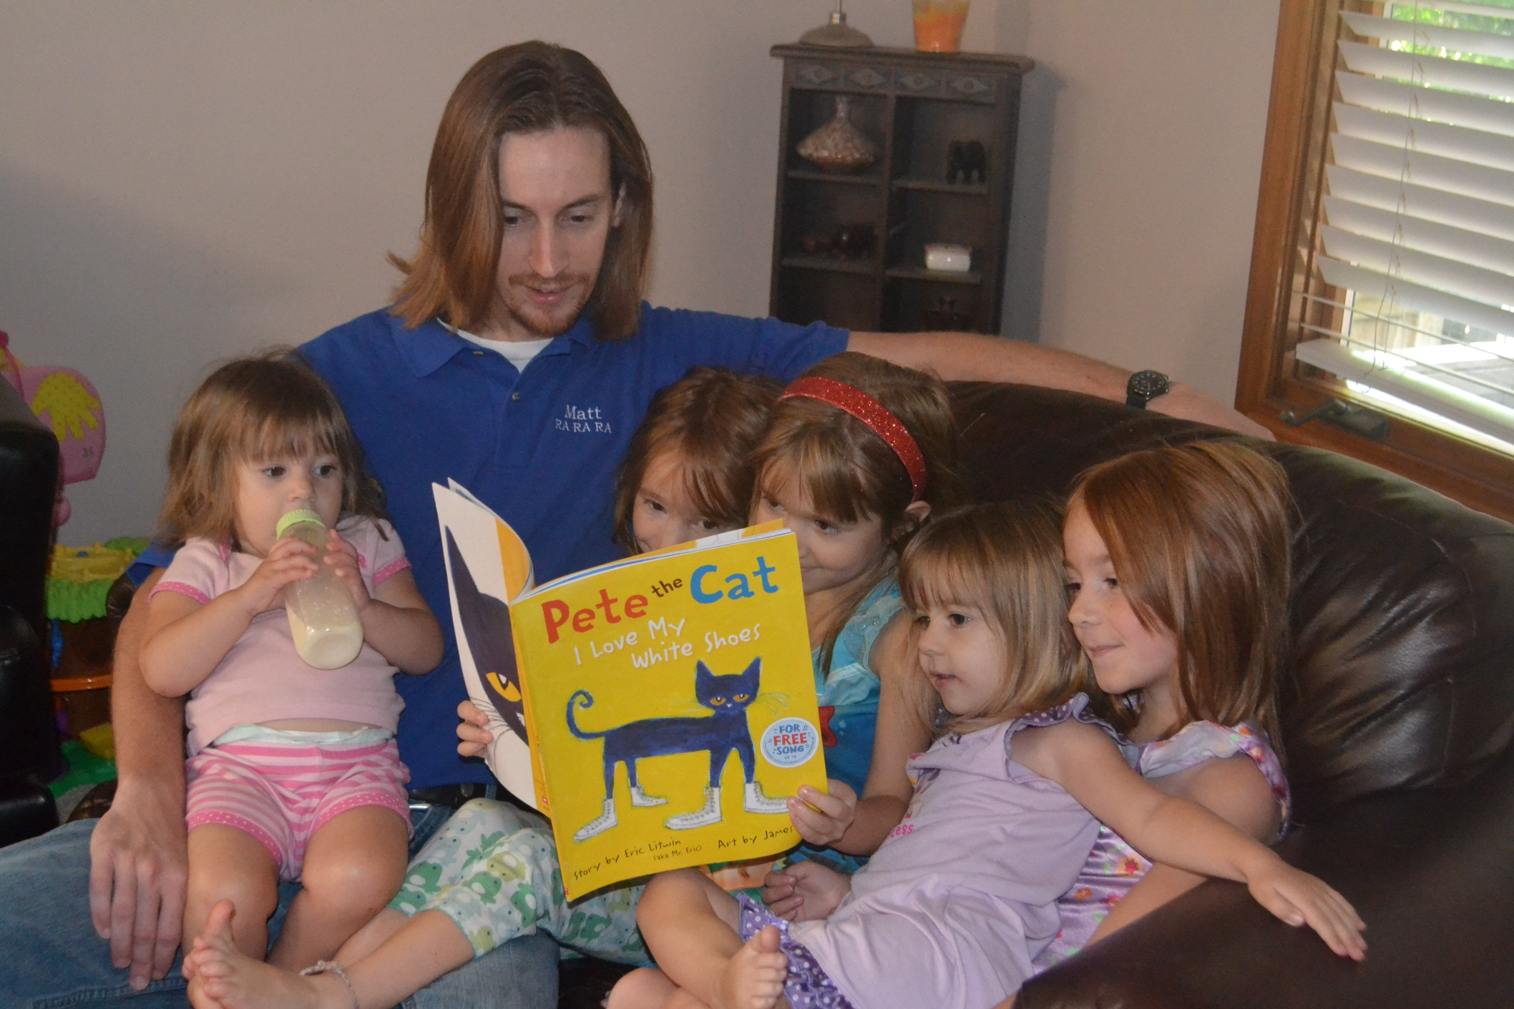
RA, RA, RA Reading! In Action

Slide 57
Step 3: Reader and Task Considerations
Based upon our examination of the Reader and Task Considerations, we have completed the third leg of the text complexity model and are now ready to recommend a final placement within a text complexity band.

Slide 58
Step 4: Recommended Placement
After reflecting upon all three legs of the text complexity model we can make a final recommendation of placement within a text and begin to document our thinking for future reference.

Slide 59
Step 4: Recommended Placement
Lexile Text Measure:
870L
ATOS Book Level:
5.6
Notes:
Using this protocol, we progressed through each leg of the text complexity model: (1) quantitative measures, (2) qualitative measures, and (3) reader and task considerations. Now we are ready to review all three legs one last time and make a final recommendation for placement of this text into a text complexity grade band.

Slide 60
Step 4: Recommended Placement
Based upon all the information—all three legs of the model—the final recommendation for To Kill a Mockingbird…
Notes:
Based upon all three legs of the model, we felt the most appropriate placement for the novel was grades 9-10.

Slide 61
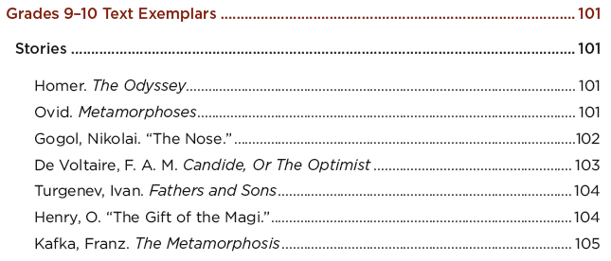
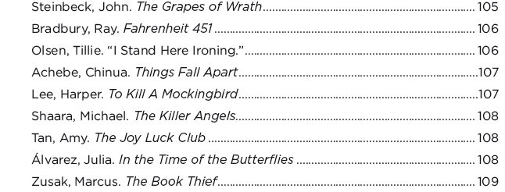
Step 4: Recommended Placement
In this instance, Appendix B
confirms our evaluation of the novel. To Kill a Mockingbird is placed within the grade 9-10 text complexity band.
Notes:
Validating our analysis, the Common Core Standards List of Exemplar Texts (Appendix B) came to this same conclusion.

Slide 62
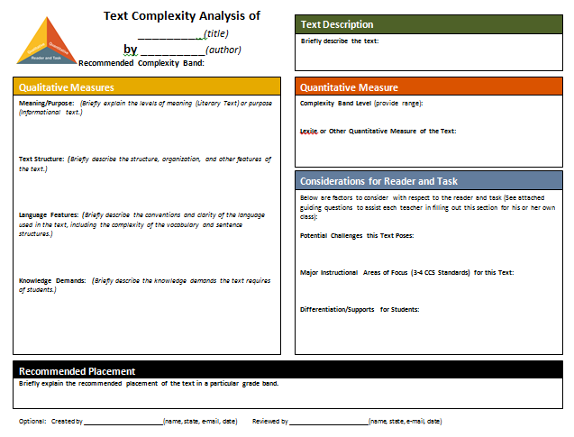
Step 4: Recommended Placement
Template for Text Complexity Analysis and Recommended Placement Form:
The one-page template provides an opportunity to record the thinking involved in recommending the placement of a specific text into a text complexity band.
Keeping a record of such analysis and thinking might be useful documentation in the case that any questions arise in the future.
Notes:
Once the recommended placement has been decided upon, educators might also find it useful to document some the thinking that led them to their conclusion.

Slide 63
Notes:
The template offers space to record information for each of the three legs of the model.

Slide 64
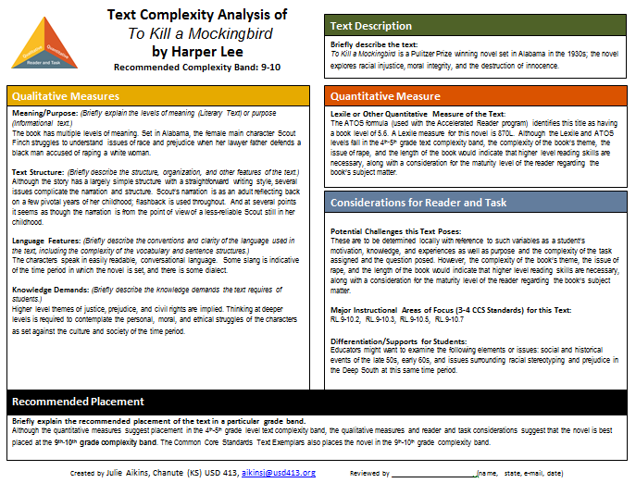
Notes:
An example of a completed template for To Kill a Mockingbird.

Slide 65
Step 4: Recommended Placement
Activity #6: Your Turn!
As a small group…
Choose one of the two texts we have analyzed today.
Begin documenting a rationale for the recommended placement of that text on the recommended placement template.
You will be sharing your recommended placement form with the larger group in the next activity!

Slide 66
Step 4: Recommended Placement
Activity #7: Gallery Walk!
After displaying your recommended placement forms for the larger group, tour the room and review the work of other groups.
Place a sticky note on those forms that display very similar results to your own.

Slide 67
Step 4: Recommended Placement
Activity #8: Discussion!
As a small group…
How might classroom teachers make use of the recommended placement forms?
How might administrators make use of the recommended placement forms?
How can I apply this model in the work that I do and encourage others I work with to embrace the model as well?
Be prepared to share your thoughts…

Slide 68
Additional Resources
Text complexity bookmark
“Beginner’s Guide to Text Complexity” from New York City Dept. of Education
Example final recommendation forms:
The Hunger Games
How to Steal a Dog
The Evolution of Calpurnia Tate
A Separate Peace
Diamond Willow
Extraordinary Mark Twain
Candy Bomber
Where Things Come Back
Why We Broke Up
Moon Over Manifest
Zora and Me

Slide 69

Matt Copeland
Kansas State Department of Education
(785) 296-5060
mcopeland@ksde.org

