Slide 1
The Instructional Leader's Guide to Implementing K-8 Science Practices
Chapter 4 - Observation

Slide 2

Community Agreements
Stay engaged
Expect and accept a lack of closure
Speak your truth
Expect to experience discomfort
Bring your identity
Curiosity is what we need. We don’t have to let go of what we believe, but we do need to be curious about what someone else believes. We do need to acknowledge that their way of interpreting the world might be essential to our survival. - Margaret Wheatley, Willing to be Disturbed, 2002

Slide 3
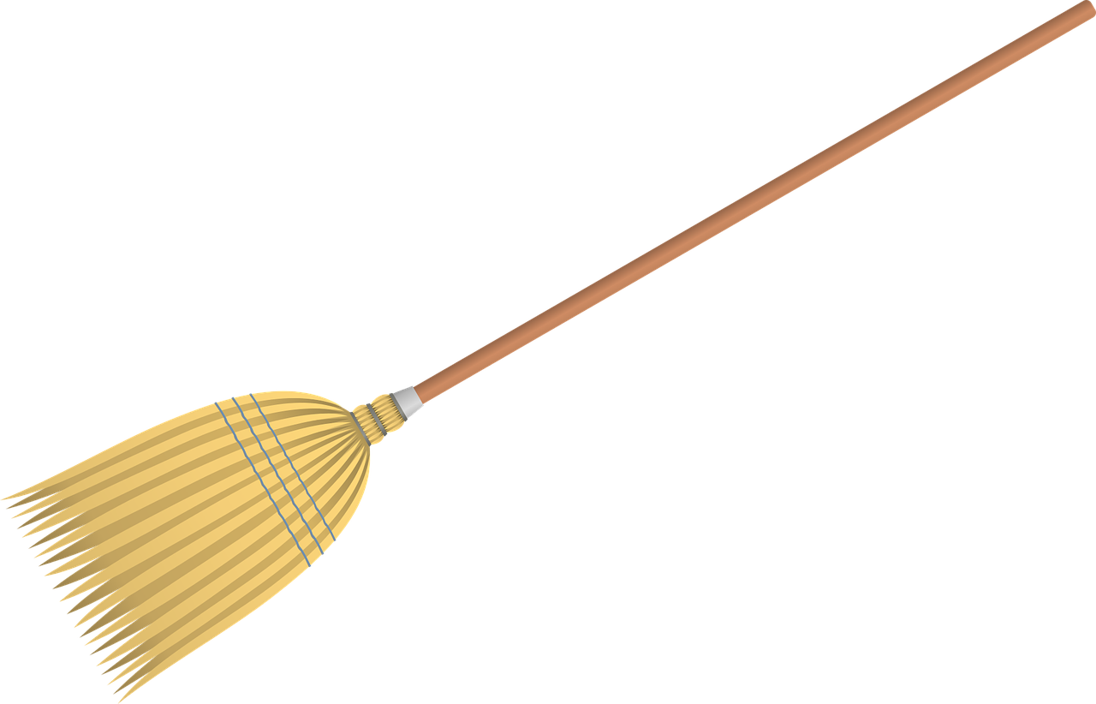
Housekeeping
To reduce background noise, please stay on mute when not speaking.
Video is optional, but please know that all attire and backgrounds are accepted!
Familiarize yourself with the chat box. It’s a great place to ask questions and post comments.
Materials will be shared following the session.

Slide 4
Noticing
"During observation, the act of noticing refers to the act of focusing on specific things we are drawn to and how we can make meaning of them" p. 60

Slide 5
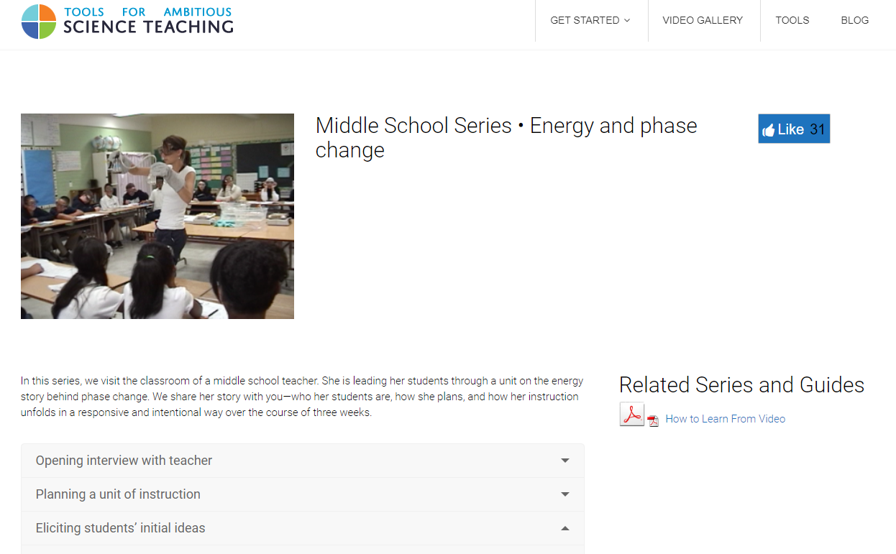

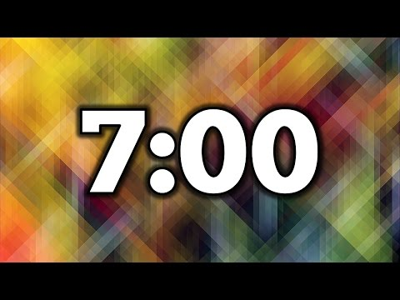
Noticing
Notes:
Video Library: https://ambitiousscienceteaching.org/middle-school-series-%e2%80%a2-energy-phase-change/#1479369685769-7b5c0b7c-02c2
Learning from Video: http://ambitiousscienceteaching.org/wp-content/uploads/2014/09/How-to-Learn-from-Video.pdf

Slide 6
SEPs Organized into Groups
Investigating Practices | Sensemaking Practices | Critiquing Practices
1. Asking Questions 3. Planning and Carrying Out Investigations 5. Using Mathematics and Computational Thinking | 2. Developing and Using Models 4. Analyzing and Interpreting Data 6. Constructing Explanations | 7. Engaging in Argument from Evidence 8. Obtaining, Evaluating and Communicating Information
Data
Explanation and/or Models
Natural World
Investigative Practices
Sensemaking
Practices
Critiquing Practices

Slide 7
"The Shift"
Learning about
Figuring out

Slide 8
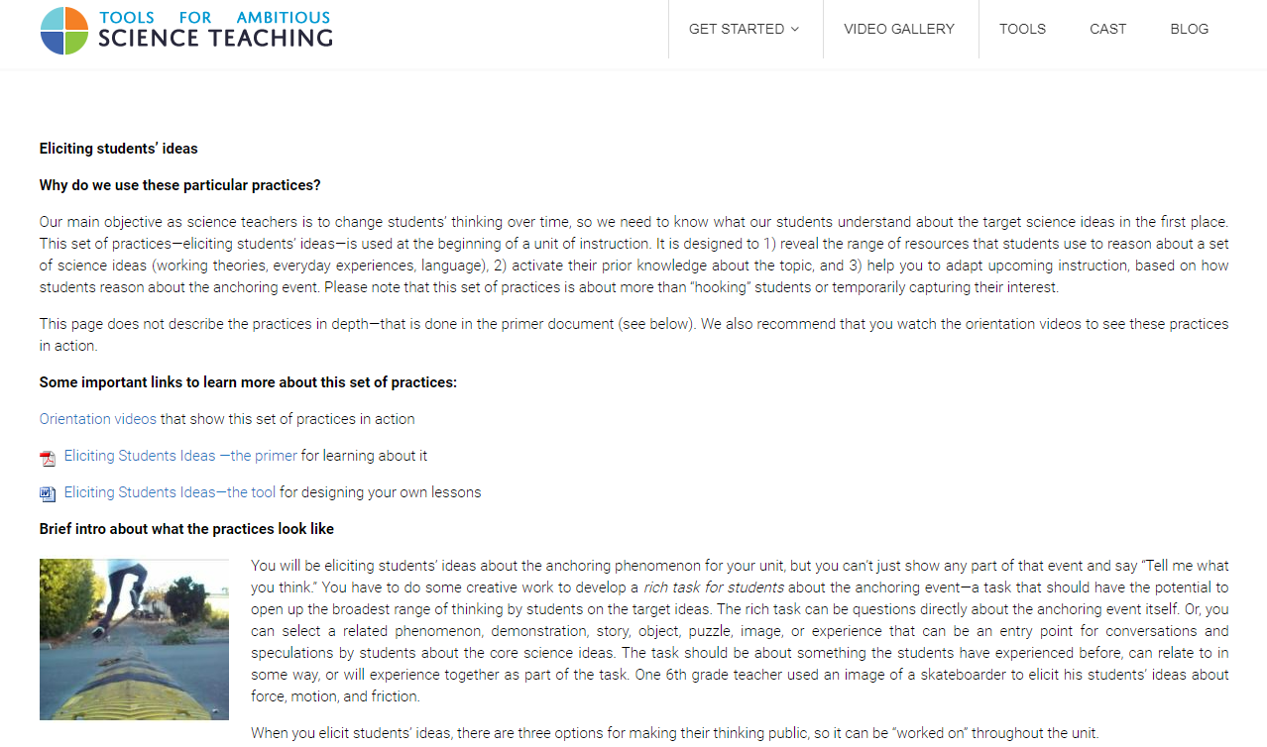
Notes:
Eliciting Student Ideas: https://ambitiousscienceteaching.org/eliciting-students-ideas-2/

Slide 9
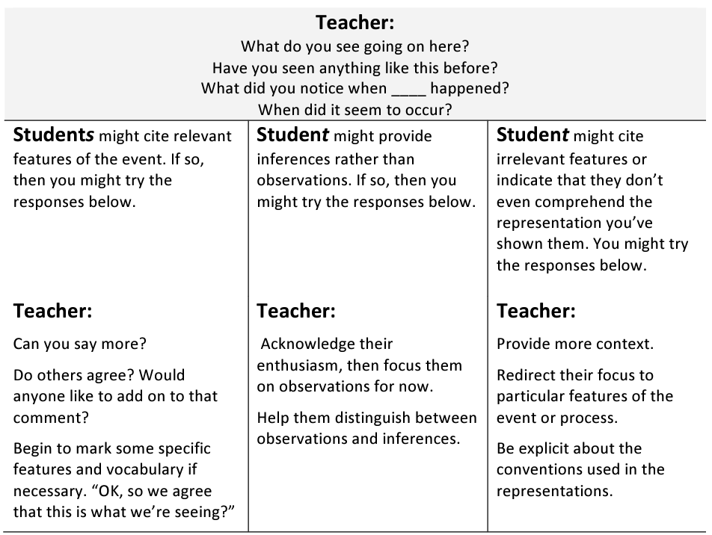

Slide 10
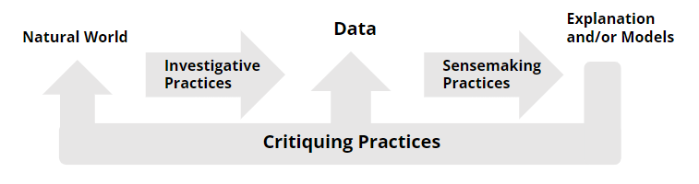
Using the Observation Tools
Refer to the continuum
Decide on a focus
  If you do not have an opportunity to identify practices in advance, you can decide to focus on the two most prevalent practices that emerge during instruction
In break-out groups take a moment to reflect;
How will we know which practices are the most prevalent?
Where should / does this focus start?
Notes:
STEM Teaching Tools #24: https://stemteachingtools.org/brief/24

Slide 11
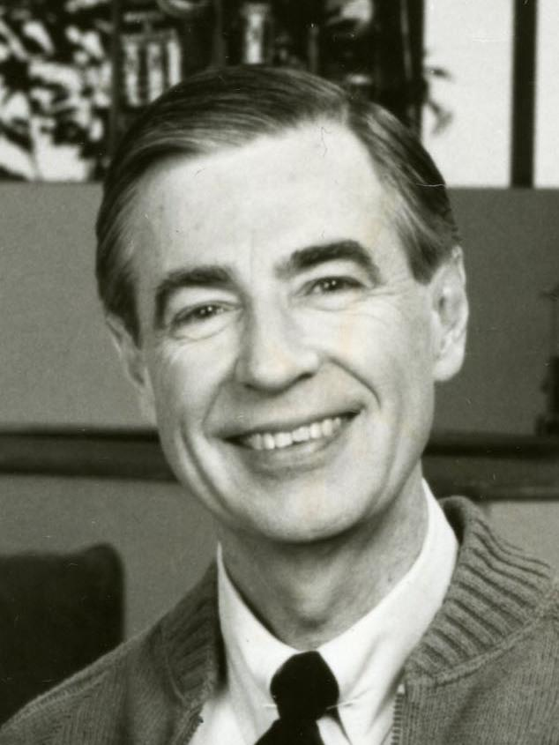
Reflection from Mr. Rogers?
What practices do you notice?
What evidence is present that students re engaged?
Where is the lesson on the continuum?
How might it be improved?

Slide 12
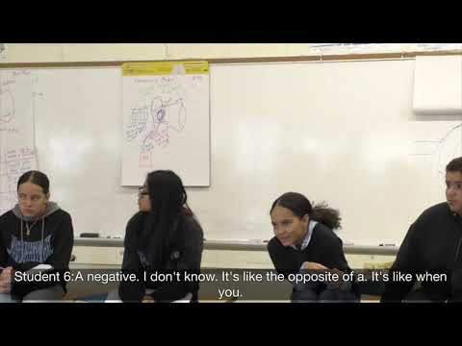
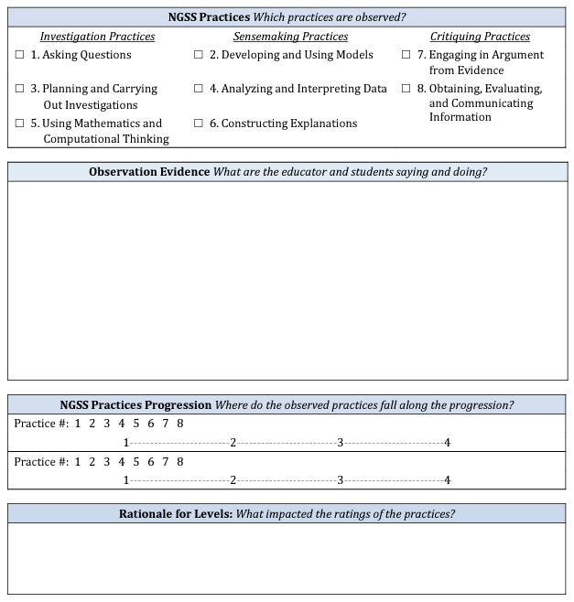
Notes:
Link to form: https://www.google.com/url?sa=i&url=https%3A%2F%2Fwww.sciencepracticesleadership.com%2Fuploads%2F1%2F6%2F8%2F7%2F1687518%2Fobservation_form_v6.pdf&psig=AOvVaw0aPuS9zqq6-2jOJdZV-cPh&ust=1651250462484000&source=images&cd=vfe&ved=0CAwQjRxqFwoTCLDeoK6Zt_cCFQAAAAAdAAAAABAD

Slide 13
Practice Using the Tools
The Science Practices can help create opportunities for in which each is known, heard and supported.
What practices do you notice?
What evidence is present that students re engaged?
Where is the lesson on the continuum?
How might it be improved?

Slide 14
Reflection / Application
What can you do to train yourself to notice more science-specific facets of instruction when you observe?
  What supports might you need to strengthen this?
  What tools might your community need to strengthen this?
Which one or two science practices speak most to you?
  Which do you find easiest to notice?

Slide 15
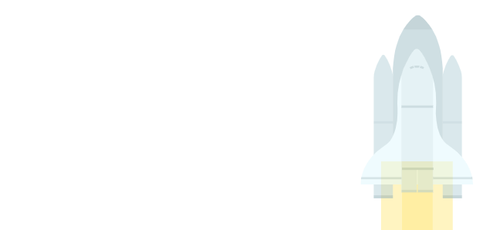
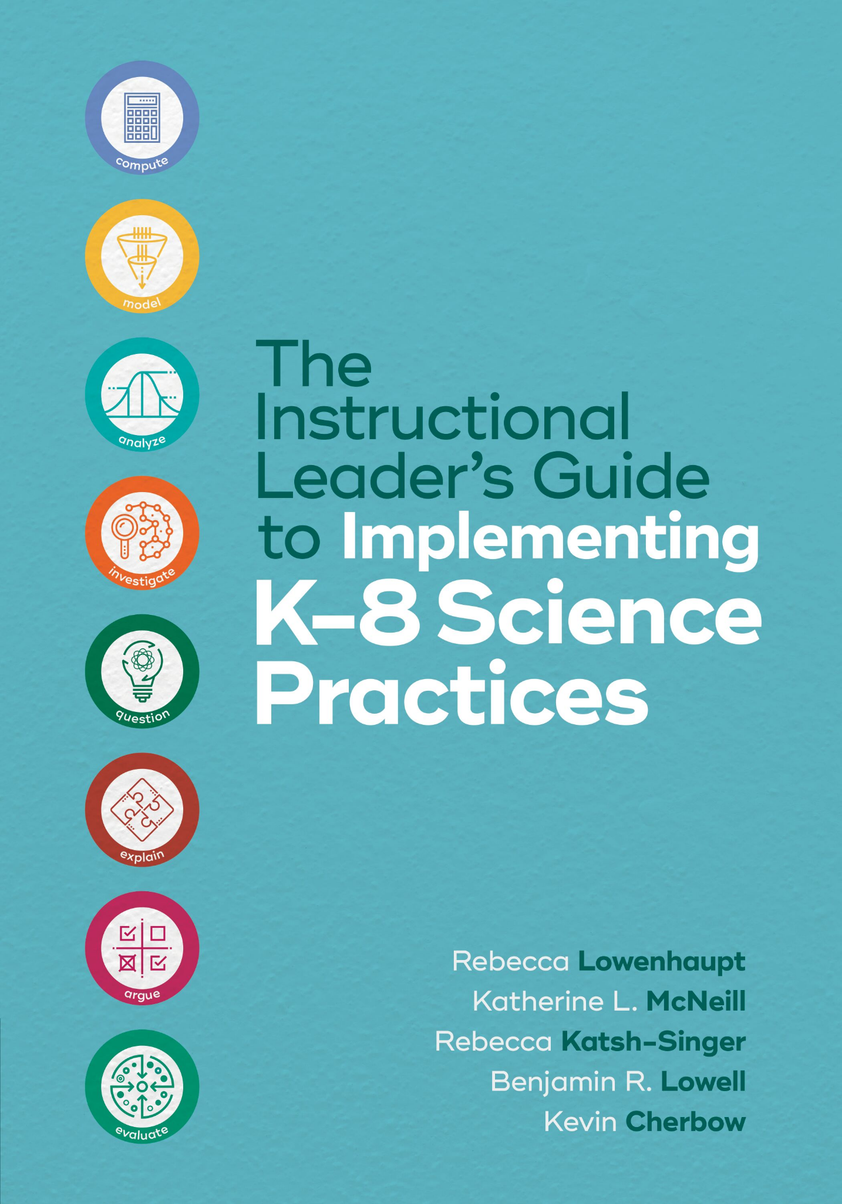
Thank you for attending Session 4!
Please provide us with feedback (Link)
Join us for Session 5 to reflect on Feedback (Ch. 6)
Notes:
Feedback Form: https://docs.google.com/forms/d/e/1FAIpQLScsAIhzGyQtzIKI-m78annk1pM9qSuFsiZScY-grnica2Vr6A/viewform?usp=sf_link

