Slide 1

Striving Readers Comprehensive Literacy (SRCL) Center Webinar
Text Complexity and the
Common Core State Standards
Matt Copeland
Kansas State Department of Education
August 15, 2012

Slide 2


Materials
  Electronic copies of all of the materials described in this presentation are available at the following URL:
  www.ksde.org/Default.aspx?tabid=4778#TextRes

Slide 3
Purposes of the Webinar
  Understand the CCSS text complexity model.
  Explore the quantitative measures tools.
  Examine the qualitative rubrics for both literary and informational texts.
  Ponder reader and task considerations and scaffolding possibilities for texts.
  Introduce the final recommendation form (i.e., the “placemat”).

Slide 4
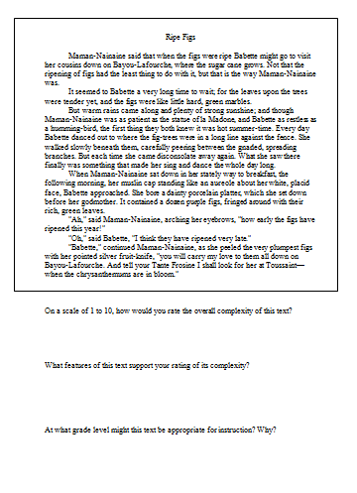
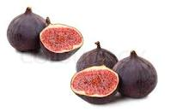
Activity
  Ripe Figs
  As a small group, read “Ripe Figs” and answer the three questions provided….
Notes:
“Ripe Figs” – Kate Chopin – 286 words – Lexile 1030 – upper end of Grade 6-8 band

Slide 5
“Ripe Figs”
Maman-Nainaine said that when the figs were ripe Babette might go to visit her cousins down on Bayou-Lafourche, where the sugar cane grows. Not that the ripening of figs had the least thing to do with it, but that is the way Maman-Nainaine was.
It seemed to Babette a very long time to wait; for the leaves upon the trees were tender yet, and the figs were like little hard, green marbles.
But warm rains came along and plenty of strong sunshine; and though Maman-Nainaine was as patient as the statue of la Madone, and Babette as restless as a humming-bird, the first thing they both knew it was hot summer-time. Every day Babette danced out to where the fig-trees were in a long line against the fence. She walked slowly beneath them, carefully peering between the gnarled, spreading branches. But each time she came disconsolate away again. What she saw there finally was something that made her sing and dance the whole day long.
Notes:
“Ripe Figs” – Kate Chopin – 286 words – Lexile 1030 – upper end of Grade 6-8 band

Slide 6
“Ripe Figs”
When Maman-Nainaine sat down in her stately way to breakfast, the following morning, her muslin cap standing like an aureole about her white, placid face, Babette approached. She bore a dainty porcelain platter, which she set down before her godmother. It contained a dozen purple figs, fringed around with their rich, green leaves.
"Ah," said Maman-Nainaine, arching her eyebrows, "how early the figs have ripened this year!"
"Oh," said Babette, "I think they have ripened very late."
"Babette," continued Maman-Nainaine, as she peeled the very plumpest figs with her pointed silver fruit-knife, "you will carry my love to them all down on Bayou-Lafourche. And tell your Tante Frosine I shall look for her at Toussaint—when the chrysanthemums are in bloom."
Notes:
“Ripe Figs” – Kate Chopin – 286 words – Lexile 1030 – upper end of Grade 6-8 band

Slide 7
Discussion
  On a scale of 1 to 10, how would you rate the overall complexity of this text?
  What features of this text support your rating of its complexity?
  At what grade level might this text be appropriate for instruction? Why?

Slide 8
Text Complexity –
Why Is This Important?
  Complexity of texts students are expected to read is below what is required to achieve college and career readiness:
    High school textbooks have declined in all subject areas over the last several decades.
    Average length of sentences in K-8 textbooks has declined from 20 to 14 words.
    Vocabulary demands have declined since the 1960s:
      8th grade textbooks = former 5th grade texts
      12th grade anthologies = former 7th grade texts
  Complexity of college and career texts has remained steady or increased, resulting in a gap

Slide 9
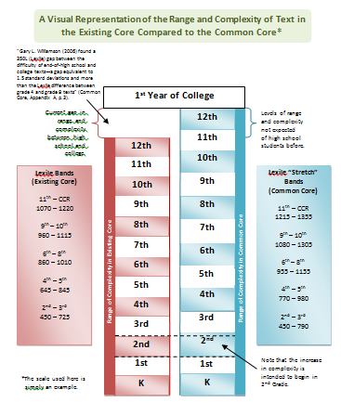
Identifying the Gap

Slide 10
Text Complexity
  Specifically, reading standard #10:
  Anchor Standard:
  R.CCR.10 Read and comprehend complex literary and informational texts independently and proficiently.
  Example Grade-level Standard (6th grade):
  RI.6.10 By the end of the year, read and comprehend literary nonfiction in the grades 6-8 text complexity band proficiently, with scaffolding as needed at the high end of the range.
Notes:
Allow small groups to interpret and report out on their understandings of each of these two standard statements.

Slide 11
Guiding Questions
  So…
  What do the Common Core State Standards mean by text complexity?
  What is a text complexity band?
  and
  How do we ensure the texts our students are reading are in the appropriate text complexity band?
Notes:
This presentation seeks to answer these questions.

Slide 12
CCSS Text Complexity Model
  Text complexity is defined by:
Quantitative measures – readability and other scores of text complexity often best measured by computer software.
Qualitative measures – levels of meaning, structure, language conventionality and clarity, and knowledge demands often best measured by an attentive human reader.
Qualitative
Quantitative
Reader and Task considerations – background knowledge of reader, motivation, interests, and complexity generated by tasks assigned often best made by educators employing their professional judgment.
Reader and Task

Slide 13
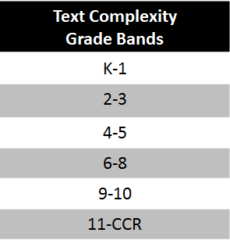
CCSS Text Complexity Model

Slide 14
Determining Text Complexity
  A Four-step Process:
Determine the quantitative measures of the text.
Analyze the qualitative measures of the text.
Reflect upon the reader and task considerations.
Recommend placement in the appropriate text complexity band.
Qualitative
Quantitative
Reader and Task
Notes:
Overview of the Protocol

Slide 15
Step 1: Quantitative Measures
  Measures such as:
  Word length
  Word frequency
  Word difficulty
  Sentence length
  Text length
  Text cohesion
Qualitative
Quantitative
Reader and Task
Notes:
“Ripe Figs” – Kate Chopin – 286 words – Lexile 1030 – upper end of Grade 6-8 band

Slide 16
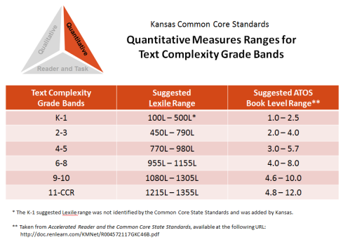


Step 1: Quantitative Measures
Qualitative
Quantitative
Reader and Task
The Quantitative Measures Ranges for Text Complexity:
This document outlines the suggested ranges for each of the text complexity bands using:
Lexile Text Measures
---or---
ATOS Book Levels (Accelerated Reader)

Slide 17
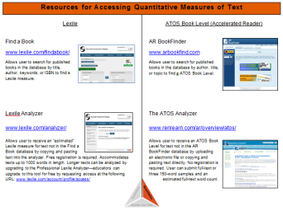
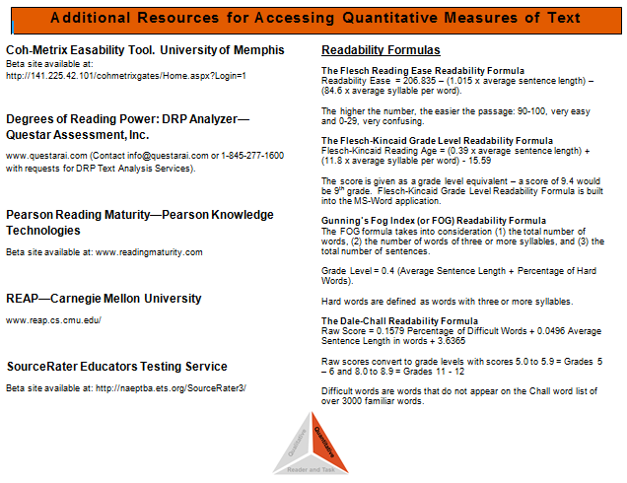
Step 1: Quantitative Measures
Qualitative
Quantitative
Reader and Task
Resources for Accessing
Quantitative Measures of Text
Quick handout documenting the availability of resources. Including:
  Lexile
  ATOS book level
  Additional measures
  Readability formulas

Slide 18

Step 1: Quantitative Measures
Qualitative
Quantitative
Reader and Task
Let’s imagine we want to see where a text falls on the quantitative measures “leg” of the text complexity triangle, using either the Lexile text measures or the ATOS book level (or both).
For illustrative purposes, let’s choose Harper Lee’s 1960 novel To Kill a Mockingbird.

Slide 19



Step 1: Quantitative Measures
Qualitative
Quantitative
Reader and Task
Lexile Text Measure:
870L
ATOS Book Level:
5.6
In which of the text complexity bands would this novel fall?

Slide 20
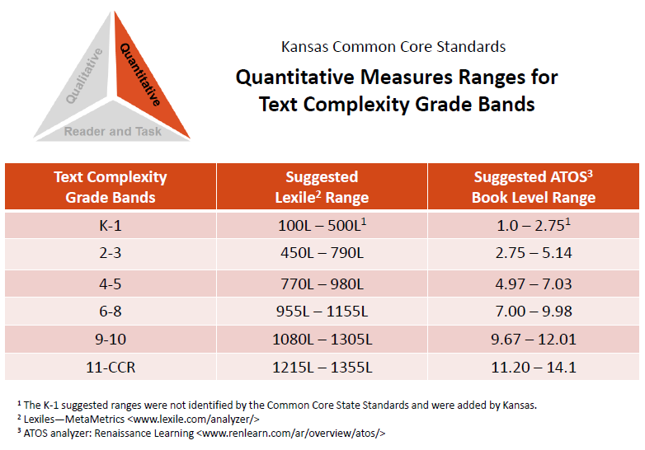

Slide 21
Step 1: Quantitative Measures
Qualitative
Quantitative
Reader and Task
Remember, however, that the quantitative measures aspect is only the first of three “legs” of the text complexity triangle.
Our final recommendation may be validated, influenced, or even over-ruled by our examination of qualitative measures and the reader and task considerations.
Qualitative
Quantitative
Reader and Task
Notes:
Pause here for questions regarding Step 1

Slide 22
Step 2: Qualitative Measures
  Measures such as:
  Levels of meaning
  Levels of purpose
  Structure
  Organization
  Language conventionality
  Language clarity
  Prior knowledge demands
Qualitative
Quantitative
Reader and Task
Notes:
“Ripe Figs” – Kate Chopin – 286 words – Lexile 1030 – upper end of Grade 6-8 band

Slide 23
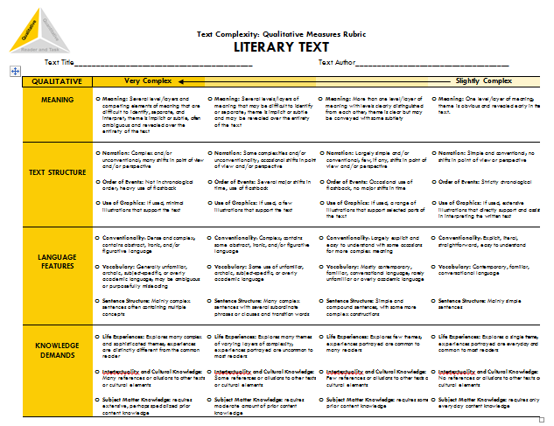
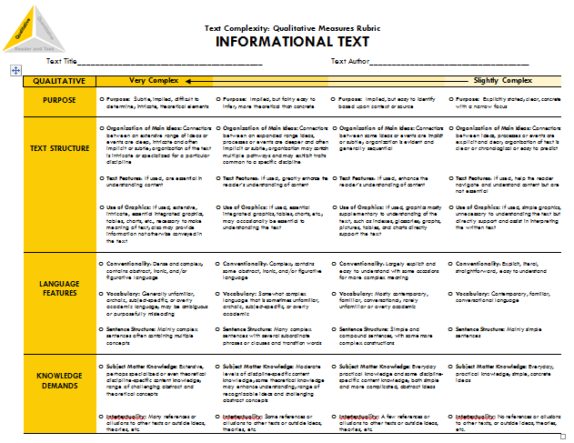
Step 2: Qualitative Measures
Qualitative
Quantitative
Reader and Task
The Qualitative Measures Rubrics
for Literary and Informational Text:
The rubric for literary text and the rubric for informational text allow educators to evaluate the important elements of text that are often missed by computer software that tends to focus on more easily measured factors.

Slide 24
Step 2: Qualitative Measures
Qualitative
Quantitative
Reader and Task
Because the factors for literary texts are different from information texts, these two rubrics contain different content. However, the formatting of each document is exactly the same.
And because these factors represent continua rather than discrete stages or levels, numeric values are not associated with these rubrics. Instead, four points along each continuum are identified from slightly complex to very complex.

Slide 25
Step 2: Qualitative Measures
Qualitative
Quantitative
Reader and Task
So…
How is the rubric used?
And how would To Kill a Mockingbird fare when analyzed through the lens of the Literary Text Rubric?

Slide 26
Notes:
Users read across the four columns for each row of checkboxes on the rubric, identifying which descriptors best match the text by marking a particular checkbox.
As Appendix A states, “Few, if any, authentic texts will be low or high on all of these measures.” The goal is not for all of the checkmarks to be in a single column; the goal is to accurately reflect these factors of the text.
The marked rubric can then serve as a guide as educators re-evaluate the initial placement of the work into a text complexity band. Such reflection may validate the text’s placement or may suggest that the placement needs to be changed.
In fact, this marked rubric represents the evaluation of To Kill a Mockingbird completed by a committee of teachers.

Slide 27
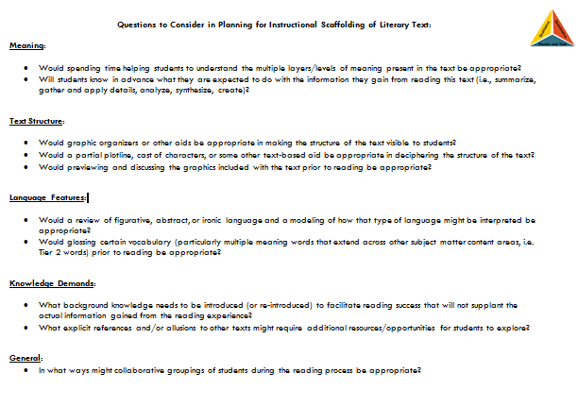
Step 2: Qualitative Measures
Qualitative
Quantitative
Reader and Task
Questions to Consider in Planning for Instructional Scaffolding
On the back side of each rubric is list of springboard questions to help educators begin thinking about the kinds of instructional scaffolding the text may also require.

Slide 28
How Should Instruction
Address Text Complexity?
RA! RA! RA! Reading!
Read Aloud
Modeling of decoding
and fluency
Heavy scaffolding for vocabulary and comprehension
Read Along
Some scaffolding, as
needed, for decoding, fluency, vocabulary, and comprehension
Read Alone
Independent,
autonomous reading
Little to no scaffolding
Student Autonomy
Teacher Scaffolding
Gradual Release of Responsibility (I do, we do, you do)…

Slide 29
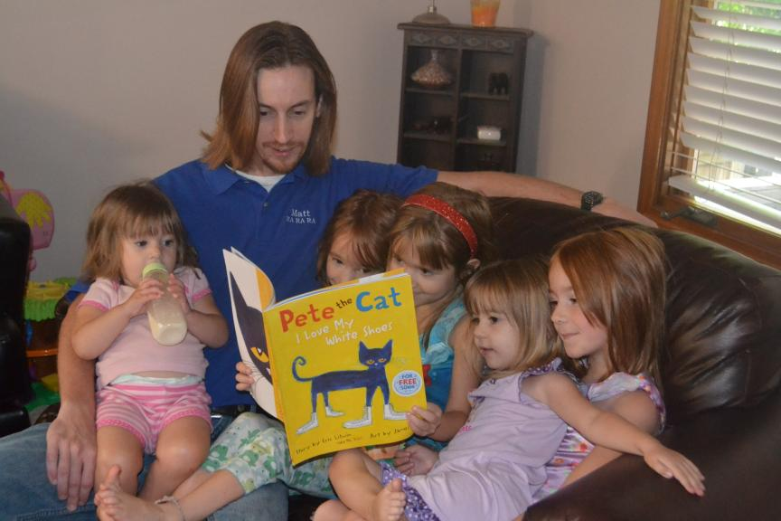
RA! RA! RA! Reading! In Action

Slide 30

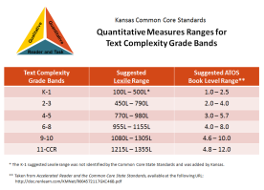
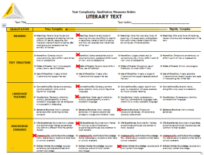
Step 2: Qualitative Measures
Step 2: Qualitative Measures
Qualitative
Quantitative
Reader and Task
From examining the quantitative measures, we knew:
Lexile Text Measure:
870L
ATOS Book Level:
5.6
But after reflecting upon the qualitative measures, we believed:

Slide 31
Step 2: Qualitative Measures
Qualitative
Quantitative
Reader and Task
Our initial placement of To Kill a Mockingbird into a text complexity band changed when we examined the qualitative measures.
Remember, however, that we have completed only the first two legs of the text complexity triangle.
Qualitative
Quantitative
The reader and task considerations still remain.
Reader and Task
Notes:
Pause for questions.

Slide 32
Step 3: Reader and
Task Considerations
  Considerations such as:
  Motivation
  Knowledge and experience
  Purpose for reading
  Complexity of task assigned regarding text
  Complexity of questions asked regarding text
Qualitative
Quantitative
Reader and Task
Notes:
“Ripe Figs” – Kate Chopin – 286 words – Lexile 1030 – upper end of Grade 6-8 band

Slide 33
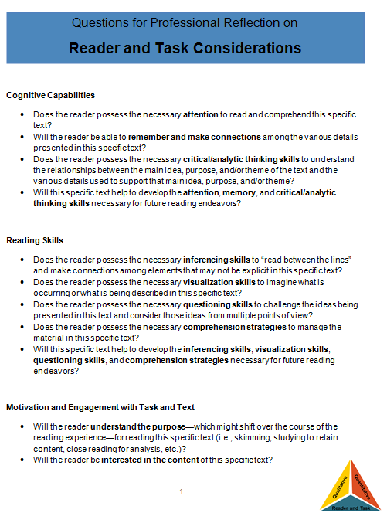
Step 3: Reader and
Task Considerations
Qualitative
Quantitative
Reader and Task
Questions for Professional Reflection on Reader and Task Considerations:
The questions provided in this resource are meant to spur teacher thought and reflection upon the text, students, and any tasks associated with the text.

Slide 34
Step 3: Reader and
Task Considerations
Qualitative
Quantitative
Reader and Task
The questions included here are largely open-ended questions without single, correct answers, but help educators to think through the implications of using a particular text in the classroom.

Slide 35
Step 3: Reader and
Task Considerations
Qualitative
Quantitative
Reader and Task
What aspects of the text will likely pose the most challenge for my students?
  Content or theme concerns or challenges?
  Text structure challenges?
  Language feature challenges?
  Knowledge and experience demands?
  Motivation for and interest in the text?

Slide 36
Step 3: Reader and
Task Considerations
Qualitative
Quantitative
Reader and Task
What aspects of the text will likely pose the most challenge for my students?
  What are natural areas of focus for this text?
  With what standards do my students need the most practice?
Will the complexity of any before, during, and after reading tasks or the complexity of any questions asked about the text interfere with the reading experience?
What supports do I need to provide so all of my students (even those who are struggling readers)can access
the text?

Slide 37
How Should Instruction
Address Text Complexity?
RA! RA! RA! Reading!
Read Aloud
Modeling of decoding
and fluency
Heavy scaffolding for vocabulary and comprehension
Read Along
Some scaffolding, as
needed, for decoding, fluency, vocabulary, and comprehension
Read Alone
Independent,
autonomous reading
Little to no scaffolding
Student Autonomy
Teacher Scaffolding
Gradual Release of Responsibility (I do, we do, you do)…

Slide 38
Step 3: Reader and
Task Considerations
Qualitative
Quantitative
Reader and Task
Based upon our examination of the Reader and Task Considerations, we have completed the third leg of the text complexity model and are now ready to recommend a final placement within a text complexity band.
Qualitative
Quantitative
Reader and Task
Notes:
Pause here for questions regarding Step 1

Slide 39
Step 4: Recommended Placement
After reflecting upon all three legs of the text complexity model we can make a final recommendation of placement within a text and begin to document our thinking for future reference.
Qualitative
Quantitative
Reader and Task

Slide 40


Step 4: Recommended
Placement
Qualitative
Quantitative
Reader and Task
Lexile Text Measure:
870L
ATOS Book Level:
5.6
Notes:
Using this protocol, we progressed through each leg of the text complexity model: (1) quantitative measures, (2) qualitative measures, and (3) reader and task considerations. Now we are ready to review all three legs one last time and make a final recommendation for placement of this text into a text complexity grade band.

Slide 41
Step 4: Recommended
Placement
Qualitative
Quantitative
Reader and Task
Based upon all the information—all three legs of the model—the final recommendation for To Kill a Mockingbird…
Notes:
Based upon all three legs of the model, we felt the most appropriate placement for the novel was grades 9-10.

Slide 42
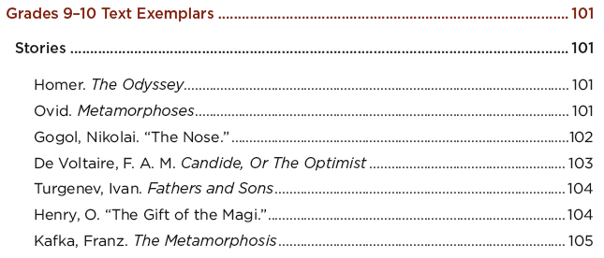
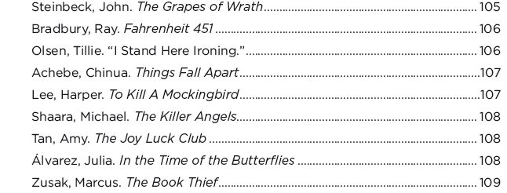
Step 4: Recommended
Placement
Qualitative
Quantitative
Reader and Task
In this instance, Appendix B
confirms our evaluation of the novel. To Kill a Mockingbird is placed within the grade 9-10 text complexity band.
Notes:
Validating our analysis, the Common Core Standards List of Exemplar Texts (Appendix B) came to this same conclusion.

Slide 43
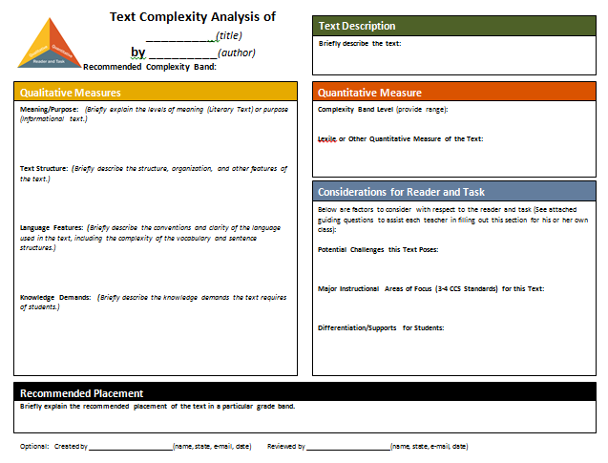
Notes:
The template offers space to record information for each of the three legs of the model.

Slide 44
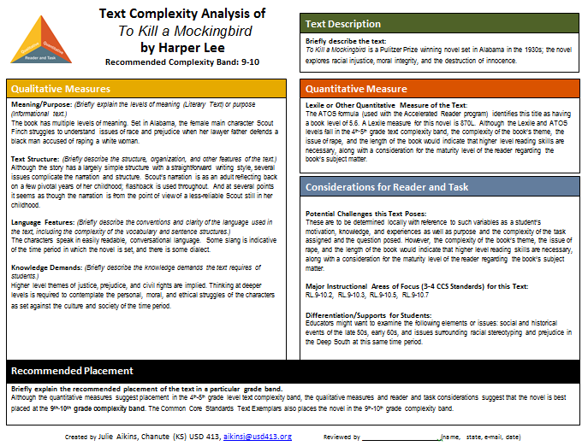
Notes:
An example of a completed template for To Kill a Mockingbird.

Slide 45
Step 4: Recommended
Placement
Qualitative
Quantitative
Reader and Task
Discussion!
How might classroom teachers make use of the recommended placement forms?
How might administrators make use of the recommended placement forms?
How can I apply this model in the work that I do and encourage others I work with to embrace the model as well?
Be prepared to share your thoughts….
Notes:
Pause here for questions regarding Step 1

Slide 46
Questions?

Slide 47
Resources
  All of the resources mentioned today and numerous others are available at the following URL:
  www.ksde.org/Default.aspx?tabid=4778#TextRes

Slide 48
Webinar Evaluation Survey
  Please take a few minutes to complete the evaluation survey to provide feedback on your webinar experience.
  Please note:
  TA suggestions are sent and produced under the U.S. Department of Education Contract
  No. ED-ESE-11-C-0057 with The Striving Readers Comprehensive Literacy Center. The views
  expressed herein do not necessarily represent the positions or policies of the Department of
  Education. No official endorsement by the U.S. Department of Education of any products,
  commodity, service or enterprise mentioned in this publication is intended or should be inferred.

Slide 49
Thank you!
For technical assistance, contact:
Susan J. Kimmel Angie Durand
Office: 405-799-6383 ext. 242 Office: 832-842-7034
Cell: 405-410-7277 Cell: 713-320-2579 skimmel@ou.edu angelia.durand@times.uh.edu

