Slide 1

K-12 Student Glossary for the 2017 Kansas Mathematics Standards

Slide 2
absolute value
4 3 2 1
-4 -3 -2 -1 0 1 2 3 4
1 2
|2| = 2 |-4| = 4 |0| = 0
the magnitude of a number without regard to its sign - it’s distance from zero
Notes:
MS – grade 6

Slide 3
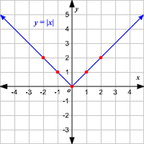
absolute value function
y = |x|
f(x) = |3x + 4|
g(x) = |x²| - 7
A function that contains an algebraic expression within absolute value symbols.
Notes:
9/10

Slide 4
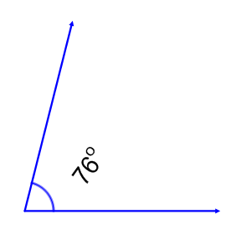
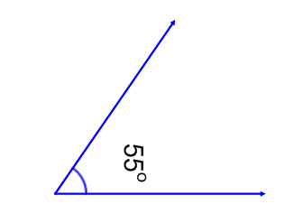
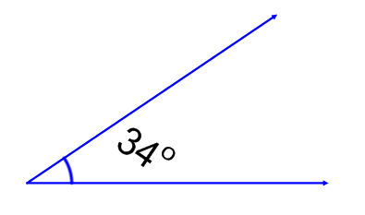
acute angle
an angle with a measure
less than 90°
Notes:
Elementary - 4

Slide 5
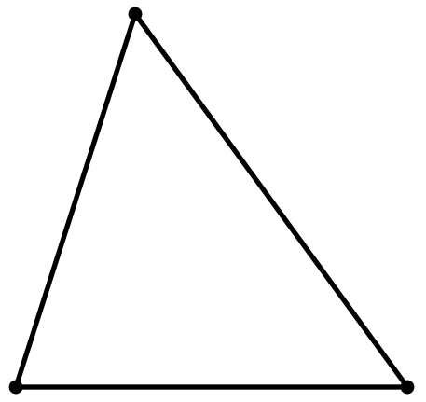
acute triangle
50°
75°
55°
a triangle with all interior angles measuring less than 90°
Notes:
Elementary - 4

Slide 6

addition
component parts: addend + addend = sum
+
=
2 + 2 = 4
an operation that combines two or more numbers or groups of objects
Notes:
Elementary – K word 1st grade the addition equation

Slide 7
additive identity property of zero
8 + 0 = 8
0 + ½ = ½
when you add 0 to any number you end up with that number
Notes:
Use in elementary starting in 1st but don’t need to know the name of the property until MS

Slide 8
additive inverse
(-5) + 5 = 0 x + (–x) = 0
additive inverse of -5 additive inverse of x
the number in the set of real numbers that when added to a given number will yield zero, also referred to as an opposite
Notes:
MS – grade 7

Slide 9
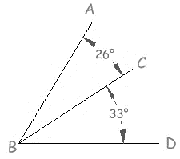
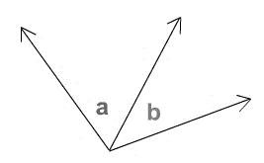
adjacent angles
two angles are adjacent when they have a common side and a common vertex, and they don’t overlap
Notes:
MS – grade 8

Slide 10
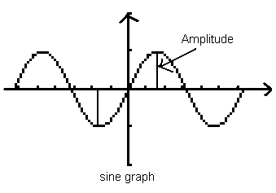
amplitude
the height from the mean value of the function to its maximum or minimum
Notes:
+ new plus standard

Slide 11
angle
two rays or line segments that share an endpoint
Notes:
Elementary – 2nd (as an attribute to describe geometric figures)

Slide 12
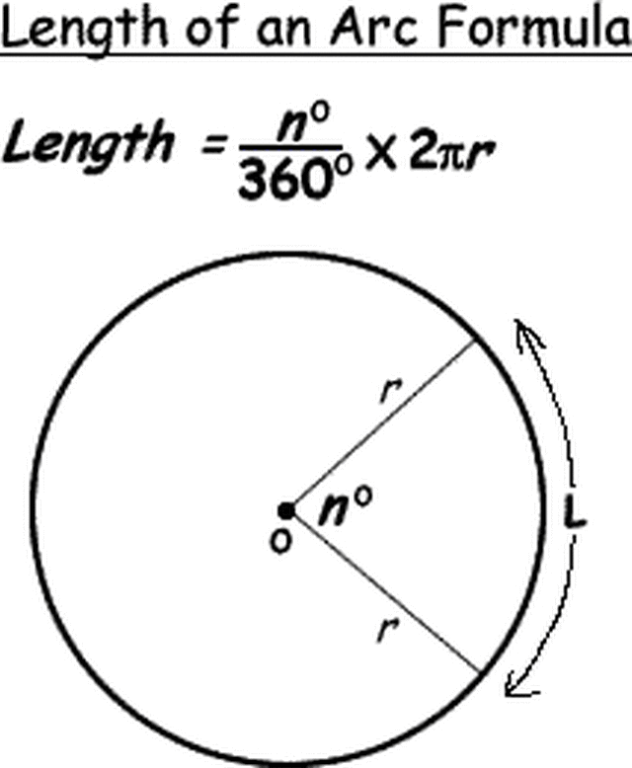
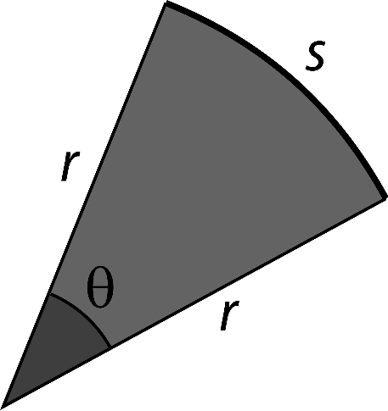
arc length
s = rθ
s = arc length
r = radius of the circle
θ = measure of the central angle in radians
the distance along a segment of the circumference of a circle or of any curve
Notes:
MS – grade 8

Slide 13
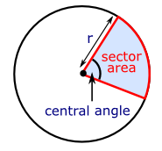
area of sector
the fractional part of the area of an entire circle
Notes:
MS – grade 8

Slide 14
area
The area of the TV screen is
15 square units.
the number of square units needed to cover a given surface
Notes:
Elementary – 3rd

Slide 15
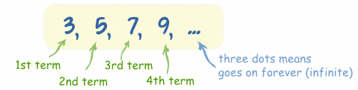
arithmetic sequence
a_{n} = a₁ + (n – 1)d
a₁ = first term a_{n} = n^{th} term
d = common difference n = number of terms
a pattern of numbers where the difference between consecutive terms is constant
Notes:
New – (+) standard

Slide 16
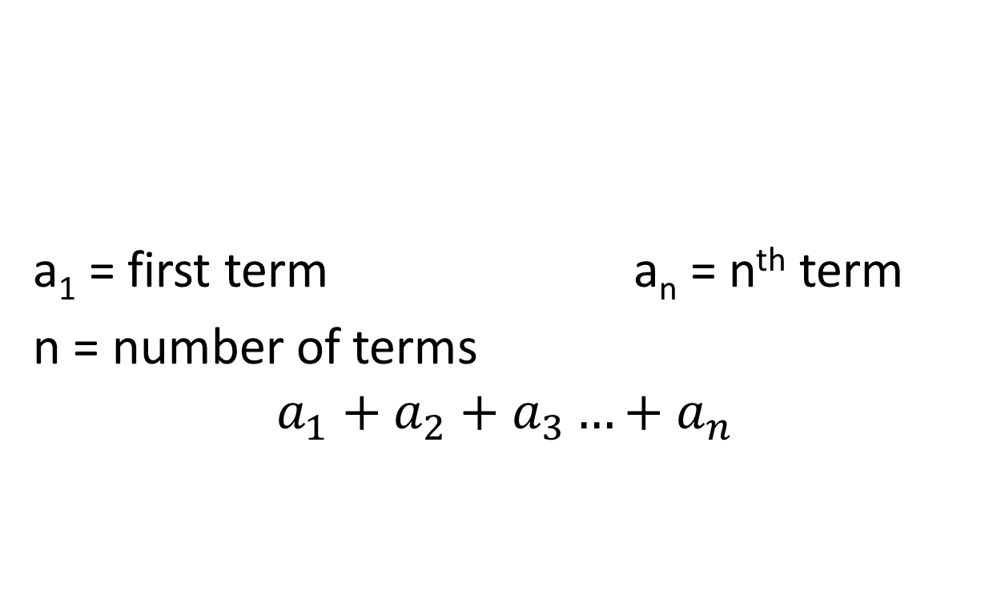
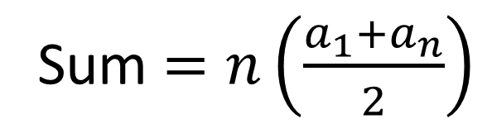
arithmetic series
a₁ = first term a_{n} = n^{th} term
n = number of terms
$$a_{1}+a_{2}+a_{3}…+a_{n}$$
Sum $=n\left(\frac{a_{1}+a_{n}}{2}\right)$
the sum of the terms of an arithmetic sequence
Notes:
New (+) standard

Slide 17
array
a rectangular arrangement of objects with equal amounts in each row
Notes:
Elem – 2nd

Slide 18
associative property
(5+2)+8 = 5+(2+8)
(a •b)•c = a •(b •c)
in addition and multiplication, no matter how the numbers are grouped, the answer will always be the same
Notes:
GRADE 3

Slide 19
attribute
3
odd equal sides
a characteristic of a number, geometric figure, mathematical operation, equation, or inequality
Notes:
Elem - K

Slide 20
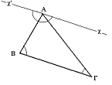
auxiliary line
an extra line needed to complete a proof in plane geometry
Notes:
New (+) standard

Slide 21
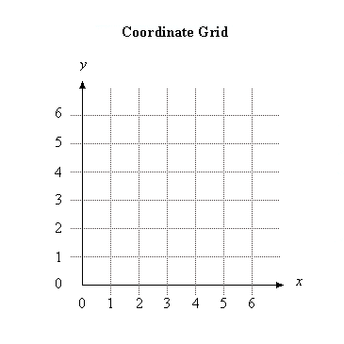
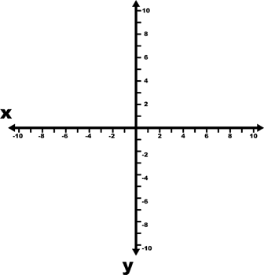
axis
axes
axes
any of the number lines that intersect to form a coordinate system
*the plural of axis is axes
Notes:
Elem – 5th

Slide 22
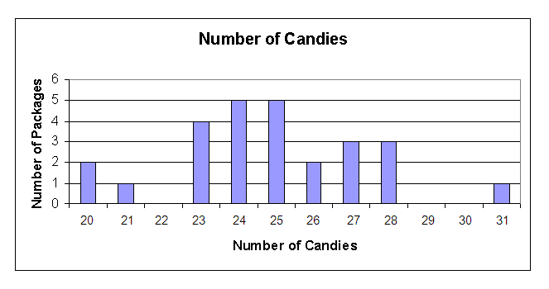
bar graph
a display that uses horizontal or vertical bars to represent data
Notes:
Elem – 2nd

Slide 23
base (polygon)
base
base
base
one of the sides of a plane figure
Notes:
MS 6th grade

Slide 24
base (solid figure)
base
base
the face that helps identify the figure (it does not always have to be on the bottom of the figure)
Notes:
Elem – 5th

Slide 25
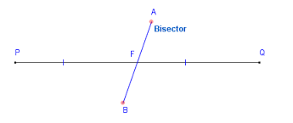
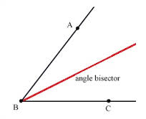
bisect
to divide into two equal parts
(the dividing line is called a bisector)
Notes:
9/10

Slide 26
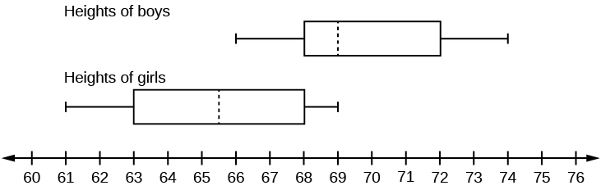
box plot
(box and whisker diagram)
1st quartile
3rd quartile
minimum
median
maximum
inches
a display of the distribution of a data set using the minimum, lower (1st) quartile, median, upper (3rd) quartile, and maximum
Notes:
MS – grade 6

Slide 27
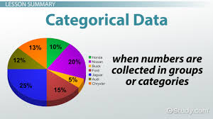
categorical data
data that can be divided into groups; i.e eye color, favorite college
Notes:
Elementary in K

Slide 28
causation
indicates that one event is the result of the occurrence of another event
Notes:
11th

Slide 29
chart
(table)
How Students Get to School
Bike | l l l l
Walk | l l l
Bus | l l l l l
Car | l l l l l l l l l l
information organized in columns and rows
Notes:
Elem – 1st

Slide 30
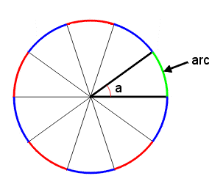
circular arc
a portion of the circumference of circle
Notes:
MS – grade 8

Slide 31
circle
a closed curve with all its points the same distance from the center
Notes:
Elem - K

Slide 32
circumference
the distance around the outside (perimeter) of a circle
Notes:
MS – grade 7

Slide 33
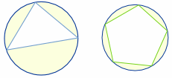
circumscribed figure
a circle that contains another geometric figure that passes through all of the vertices of that figure
Notes:
New
9/10

Slide 34

clustering
There is clustering around the value 8.
when data seems to be "gathering" around a particular value
Notes:
MS – grade 8

Slide 35
coefficient
7n + 8 -4x - 7
7 is the coefficient
-4 is the coefficient
the number by which a variable is multiplied
Notes:
MS – grade 6

Slide 36
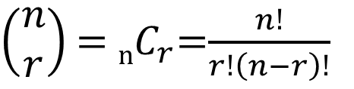

combinations
How many different committees of
4 students can be chosen
from a group of 15?
$\left(\begin{matrix}n \\ r\end{matrix}\right)$ = _{n}$C_{r}$=$\frac{n!}{r!\left(n−r\right)!}$
$\left(\begin{matrix}15 \\ 4\end{matrix}\right)$= $\frac{15!}{4!\left(15−4\right)!}$
A selection of objects from a collection where order is irrelevant.
Notes:
(+) standard

Slide 37
commutative property
5+3 = 3+5
½ x ¼ = ¼ x ½
numbers may be added or multiplied together in any order without changing the answer
Notes:
Use in Elem at 1st but don’t need to know definition of term until MS

Slide 38
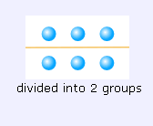
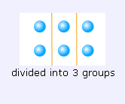
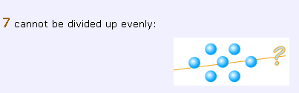
composite number
composite number NOT a composite number
7 cannot be divided into equal groups
factors of 6: 1, 2, 3, 6
factors of 7: 1, 7
a number that has more than two factors
Notes:
Elem – 4th

Slide 39
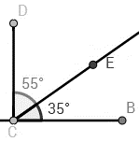
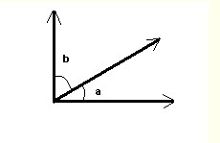
complementary
two angles whose sum is 90°
Notes:
MS – grade 8

Slide 40

Complex Conjugate
Two complex numbers of the form a + bi and a – bi.
For example, the complex conjugate of 3 + 4i is 3 – 4i.
Notes:
11th

Slide 41
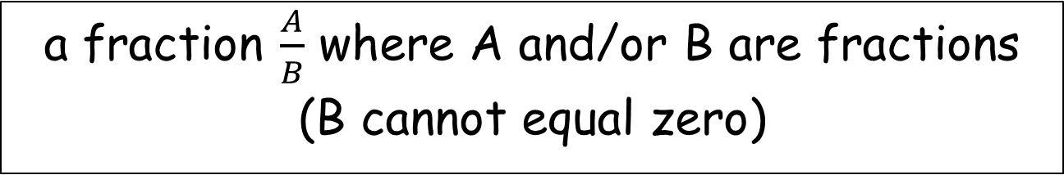


complex fraction
$$\frac{\frac{2}{5}}{\frac{3}{8}}$$
$$\frac{5}{\frac{1}{2}}$$
a fraction $\frac{A}{B}$ where A and/or B are fractions
(B cannot equal zero)
Notes:
MS – grade 7

Slide 42

Complex Number
a number that can be expressed in the form a + bi, where a and b are real numbers
Notes:
11th

Slide 43
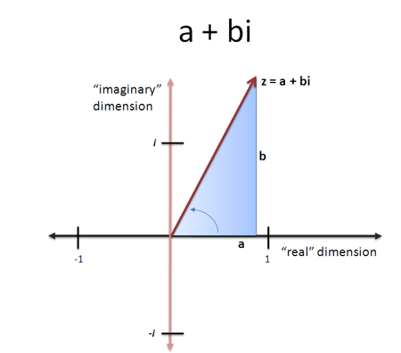
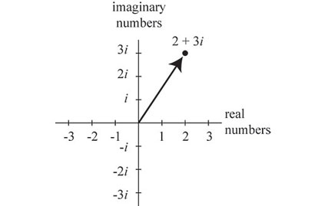
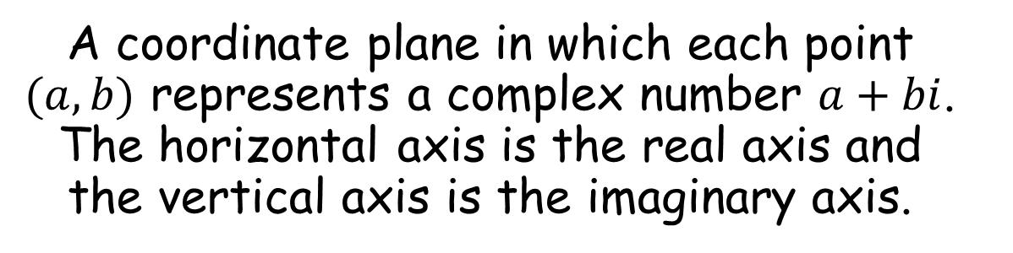
Complex Plane
A coordinate plane in which each point $(a, b)$ represents a complex number $a+bi$. The horizontal axis is the real axis and the vertical axis is the imaginary axis.
Notes:
HS +

Slide 44
compound events
Example: tossing a coin is a simple event, but rolling a die and tossing a coin is a combination of 2 simple events and therefore a compound event.
a combination of two or more simple events
Notes:
MS – grade 7

Slide 45
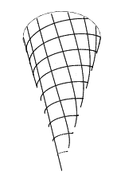
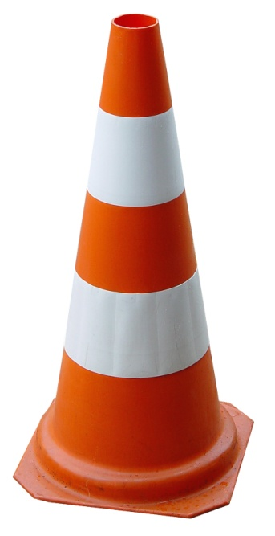
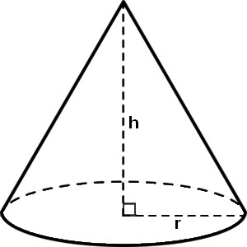
cone
a 3-dimensional figure with a curved surface, a flat circular base, and a vertex
Notes:
Elem - K

Slide 46
congruent
having exactly the same size and shape
Notes:
HS 9/10

Slide 47
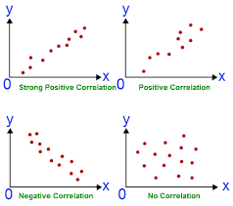
correlation
shows how whether and how strongly pairs of variables are related
Notes:
HS 11

Slide 48
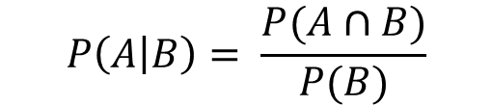
conditional probability
$$P\left(A | B\right)= \frac{P(A∩B)}{P(B)}$$
the probability of an event ( A ), given that another ( B ) has already occurred.
Notes:
(+) standard

Slide 49
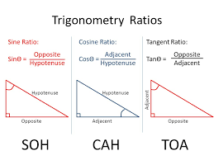
cosine
The trigonometric function that is equal to the ratio of the side adjacent a given angle (in a right triangle) to the hypotenuse.
Notes:
9/10

Slide 50
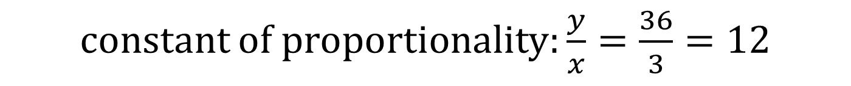
constant of proportionality
Chaperones | 1 | 2 | 3 | 4 | 5
Students | 12 | 24 | 36 | 48 | 60
constant of proportionality: $\frac{y}{x}=\frac{36}{3}=12$
in a proportional relationship, every pair of numbers has the same unit rate (referred to as the “constant of proportionality”)
Notes:
MS – grade 8

Slide 51
converse
Switching the hypothesis and conclusion of a conditional statement.
For example, the converse of "If it is raining then the grass is wet" is "If the grass is wet then it is raining”.
Notes:
New
MS – grade 8

Slide 52
converse of the
Pythagorean Theorem
3² + 4² = 5²
+ 16 = 25
It is a right triangle
5 cm
3 cm
4 cm
when a triangle has side lengths of a, b and c, and a² + b² = c², then the angle opposite the side of length c is a right angle
Notes:
MS – grade 8

Slide 53
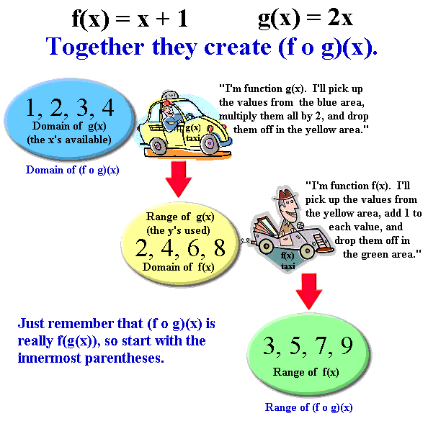
Composition of functions
Notes:
(+) standard

Slide 54
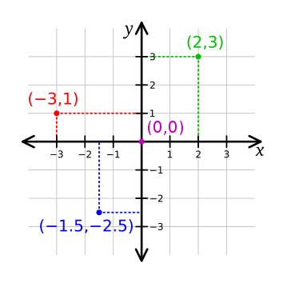
coordinates
X | Y
0 | 0
2 | 3
-3 | 1
-1.5 | -2.5
an ordered pair of numbers (x, y) that gives the location of a point on a coordinate plane
Notes:
Elem – 5th

Slide 55
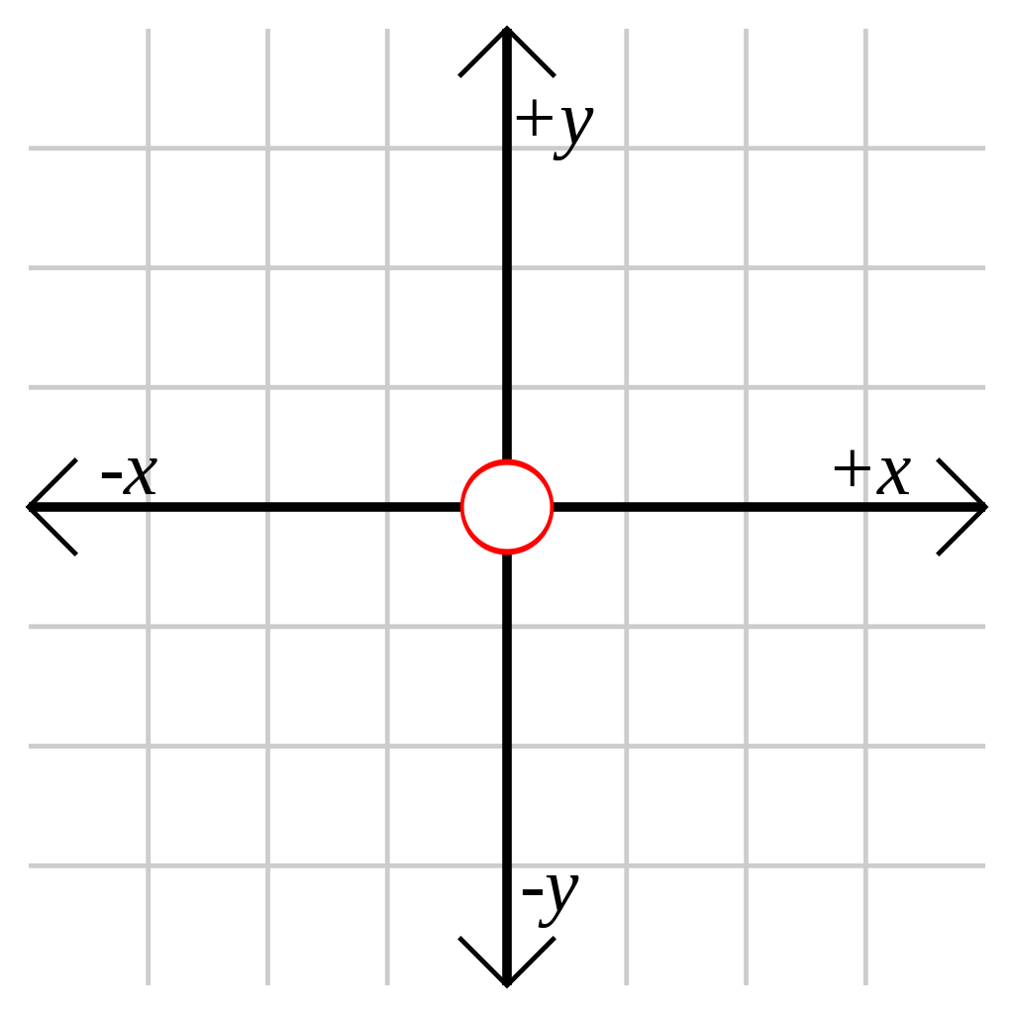
coordinate grid/plane
the plane formed by two perpendicular number lines intersecting at their zero points used for displaying the location of coordinates
Notes:
Elem – 5th (only w/ positive values)

Slide 56
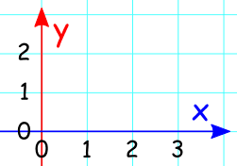
coordinate system
a plane formed by a horizontal number line, called the x-axis, and a vertical number line, called the y-axis which intersect at a point called the origin
Notes:
Grade 5

Slide 57
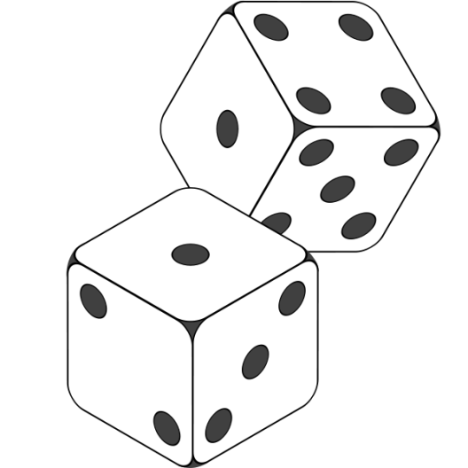
cube
a 3-dimensional figure with
six congruent square faces
Notes:
Elem - K

Slide 58
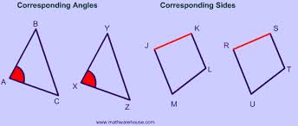
Corresponding parts
The parts of a figure (angles or sides) are in the same relative position in each of the figures.
Notes:
9/10

Slide 59
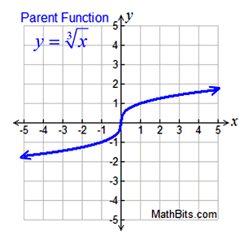
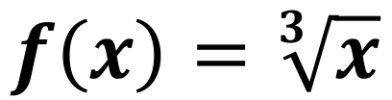
Cube root function
$$f\left(x\right)=\sqrt[3]{x}$$
Features (of parent function):
• increasing (-∞,∞)• positive (0,∞)
• negative (-∞,0)
• no absolute max (graph → ∞)
• no absolute min (graph→ -∞)
• no relative max or min
• end behavior
f (x) → +∞, as x → +∞
f (x) → -∞, as x → -∞
Notes:
11th

Slide 60

cylinder
a 3-dimensional figure with one curved surface and two parallel, congruent circular bases
Notes:
Elem - K

Slide 61


data
information that is collected by counting, measuring, asking questions, or observing that is usually organized for analysis
Notes:
Elem - K

Slide 62
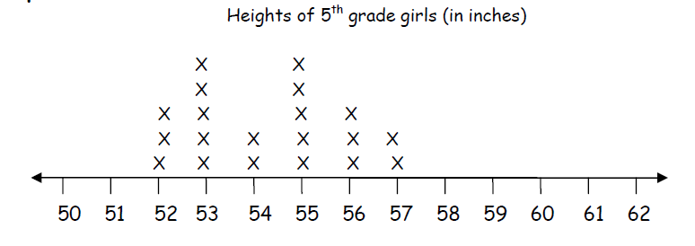

data display
Sides of Squares
# of sides | 4 | 8 | 12 | 16
# of squares | 1 | 2 | 3 | 4
a way to organize data
Notes:
Elem – 2nd

Slide 63



data distribution
graphical methods of organizing and displaying data
Notes:
MS – grade 7

Slide 64

decagon
a polygon with 10 sides
Notes:
Elem – 3rd

Slide 65

decay
When a population or group of something is declining, and the amount that decreases is proportional to the size of the population.
Notes:
11th

Slide 66
decimal fraction
$23.75
.6 4.0
a number written in standard base-10 notation
Notes:
Elem – 4th

Slide 67

decreasing (function)
A function is ”decreasing" when the
y-value decreases as the x-value increases
Notes:
8th

Slide 68

denominator
3
4 equal parts
0
1
the number of equal parts making up a whole
(the bottom number in a fraction)
Notes:
Elem – 3rd

Slide 69

density
Notes:
9/10

Slide 70
dependent variable
Example:
Melissa and her friends are at an arcade and are redeeming their tickets for prizes. The number of tickets (t) they have won determines how many prizes (p) they can get.
(p) the number of prizes is the dependent variable.
a variable (often y) whose value depends on that of another
Notes:
MS – grade 6

Slide 71


Determinant
A useful value that can be computed from the elements of a square matrix. The determinant of a matrix A is denoted det(A), detA , or |A|.
Notes:
11th

Slide 72


diagonals
A straight line joining two opposite corners of a square, rectangle, or other straight-sided shape.
Notes:
9/10

Slide 73
diameter
diameter
a line segment that passes through
the center of a circle and has
endpoints on the circle
Notes:
Used in formulas grade 7 but not formally mentioned in standards until HS

Slide 74
difference
2
9
7
_2_
7 9
9 - 7 = 2
difference
the space between the value of two numbers
(the result of subtracting one number from another)
Notes:
Elem – 2nd

Slide 75
digit
digit
cards
4
2
0
Hundreds
Tens
Ones
any one of the ten symbols
0, 1, 2, 3, 4, 5, 6, 7, 8, 9
Notes:
Elem – 1st

Slide 76


dilation
A transformation that produces an image that is the same shape as the original, but is a different size. A dilation stretches or shrinks the original figure.
Notes:
9/10

Slide 77
distributive property of multiplication
over addition
4(2+3) = 4x2 + 4x3
123 = (1 x 100) + (2 x 10) + (3 x 1)
Notes:
Know how to use it in Elem in 3rd grade but don’t need to know definition of term term until MS
MS – grade 6

Slide 78
division
component parts: dividend ÷ divisor = quotient
6
3
= 2
6 ÷ 3 = 2
2
)
3
6
the operation of making equal groups to find out how many in each group or how many groups
Notes:
Elem – 3rd

Slide 79


domain
All the values that go into a function (x-values, independent variables, input values).
Notes:
9/10

Slide 80

dot plot
statistical chart consisting of data points plotted on a fairly simple scale, typically using filled in circles
Notes:
MS – grade 6

Slide 81
edge
edge
where two faces of a solid shape intersect
Notes:
Elem – 5th

Slide 82
ellipse
Notes:
Elem – should be familiar with tern but will not be in assessment

Slide 83



equal
=
2 + 4 = 13 - 7
having the same value
Notes:
Elem - K

Slide 84
equation
8 + 2 = 10
5 x 5 = 100 ÷ 4
20 = 18 + 2
a mathematical sentence where the left side of the equal sign has the same value as the right side of the equal sign
Notes:
Elem – begin to understand in K but don’t use until 2nd

Slide 85
equilateral
a polygon with all sides congruent
Notes:
Elem – 4th

Slide 86

equilateral triangle
a triangle whose sides are all
the same length
Notes:
Elem – 4th

Slide 87
equivalent
7 + 2 = 10 - 1
.5 = ½
.5 = .50
having the same value
Notes:
Elem – start understanding term in 1st grade but don’t need to know until 3rd

Slide 88
estimate
About how many?
to find a number close to an exact amount
Notes:
Elem - K

Slide 89
even number
374
12 86,460
3,496
whole numbers that are divisible by 2 Hint: even numbers have 0, 2, 4, 6, or 8 in the ones place
Notes:
Elem – 2nd

Slide 90
expanded form (expanded notation)
493 = 400 + 90 + 3
493 = (4 x 100) + (9 x 10) + 3
a way to write numbers showing the place value of each digit
Notes:
Elem – 2nd

Slide 91
experimental probability
A student tosses a number cube 8 times and it lands on a four, 1 of those times.
Experimental Probability = 1 (# of times occurred)
of landing on a 4. 8 (# of times performed)
the ratio of the number of times an event occurs to the total number of trials or times the activity is performed
Notes:
MS – grade 7

Slide 92
exponent
10⁵
10 x 10 x 10 x 10 x 10
exponent
a numeral telling how many times a factor is to be multiplied
Notes:
Elem - 5th grade

Slide 93


exponential function
$$f\left(x\right)=b^{x}$$
Notes:
11th

Slide 94
expression
6 x 9
(12 ÷ 3) + 2
20 - y
a mathematical phrase made up of numbers, variables, operational symbols, and/or parentheses
Notes:
An expression DOES NOT contain relation symbols such as =, <, >
Elem – 5th

Slide 95

Exterior angle
The angle between any side of a shape, and a line extended from the next side.
Notes:
MS – grade 8
new

Slide 96

Extraneous Solution
A solution obtained from solving an equation that does not satisfy the original equation.
Notes:
9/10

Slide 97

face
the flat surface of a solid figure
Notes:
Elem - K

Slide 98

Factoring
Finding what to multiply to get an expression.
Example: 2y+6 = 2(y+3),
so the factors of 2y+6 are: 2 and (y+3)
Notes:
Process is used in grade 8 but not formally referred to as factoring until HS

Slide 99


fraction
1
3 is white
1
2 of the stars are circled
a part of a whole (region, line or set); the name for a number written in the form (e.g. ¼ )
A fraction may also be used to represent division.
Notes:
Elem – 3rd

Slide 100
frequency table
a table that shows how often that
data point occurred
(tally marks are commonly used)
Notes:
MS 7th grade

Slide 101
Functional Relationships
Function example :
y= 2x
Input | Relationship | Output
0 | × 2 | 0
1 | × 2 | 2
7 | × 2 | 14
10 | × 2 | 20
... | ... | ...
A function is a special relationship where each input has a single output.
Notes:
MS – grade 8

Slide 102

Function notation
$$f\left(x\right)=y$$
Notes:
9/10

Slide 103

Geometric sequence
a pattern of multiplying a fixed amount from one term to the next
a₁ = first term a_{n} = n^{th} term
r=common ratio n=number of terms
Notes:
(+) standard

Slide 104

Geometric series
Summation of a pattern of multiplying a fixed amount from one term to the next
a₁ = first term r=common ratio n=number of terms
Notes:
(+) standard

Slide 105
greatest common factor
Two methods to find the greatest common factor include:
The greatest common factor either way is 2 x 3 or 6
1. List the prime factors of each number
2. Identify the factors in common
3. Multiply those factors together
Prime factors of 18: 2 x 3 x 3
Prime factors of 24: 2 x 2 x 2 x 3
List all factors of each number
Identify the largest factor in common
Factors of 18: 1, 2, 3, 6, 9, 18
Factors of 24: 1, 2, 3, 4, 6, 8, 12, 24
the largest value that divides into two or more numbers
Notes:
MS – grade 6

Slide 106
growth pattern
1 2 4 8 16
This pattern is following a “x2” rule.
a type of pattern made by following a rule using operations
Notes:
Elem – 1st

Slide 107


Half-Planes
The two regions into which the boundary line of a linear inequality divides the coordinate plane.
Notes:
9/10

Slide 108
height
height
the distance from the base to the top of an object or shape
Notes:
Elem – 1st

Slide 109

heptagon (septagon)
a polygon with 7 sides
Notes:
Elem – 3rd

Slide 110

hexagon
a polygon with 6 sides
Notes:
Elem – 2nd

Slide 111


histogram
a graph consisting of adjacent rectangular bars with height proportional to the value of a variable and whose width is a consistent interval
Notes:
MS – grade 6

Slide 112



horizontal asymptote
For curves given by the graph of a function $y=f(x)$, horizontal asymptotes are horizontal lines that the graph of the function approaches as x approaches $±∞$.
Notes:
New
(+) standard

Slide 113


hyperbola
Notes:
New (+) standard

Slide 114
improper fraction
7
4
0
1
2
a fraction with a numerator that is greater than or equal to its denominator
Notes:
This is a term that is not needed according to the standards but we included it since so many different curricula have it – Elem 3rd grade starts with the understanding but the term is not required.
Should use the phrase “fractions larger than one” instead of this term.

Slide 115

Inscribed figure
To draw a circle on the inside of a figure, touching as many points as possible.
Notes:
+ new

Slide 116
independent events
the probability of one event occurring in no way affects the probability of another event occurring
Notes:
(+) standard

Slide 117
independent variable
Example:
Melissa and her friends are at an arcade and are redeeming their tickets for prizes. The number of tickets (t) they have won determines how many prizes (p) they can get.
(t) the number of tickets is the independent variable.
a variable (often x) whose value does not depend on that of another
Notes:
MS – grade 6

Slide 118
Interior angle
An angle inside a shape.
Notes:
New
Used at MS grade 8

Slide 119
inequality
4 + 3 < 5 + 7
2y > 14
a number sentence not equal in size, amount, or value
(usually one of the following symbols is used <, >, ≤, ≥, ≠)
Notes:
Elem – 1st start understanding but use the term in 3rd

Slide 120


Infinitely Many Solutions
Infinite solutions would mean that any value for the variable would make the equation true.
If the variables disappear, and you get a statement that is always true, such as 0 = 0 or 3 = 3, then there are "infinite solutions", meaning, when graphed, the two equations would form the same line
Notes:
MS – grade 8

Slide 121

Input and Output
Y=3x+1
Y= 3(2) +1
X
x=2
Y
Y=7
Mathematical equations called functions use the input and output to replace the variables in an equation. The input is the known variable, while the output is the solution.
Inputs (x) are numeric values to which a procedure is applied, producing an output (y), which is also a numeric value.
Notes:
8th

Slide 122

input/output table
a table that shows an output value for each input value
Notes:
Not a required term in Elem but used.
Required by 8th grade

Slide 123
integers
…-3, -2, -1, 0, 1, 2, 3…
the set of whole numbers and their opposites: . . . ,-2, -1, 0, 1, 2, . . .
Notes:
MS – grade 6

Slide 124
intersecting lines
lines that meet or cross
Notes:
MS – grade 8

Slide 125


interval (linear)
{
{
interval
space between numbers on a number line or the grid lines of a graph
Notes:
Elementary – used to describe equal spacing on number line starting in 3rd grade

Slide 126


interval (time)
a space of time between events
Notes:
Elem – grade 4

Slide 127
interquartile range
Quartiles divide a rank-ordered data set into four equal parts. The values that divide each part are called the first, second, and third quartiles; and are denoted by Q1, Q2, and Q3, respectively.
Interquartile range is a measure of variation equal to Q3 minus Q1 and Q2 represents the median.
2, 3, 5, 5, 6, 6, 6, 8, 10, 12
Interquartile range: 8 – 5 = 3
the difference between the upper (third) quartile and lower (first) quartile in a set of data
Notes:
MS – grade 6

Slide 128

intercepts
X Intercept: where the graph of an equation crosses the x-axis
Y Intercept: where the graph of an equation crosses the y-axis
Notes:
New
MS – grade 8

Slide 129

Increasing (function)
A function is "increasing" when the
y-value increases as the x-value increases
Notes:
New
8th

Slide 130


Interval (function)
All the domain/range between two given points on graph.
Notes:
9/10

Slide 131
Inverse (geometry)
Negating both the hypothesis and conclusion of a conditional statement.
For example, the inverse of "If it is raining then the grass is wet" is "If it is not raining then the grass is not wet".
Notes:
New 9/10

Slide 132

Irrational
A real number that can NOT be made by dividing two integers. (Note: integers have no fractions.)
The decimal goes on forever without repeating.
Notes:
MS – grade 8

Slide 133
irregular polygon
a polygon whose sides are
not all the same length
Notes:
Term does not need to be known for Elem but they understand the concept

Slide 134

isosceles triangle
c
c
c
c
b
b
a triangle with 2 equal sides
Notes:
Elem – 4th

Slide 135

isosceles triangle
A triangle with exactly two sides of equal length (exclusive); a triangle with at least two sides of equal length (inclusive)
Notes:
High School 9/10

Slide 136


kite
a quadrilateral with two pairs of equal adjacent sides
Notes:
Elem – 3rd

Slide 137
least common multiple
Two methods to find the least common multiple include:
The least common multiple either way is 2 x 2 x 2 x 3 x 3 or 72
1. List the prime factors of each
2. Identify the groups of factors with greatest frequency for each
3. Multiply those groups of factors
Prime factors of 18: 2 x 3 x 3
Prime factors of 24: 2 x 2 x 2 x 3
Start listing multiples of each number
Identify the smallest multiple in common
Factors of 18: 18, 36, 54, 72, 90, …
Factors of 24: 24, 48, 72, 96, 120, …
the smallest positive value that is divisible by both original numbers
Notes:
MS – grade 6

Slide 138
length
Graphic here
the measure of one side of an object, typically the longer side
Notes:
Elem - K

Slide 139

Like Terms
Terms whose variables (and their exponents such as the 2 in x²) are the same.
Example: 7x and 2x are like terms because the variables are both "x"
But 7x and 7x² are NOT like terms (they are Unlike Terms)
Notes:
MS – grade 6

Slide 140
line
an infinite set of points forming a straight path extending in two directions
Notes:
Elem – 4th

Slide 141

line plot
(dot plot)
a display using a number line with marks or dots that show frequency
Notes:
Elem – 3rd

Slide 142
line segment
a part of a line defined by
two endpoints
Notes:
Elem – 4th

Slide 143


Linear
an equation or function that is the equation of a straight line and takes the form y = mx + b, where "m" is equal to the slope, and "b" is equal to the y-intercept. The degree on variable is always 1.
The rate of change is constant between any two points.
Notes:
MS – grade 7

Slide 144

Linear Equations
An equation that makes a straight line when it is graphed.
Often written in the form: y = mx+b
Notes:
MS – grade 8

Slide 145

Linear functions
Example: y=2x
A linear function is any function that graphs to a straight line.
A linear function is a first degree polynomial of the form, y = m x + b, where m and b are constants and x is a real variable.
The constant m is called slope and b is called y-intercept.
Notes:
MS – grade 8

Slide 146

Linear Relationships
An equation with a pattern that includes a constant rate of change
There are only three criteria that equations must meet to qualify as a linear relationship.
1. The equation can have up to two variables, but it cannot have more than two variables.
2. All the variables in the equation are to the first power.
3. The equation must graph as a straight line.
Notes:
MS – grade 8

Slide 147
liquid volume
(capacity)
the amount that a container can hold
common units of measure: cup, pint, gallon, liter, etc.
Notes:
Elem – 3rd

Slide 148

(local) Maxima or Minima
Maxima: The height of the function at "a" is greater than (or equal to) the height anywhere else in that interval.
Minima: The height of the function at "a" is less than (or equal to) the height anywhere else in that interval.
Notes:
9/10

Slide 149



Logarithm (function)
$$f(x) = loga(x)$$
a is any value greater than 0, except 1 When a=1, the graph is not defined
For a between 0 and 1
As x nears 0, it heads to -infinity
As x increases it heads to infinity
it is a Strictly Increasing function
It has a Vertical Asymptote along
he y-axis (x=0).
For a above 1:
As x nears 0, it heads to infinity
As x increases it heads to -infinity
It is a Strictly Decreasing function
It has a Vertical Asymptote along the y-axis (x=0).
Notes:
11th

Slide 150


Magnitude
the length of the vector, magnitude of vector a is denoted as $\left\|a\right\|$
Notes:
(+) standard

Slide 151
mathematical modeling
the process of developing a description of a system using mathematical concepts and language
Notes:
Not on assessment but all grades should be familiar with term.

Slide 152

Matrix
a rectangular array of numbers, symbols, or expressions arranged in rows and columns
For example, the dimensions of a 2 × 3 matrix (read "two by three") has two rows and three columns.
Notes:
(+) standard

Slide 153


Maximum
The largest value of a function.
For example, the y-coordinate of the vertex for $y=ax^{2}+bx+c$ when $a<0$ is the maximum.
Notes:
9/10

Slide 154
mean
Set of Data: {2, 3, 5, 5, 6, 6, 6, 8, 10, 12}
Mean: (2+3+5+5+6+6+6+8+10+12)/10 = 6.3
the sum of a collection of numbers divided by the number of numbers in the collection
Notes:
MS – grade 6

Slide 155
mean absolute deviation
The steps to find the mean absolute deviation include:
1. find the mean
2. find the difference between each data value and the mean
3. take the absolute value of each difference
4. find the mean of these differences
the mean distance between each data value and the mean
Notes:
MS – grade 7

Slide 156
measure of center
2, 3, 5, 5, 6, 6, 6, 8, 10, 12
Mean: (2+3+5+5+6+6+6+8+10+12)/10 = 6.3
2, 3, 5, 5, 6, 6, 6, 8, 10, 12
Median: 6
2, 3, 5, 5, 6, 6, 6, 8, 10, 12
Mode: 6
the value representing the central position or middle value of a data set (usually the mean, median or mode)
Notes:
MS – grade 6

Slide 157
measures of spread (variability)
describe how varied or similar the set of observed values are to a particular data item…The statistics included are range, interquartile range, variance, and standard deviation.
Notes:
MS – grade 6 but it is referred to as measure of variability not measure of spread

Slide 158
measure of variation
2, 3, 5, 5, 6, 6, 6, 8, 10, 12
Range: 12 – 2 = 10
2, 3, 5, 5, 6, 6, 6, 8, 10, 12
Interquartile range: 8 – 5 = 3
the value representing the amount of spread or variability in a data set (usually the range or interquartile range)
Notes:
MS – grade 6

Slide 159
median
Set of Data: {2, 3, 5, 5, 6, 6, 6, 8, 10, 12}
Median: 6
Set of Data: {1, 2, 3, 6, 6, 6, 8, 10, 12}
Median: 6
the middle value in a list of numbers in numerical order
Notes:
MS – grade 6

Slide 160

Median of a triangle
A line segment joining a vertex to the midpoint of the opposing side. The center of these lines is called a centroid.
Notes:
9/10

Slide 161

midpoint
A point on a line segment that divides it into two equal parts.
Notes:
9/10

Slide 162


Minimum
The smallest value of a function.
For example, the y-coordinate of the vertex for when is the minimum.
Notes:
9/10

Slide 163
mode
Set of Data: {2, 3, 5, 5, 6, 6, 6, 8, 10, 12}
Mode: 6
the value that appears most often in a set of data
Notes:
MS – grade 6

Slide 164


Modulus
The modulus of a complex number z = a + bi, denoted by $\left|z\right|$, is defined by $\left|z\right|=\sqrt{a^{2}+b^{2}}.$
Notes:
(+) standard

Slide 165



mixed number
1
2
3
0
1
2
3
4
a quantity written with an integer and
a fraction
Notes:
Elem – 4th

Slide 166
multiple
multiples of 3
3, 6, 9, 12, 15, 18
multiples of 6
6, 12, 18, 24, 30
the product of any number and a counting number is a multiple of that number
Notes:
Elem 3rd

Slide 167
multiplication
Component Parts:
factor x factor = product
0 1 2 3 4 5 6 7 8 9 10 11 12
the operation of repeated addition
Notes:
Elem – 3rd

Slide 168

multiplicative comparison
The first flower is
2 times taller than
the second flower.
The walk was 3 times
longer today than it
was yesterday.
comparing the difference between values using multiplication
Notes:
Elem – 4th

Slide 169
multiplicative identity property of one
7 x 1 = 7 12 x 1 = 12
n x 1 = n
when a number is multiplied by 1, the product is that number
Notes:
Know how to use this in Elem at 3rd but not know term until MS

Slide 170

negative association
two variables have a negative association when the values of one variable tend to decrease as the values of the other variable increase
Notes:
MS – grade 8

Slide 171

negative numbers
numbers less than zero
Notes:
MS – grade 6

Slide 172

net
an arrangement of polygons joined at the edges which represent the faces of a 3-dimensional figure
Notes:
MS – grade 6

Slide 173


No Solution
No solution is an answer that means no matter what value is plugged in for the variable, you will ALWAYS get a contradiction. A visual representation on a graph would be two parallel lines - they would never intersect.
Notes:
MS – grade 8

Slide 174

nonagon
a polygon with 9 sides
Notes:
Elem – 3rd

Slide 175


Nonlinear
Equation whose graph does not form a straight line (linear) is called a Nonlinear Equation
In a nonlinear equation, the variables are either of degree greater than 1 or less than 1, but never 1.
Notes:
MS – grade 8

Slide 176

normal distribution
a function that represents the distribution of many random variables as a symmetrical bell-shaped graph
Notes:
(+) standard

Slide 177
number forms
Standard form: 3045
Word form: three thousand, forty-five
Expanded form: 3000 + 40 + 5
(see expanded form card for more examples)
Unit form: 3 thousands 4 tens 5 ones
Notes:
Elem – 2nd

Slide 178

number model
2 x 6 = 12
2 groups of 6 crayons = 12 crayons
1 + 2 = 3
1 boy and 2 girls = 3 children
a mathematical representation of a situation
Notes:
Elem – 2nd

Slide 179
number sentence
5 + 3 = 8 7 > 4 x 1
5 + 2 < 8 5 + 3 ≠ 2 + 1
an equation (=) or inequality (<,>, ≤, ≥, ≠) with numbers
Notes:
Elem – 2nd

Slide 180

number systems
Real
Complex
Irrational
the different subgroups of numbers
Notes:
9/10

Slide 181
numerator
2
4
parts described
0
1
tells how many equal parts of a whole are being described
(the top number of a fraction)
Notes:
Elem – 3rd

Slide 182



obtuse angle
an angle with a measure greater than 90° and less than 180°
Notes:
Elem – 4th

Slide 183

obtuse triangle
140 °
110 °
a triangle with an angle measuring more than 90°
Notes:
Elem – 4th

Slide 184

octagon
a polygon with 8 sides
Notes:
Elem – 3rd

Slide 185
odd number
4,283
21
11 283,005
whole numbers that cannot be divided into 2 equal groups of whole numbers
Hint: odd numbers have 1, 3, 5, 7, or 9 in the one’s place
Notes:
Elem – 2nd

Slide 186


one degree angle
a unit for measuring the size of angles; a full rotation is 360 degrees, so a one degree angle is 1/360 of a circle
Notes:
MS – grade 8

Slide 187

operational symbols
+
x
÷
-
*
●
symbols used to indicate computation
Notes:
Start understanding in 1st grade but not use until 3rd

Slide 188

ordered pair
a pair of numbers that gives the coordinates of a point on a grid in this order:
(horizontal coordinate, vertical coordinate)
Notes:
Elem – 5th

Slide 189
orientation
rectangular prism
Square – even when rotated
position and direction in space
Notes:
Start understanding in Elem but not necessary to know the term

Slide 190

Origin
The starting point.
On a number line it is 0
On a two-dimensional graph it is where the X axis and Y axis cross, marked (0, 0) on the graph here:
In three dimensions it
is the point (0, 0, 0)
Often written as the letter O
Notes:
Elem – 5th

Slide 191
outcome
a possible result of a probability experiment
Notes:
MS – grade 7

Slide 192

outlier
Set of data:
{12, 12, 13, 13, 13, 13, 13, 13, 14, 14, 24}
The outlier is 24
a value that is much smaller or larger than most other values in a set of data
Notes:
MS – grade 6

Slide 193


parabola
A graph of a quadratic function, y = x².
Notes:
11th

Slide 194
parallel lines
lines that are always the same distance apart and will never intersect
Notes:
Elem – 3rd

Slide 195
parallelogram
a quadrilateral with two pairs of parallel sides
Notes:
Elem – 3rd

Slide 196

Part-to-Part Ratio
Can also be written 2/3 or 2:3
Can also be written 3/2 or 3:2
a comparison of two values where each is a part of the whole
Notes:
MS – grade 6

Slide 197

Part-to-Whole Ratio
Can also be written 3/8 or 3:8
Can also be written 5/8 or 5:8
a comparison of two values where one is a part of the whole and the other is the whole.
Notes:
MS – grade 6

Slide 198

Pascal’s Triangle
a triangular array of numbers in which those at the ends of the rows are 1 and each of the others is the sum of the nearest two numbers in the row above (the apex, 1, being at the top)
Notes:
(+) standard

Slide 199

pattern
repeating growing
Core (or unit) of the repeating pattern.
a logical sequence of numbers, pictures, shapes, or symbols
Notes:
Elem – not necessary to know the term repeating since it is not a standards expectation. Growing patterns begin in 1st grade

Slide 200

pentagon
a polygon with 5 sides
Notes:
Elem – 2nd

Slide 201

periodicity
A function whose output contains values that repeat periodically (such as sine and cosine).
Notes:
9/10

Slide 202
perimeter
the distance around a figure
Notes:
Elem – 3rd

Slide 203


permutation
$$\frac{n!}{\left(n−k\right)!}$$
_{n}$P_{k}$=
All possible arrangements of a collection of things, where the order is important.
Notes:
(+) standard

Slide 204

perpendicular lines
two lines that form a right angle where they intersect
Notes:
Elem – 4th

Slide 205

Piecewise functions
A function which is defined by multiple sub-functions, each sub-function
applying to a certain interval of the main
function's domain
(a sub-domain).
Notes:
+ new

Slide 206

pictograph
a display that uses pictures or symbols to represent data
Notes:
Elem – 1st

Slide 207

place value
2,365
3 units of size 100
30 units of size 10
300 units of size 1
the value of a digit depending on
its place in a number
Notes:
Elem – 2nd

Slide 208

plane figures (2-D)
any 2-dimensional shape that lays in a single plane
a flat surface extending infinitely in all directions
Notes:
Elem – need to know 2-D shapes in 1st grade but don’t need to know the term plane figures until MS
MS – grade 7

Slide 209
plot
y
P (4,2)
x
to place (points or other figures) on a graph by means of coordinates
Notes:
Elem – 5th

Slide 210
point
an exact location in space
Notes:
Elem – 4th

Slide 211
polygon
a closed plane figure made from line segments that meet at endpoints and do not cross
Notes:
Elem – 3rd

Slide 212

positive association
two variables have a positive association when the values of one variable tend to increase as the values of the other variable increase
Notes:
MS – grade 8

Slide 213
positive numbers
numbers that are greater than zero
Notes:
MS – grade 6

Slide 214

Polynomial function
An expression that can have constants, variables and exponents, that can be combined using addition, subtraction, multiplication and division, but:
• no division by a variable.
• a variable's exponents can only be 0,1,2,3,... etc.
• it can't have an infinite number of terms.
Notes:
9/10

Slide 215
prime number
prime number NOT a prime number
7 cannot be divided into equal groups
factors of 7: 1, 7
factors of 6: 1, 2, 3, 6
a counting number greater than 1 that has exactly two factors, itself and 1
Notes:
Elem – 4th

Slide 216


prism
a 3-dimensional figure with two identical, parallel faces (bases) that are polygons; the remaining faces are parallelograms
* A prism is named by its base.
Notes:
Elem – 5th

Slide 217
probability
P(A) = $\frac{number of outcomes in event A}{number of outcomes in the sample space}$
The likelihood of the occurrence of an event. The probability of event A is written P(A). Probabilities are always numbers between 0 and 1, inclusive.
Notes:
MS – grade 7

Slide 218
procedural fluency
refers to knowledge of procedures, knowledge of when and how to use them appropriately, and skill in performing them flexibly, accurately, and efficiently
Notes:
Not on assessment

Slide 219



pyramid
a 3-dimensional figure whose base is a polygon and whose other faces are triangles that
share a common vertex
* A pyramid is named by its base.
Notes:
Start looking at this shape in elementary but don’t need to know term then.
MS – grade 8

Slide 220

Pythagorean Theorem
a² + b² = c²
in a right triangle, the square of a hypotenuse is equal to the sum of the squares of the other two sides
Notes:
MS – grade 8

Slide 221

quadrant
one of four equal parts of a coordinate plane created by the intersection of the x and y axes
Notes:
Introduced in grade 5 but more fully integrated at MS grade 6

Slide 222

Quadratic
a quadratic function, a quadratic polynomial, a polynomial of degree 2, or simply a quadratic, is a polynomial function in one or more variables in which the highest-degree term is of the second degree.
Notes:
11th

Slide 223

quadrilateral
square rectangle parallelogram rhombus kite
a polygon with 4 sides
Notes:
Elem – 2nd

Slide 224

Qualitative
Qualitative data is information that describes something.
Examples:
• Your friends' favorite holiday destination
• The most common given names in your town
• How people describe the smell of a new perfume
Note: the other type of data is "Quantitative Data" which can be counted or measured.
Notes:
MS – grade

Slide 225
Quantitative
Data that can be:
• counted (called "discrete data") or
• measured (called "continuous data")
Notes:
MS – grade 8

Slide 226

Radical
a quantity expressed as a root of another quantity
Notes:
MS – grade 8

Slide 227
radius
radius
2 inches
the distance from the center of a circle to any point on a circle
Notes:
MS – grade 7

Slide 228
random sampling
Example: One might choose people by assigning each person a number or giving each person a ticket and then randomly selecting a number or drawing a ticket out of a hat.
a sampling method in which all members of a group have an equal and independent chance of being selected
Notes:
MS – grade 7

Slide 229
range
Set of data:
{89, 73, 84, 91, 87, 77, 94}
largest – smallest = 94 – 73 = 21
the difference between the largest and smallest values in a set of data
Notes:
MS – grade 6

Slide 230
Range of a function
All the values that out of a function (y-values, dependent variables, output values).
Notes:
9/10

Slide 231

Rate of Change
A ratio of the difference in the dependent variable over the different in the independent variable
SynonyMS
  Slope,
  rise/run,
  change in y/change in x
Notes:
MS – grade 8

Slide 232

ratio
Can be written with a fraction bar, colon or the word “to”
a comparison of two values using division
Notes:
MS – grade 6

Slide 233


Rational function
A function that is written as $f\left(x\right)=\frac{P(x)}{Q(x)}$ where $P(x) and Q(x)$are polynomials and $Q(x)≠0.$
Notes:
+ new

Slide 234
rational number
1.5 -0.1 0.001
6 0.222….
a number that can be written as a ratio
Notes:
MS – grade 6

Slide 235
ray
a part of a line that has one endpoint and extends forever in one direction
Notes:
Elem – 4th

Slide 236
rectangle
a quadrilateral with 4 right angles
Notes:
Elem – K

Slide 237
rectilinear polygon
a polygon whose edges meet at right angles
Notes:
Elem – 3rd

Slide 238


radian
The angle made when the radius is wrapped round the circle
Notes:
(+) standard

Slide 239

reflex angle
an angle that measures greater than 180°
Notes:
Elem – 4th

Slide 240
regular polygon
a polygon with all sides the same length and all angles the same measure
Notes:
Need to start understanding the qualities but don’t need to know the term in Elem

Slide 241
related equations
(fact families)
addition/subtraction
7 + 4 = 11 11 – 7 = 4
4 + 7 = 11 11 – 4 = 7
11 = 4 + 7 11 = 7 + 4
7 = 11 – 4 4 = 11 - 7
multiplication/division
3 x 4 = 12 12 ÷ 3 = 4
4 x 3 = 12 12 ÷ 4 = 3
12 = 3 x 4 12 = 4 x 3
3 = 12 ÷ 4 4 = 12 ÷ 3
a set of equations that all communicate the same relationship between three values, but in different ways
Notes:
Elem – 1st

Slide 242
relative frequency
Example: Your team has won 9 games from a total of 12 games played.
Relative Frequency of winning is 9/12 = 75%
how often something happens divided by all outcomes
Notes:
MS – grade 7

Slide 243
relational symbols
=
<
≠
>
symbols used to show equalities and inequalities between quantities and values
Notes:
Start building understanding in K but don’t need to know term until 3rd

Slide 244
remainder
9 ÷ 2 = 4 r 1
amount leftover after dividing a number
Notes:
Elem – 4th

Slide 245

recursive function
Function in which each term is defined as a function of its preceding term(s). [Each term is found by doing something to the term(s) immediately in front of that term.]
Notes:
(+) standard

Slide 246

reflection
A transformation in which each point of the original figure (pre-image) has an image that is the same distance from the line of reflection as the original point but is on the opposite side of the line. Remember that a reflection is a flip.
Notes:
NEW – 6th grade

Slide 247
rhombus
a parallelogram with equal sides and opposite angles equal
Notes:
Elem – 3rd

Slide 248


right angle
an angle that measures 90°
Notes:
Elem – 3rd

Slide 249

right prism
a 3-dimensional figure with two identical, parallel faces (bases) that are polygons; the remaining faces are parallelograMS and are perpendicular to the faces (bases)
* A prism is named by its base. A triangular prism has a triangle as its base and a rectangular prism has a rectangle as its base.
Notes:
MS – grade 7

Slide 250

right rectangular prism
a 3-dimensional figure with two identical, parallel faces (bases) that are rectangles; the remaining faces are parallelograms and are perpendicular to the faces (bases)
Notes:
Elem – 5th

Slide 251


right rectangular pyramid
a 3-dimensional figure whose base is a rectangle and whose other faces are triangles that share a common vertex: if the vertex lies on the line perpendicular to the base at its center, the pyramid is called a right rectangular pyramid
Notes:
Pyramid is used at grade 8 but “right rectangular pyramid” does not appear in the document as a specific name

Slide 252


right triangle
a
b
c
a triangle that has one 90° angle
Notes:
Elem – 4th (leg and hypotenuse are not until 8th grade)

Slide 253

rotation
A transformation is where you turn a figure about a given point.
Notes:
9/10

Slide 254

rounding
34
rounds to
30
closer to 30
30
40
to adjust a number so it is easier to work with based on a given place value
Notes:
Elem – 3rd

Slide 255
sample space
set of all possible outcomes
Notes:
MS – grade 7

Slide 256

Scalar
a real number by which you multiply a matrix
Notes:
(+) standard

Slide 257


scale
{
Graphic here
{
scale
scale
ordered marks at fixed intervals (graphing or measurement)
Notes:
Elem – start using this in 2nd grade but don’t need to know term until 3rd

Slide 258

scale drawing
a drawing that shows a real object with accurate sizes reduced or enlarged by a certain amount (called the scale)
Notes:
MS – grade 7

Slide 259
scaling
resizing
this is ½ the size
of the original bear
this is 2 times the size of the original bear
original bear
expressing the amount of the enlargement or reduction
to the original
Notes:
Elem – 5th

Slide 260

scalene triangle
a triangle having no equal sides
Notes:
Elem – 4th

Slide 261
scatter plot
a graph of plotted points that show the relationship between two sets of data
Notes:
MS – grade 8

Slide 262

Scientific Notation
Where a number is written in two parts:
A decimal point is placed after the first non-zero digit. This is followed by: ×10 to a power that will put the decimal point back where it should be.
Notes:
MS – grade 8

Slide 263
sine
The trigonometric function that is equal to the ratio of the side opposite a given angle (in a right triangle) to the hypotenuse.
Notes:
9/10

Slide 264

Similar
In Geometry, two shapes are Similar when the only difference is size (and possibly the need to move, turn or flip one around).
These two shapes are Similar (one is smaller and flipped over, but otherwise the same)
Notes:
MS – grade 8

Slide 265
situation equation
solution equation
A boy had some balloons and his dad gave him 2 more so he has 8. How many balloons did he start with?
? + 2 = 8
8 – 2 = ?
an equation that models the situation in a real-life and/or word problem
an equation that models how the situation in a real-life and/or word problem can be solved
Notes:
Elem – start using term in 2nd grade but don’t need term until 3rd

Slide 266

Skew
The distribution of data that is pulled to the left or pulled to the right from a symmetrical form.
Notes:
MS – grade 6

Slide 267

Slope
How steep a straight line is.
In this example the slope is 3/5 = 0.6
Also called "gradient".
Notes:
MS – grade 8

Slide 268
solid figures (3-D)
a geometric figure with three dimensions (length, width, and height)
Notes:
Elem – start looking at these in K but don’t need to know term until 5th

Slide 269

Special triangles
Notes:
9/10

Slide 270



sphere
a 3-dimensional figure that is perfectly round
Notes:
Elem - K

Slide 271
square
a parallelogram with equal sides and four right angles
Notes:
Elem – K

Slide 272


Square root function
$$f\left(x\right)=\sqrt{x}$$
Features (of parent function):
increasing function [0,∞)
positive function (0,∞)
no absolute max (graph → ∞)
absolute minimum 0
no relative max/min
end behavior
f (x) → +∞, as x → +∞
f (x) → 0, as x → 0
Notes:
11th

Slide 273

standard deviation
a measure that is used to quantify the amount of variation or dispersion of a set of data values is often abbreviated as SD, s or σ
Notes:
9/10

Slide 274

straight angle
an angle with a measure of 180°
Notes:
Elem – 4th

Slide 275


Step function
A function that increases or decreases abruptly from one constant value to another.
Notes:
+ new

Slide 276
subset
quadrilaterals
rectangles
Rectangles are a subset of all quadrilaterals.
a set within a larger set
Notes:
Students should be familiar with term but will not be assessed.

Slide 277
subtraction
component parts: minuend - subtrahend = difference
6 – 2 = 4
the difference between
6 and 2 is 4
an operation that gives the difference or comparison between two numbers
Notes:
Elem – 1st

Slide 278


supplementary
two angles whose sum is 180⁰
Notes:
MS – grade 8

Slide 279




surface area
the total area of the surface of a three-dimensional object
Notes:
MS – grade 6

Slide 280
symmetric property
of equality
80 + 20 = 100
100 = 80 + 20
the answer to an equation can be on
either side of the equal sign
Notes:
Start using this in Elem but don’t need to know term

Slide 281
symmetry
(line symmetry)
a line that divides a figure into
two congruent halves that are
mirror images of each other
Notes:
Elem – 4th

Slide 282


System of Equations
A set of two or more equations with the same variables.
Notes:
9/10

Slide 283
tangent
The trigonometric function that is equal to the ratio of the side opposite a given angle (in a right triangle) to the side adjacent to the given angle.
Notes:
9/10

Slide 284

Tangent line
A perpendicular line to the radius drawn to the point of tangency.
Notes:
+ new

Slide 285



theorem
a statement that has been proved on the basis of previously established statements
Notes:
New
MS – grade 8 (specifically Pythagorean Theorem)

Slide 286
theoretical probability
Theoretical Probability of a number cube landing on a 4.
1 (# of 1’s on a number cube)
6 (total number of sides on a number cube)
the ratio of the number of ways the event can occur to the total number of possible outcomes (based on a probability model)
Notes:
MS – grade 7

Slide 287

three dimensional
having three dimensions: length, width, and height
Notes:
Elem – start using this in K

Slide 288


time
the way we measure years, days, minutes, etc.
Notes:
Elem – 1st

Slide 289

transformation
A transformation is a general term for four specific ways to manipulate the shape of a point, a line, or shape:
Translation
Reflection
Rotation
Dilation
Notes:
9/10

Slide 290

transversal
a line that crosses at least two other lines
Notes:
MS – grade 8

Slide 291

translation
A transformation that "slides" an object a fixed distance in a given direction.
Notes:
9/10

Slide 292
trapezoid
a quadrilateral with at least one pair of parallel sides
Notes:
Elem – 1st

Slide 293
triangle
a polygon with 3 sides
Notes:
Elem - K

Slide 294

Triangle Congruence Theorems
Notes:
HS 9/10

Slide 295


Trigonometric function
Notes:
(+)

Slide 296


Trigonometric laws
An equation relating the lengths of the sides of any shaped triangle to the sines/cosines of its angles.
Notes:
+ new

Slide 297
two dimensional
having two dimensions, length and width
Notes:
Elem – 1st

Slide 298
unit fraction
1
3
1
3
1
3
0
1
when a whole is divided into equal parts, a unit fraction is one of those parts.
(A unit fraction has a numerator that is 1.)
Notes:
Elem – 3rd

Slide 299


unit rate
A 12-ounce can of corn costs $0.69
Cost per ounce is 0.69 ÷ 12 ≈ 0.06 or
6¢ per ounce
$\frac{\$0.69}{12 oz}=\frac{\$0.0575}{1 oz}$
a comparison of two quantities expressed with a denominator of one
Notes:
MS – grade 6

Slide 300
variable
5 + n = 7
n is the variable
a letter or symbol that represents a number
Notes:
MS – grade 6

Slide 301


Vector
a quantity having direction as well as magnitude, especially as determining the position of one point in space relative to another
Notes:
(+)

Slide 302


vertex
vertices
the point at which two line segments, lines, or rays meet to form an angle
Notes:
Start understanding this in Elem but not a required known term

Slide 303


vertical angles
the angles opposite each other when two lines cross, which are always equal
Notes:
MS – grade 8

Slide 304



vertical asymptote
For curves given by the graph of a function $y=f(x)$ vertical asymptotes are vertical lines near which the function grows without bound in either direction.
Notes:
New
(+) standard

Slide 305

volume
the number of cubic units it takes to fill a 3-dimensional figure
Notes:
Elem – 5th

Slide 306
weight mass
the measure of how heavy something is; the force of gravity on an object
the amount of matter
Notes:
Elem – start using weight in K and mass in 3rd

Slide 307
whole number
0, 1, 2, 3, 4, 5, 6, 7, 8, 9, 10, 11, 12, 13, 14…
counting numbers and zero
Notes:
Elem – 1st

Slide 308

width
the measure of one side of an object, typically the shorter side
Notes:
Elem – 1st

Slide 309
zero pair
(-5) + 5 = 0 7 + (–7) = 0
zero pair zero pair
-5 and 5 7 and -7
a pair of numbers whose sum equals zero
Notes:
MS – grade 7

Slide 310
zero property
(multiplication property of zero)
Example:
0 x 3 = 0 3 x 0 = 0
Zero groups of 3 equals Zero
3 groups of zero equals zero
when a number is multiplied by 0, the product is always 0
Notes:
Elem start understanding in 3rd grade but don’t need to know term for assessment purposes.

Slide 311

zeroes
Where a function equals the value zero (0).
Notes:
9/10

