Slide 1

9-12 Student Glossary for the 2017 Kansas Mathematics Standards

Slide 2
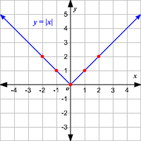
absolute value function
y = |x|
f(x) = |3x + 4|
g(x) = |x²| - 7
A function that contains an algebraic expression within absolute value symbols.
Notes:
9/10

Slide 3
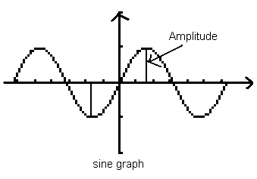
amplitude
the height from the mean value of the function to its maximum or minimum
Notes:
+ new plus standard

Slide 4
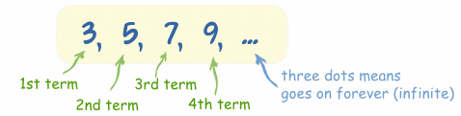
arithmetic sequence
a_{n} = a₁ + (n – 1)d
a₁ = first term a_{n} = n^{th} term
d = common difference n = number of terms
a pattern of numbers where the difference between consecutive terms is constant
Notes:
New – (+) standard

Slide 5
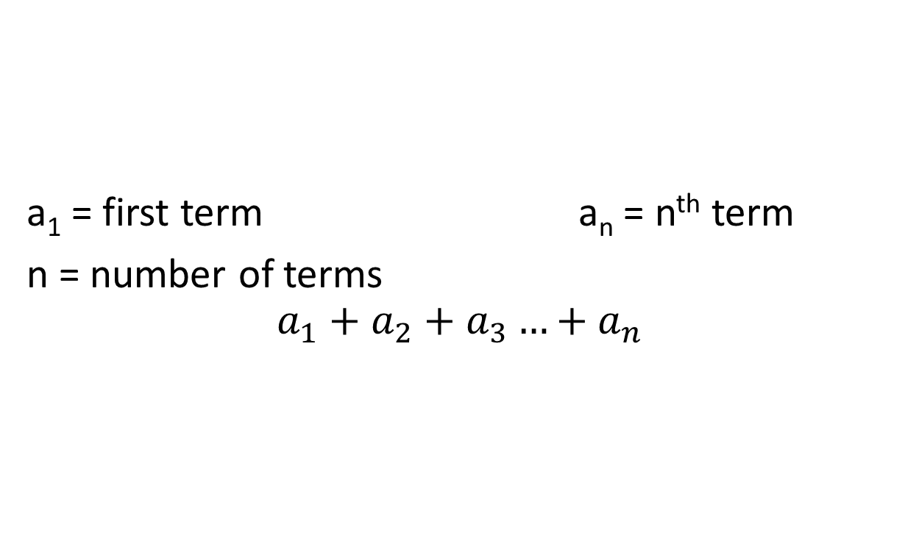
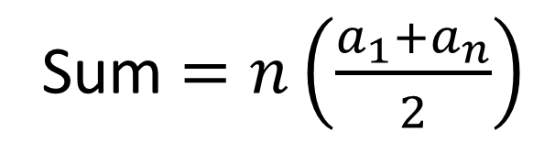
arithmetic series
a₁ = first term a_{n} = n^{th} term
n = number of terms
$$a_{1}+a_{2}+a_{3}…+a_{n}$$
Sum $=n\left(\frac{a_{1}+a_{n}}{2}\right)$
the sum of the terms of an arithmetic sequence
Notes:
New (+) standard

Slide 6
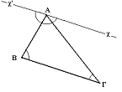
auxiliary line
an extra line needed to complete a proof in plane geometry
Notes:
New (+) standard

Slide 7
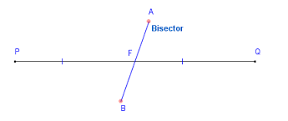
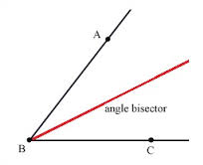
bisect
to divide into two equal parts
(the dividing line is called a bisector)
Notes:
9/10

Slide 8
causation
indicates that one event is the result of the occurrence of another event
Notes:
11th

Slide 9
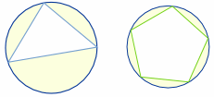
circumscribed figure
a circle that contains another geometric figure that passes through all of the vertices of that figure
Notes:
New
9/10

Slide 10
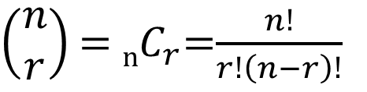

combinations
How many different committees of
4 students can be chosen
from a group of 15?
$\left(\begin{matrix}n \\ r\end{matrix}\right)$ = _{n}$C_{r}$=$\frac{n!}{r!\left(n−r\right)!}$
$\left(\begin{matrix}15 \\ 4\end{matrix}\right)$= $\frac{15!}{4!\left(15−4\right)!}$
A selection of objects from a collection where order is irrelevant.
Notes:
(+) standard

Slide 11

Complex Conjugate
Two complex numbers of the form a + bi and a – bi.
For example, the complex conjugate of 3 + 4i is 3 – 4i.
Notes:
11th

Slide 12

Complex Number
a number that can be expressed in the form a + bi, where a and b are real numbers
Notes:
11th

Slide 13
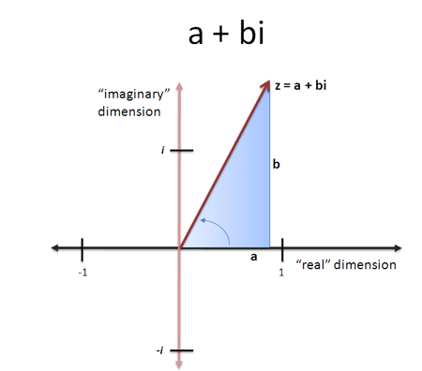
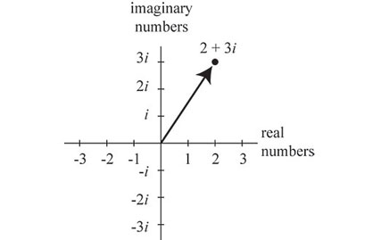
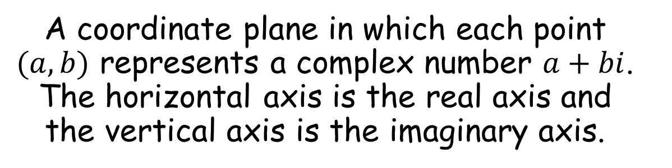
Complex Plane
A coordinate plane in which each point $(a, b)$ represents a complex number $a+bi$. The horizontal axis is the real axis and the vertical axis is the imaginary axis.
Notes:
HS +

Slide 14
congruent
having exactly the same size and shape
Notes:
HS 9/10

Slide 15
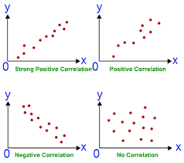
correlation
shows how whether and how strongly pairs of variables are related
Notes:
HS 11

Slide 16
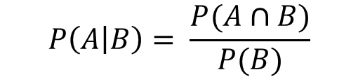
conditional probability
$$P\left(A | B\right)= \frac{P(A∩B)}{P(B)}$$
the probability of an event ( A ), given that another ( B ) has already occurred.
Notes:
(+) standard

Slide 17
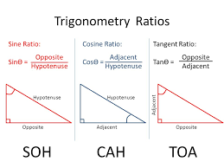
cosine
The trigonometric function that is equal to the ratio of the side adjacent a given angle (in a right triangle) to the hypotenuse.
Notes:
9/10

Slide 18
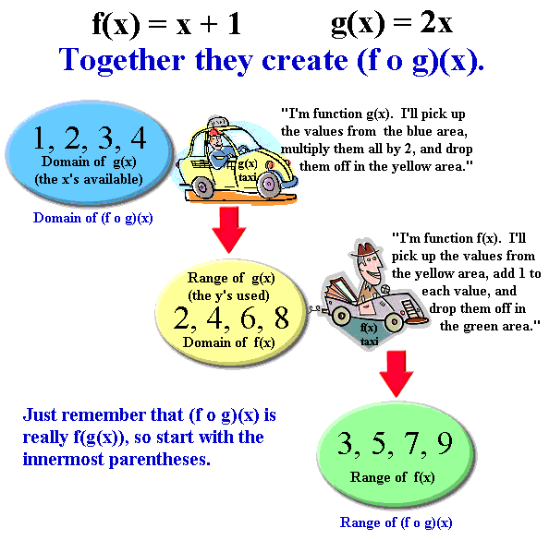
Composition of functions
Notes:
(+) standard

Slide 19
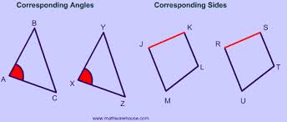
Corresponding parts
The parts of a figure (angles or sides) are in the same relative position in each of the figures.
Notes:
9/10

Slide 20
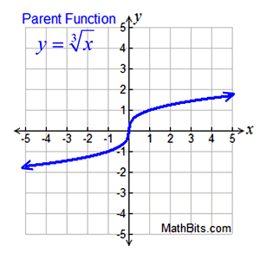
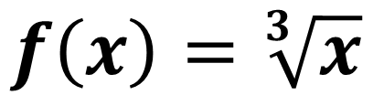
Cube root function
$$f\left(x\right)=\sqrt[3]{x}$$
Features (of parent function):
• increasing (-∞,∞)• positive (0,∞)
• negative (-∞,0)
• no absolute max (graph → ∞)
• no absolute min (graph→ -∞)
• no relative max or min
• end behavior
f (x) → +∞, as x → +∞
f (x) → -∞, as x → -∞
Notes:
11th

Slide 21
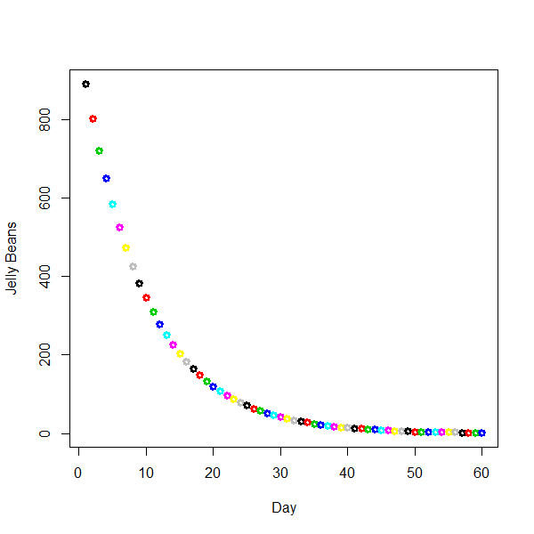
decay
When a population or group of something is declining, and the amount that decreases is proportional to the size of the population.
Notes:
11th

Slide 22
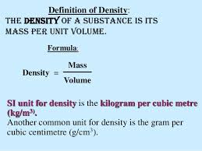
density
Notes:
9/10

Slide 23
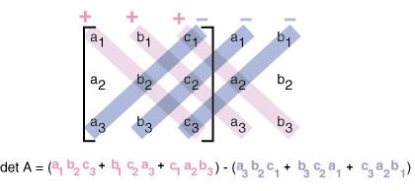
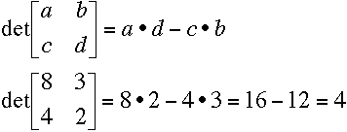
Determinant
A useful value that can be computed from the elements of a square matrix. The determinant of a matrix A is denoted det(A), detA , or |A|.
Notes:
11th

Slide 24
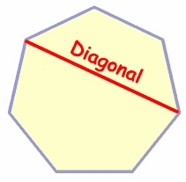
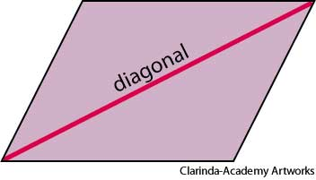
diagonals
A straight line joining two opposite corners of a square, rectangle, or other straight-sided shape.
Notes:
9/10

Slide 25
diameter
diameter
a line segment that passes through
the center of a circle and has
endpoints on the circle
Notes:
Used in formulas grade 7 but not formally mentioned in standards until HS

Slide 26
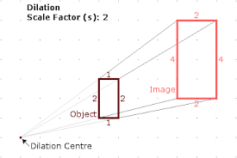
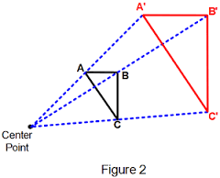
dilation
A transformation that produces an image that is the same shape as the original, but is a different size. A dilation stretches or shrinks the original figure.
Notes:
9/10

Slide 27
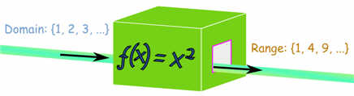
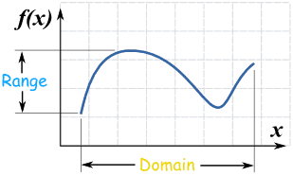
domain
All the values that go into a function (x-values, independent variables, input values).
Notes:
9/10

Slide 28
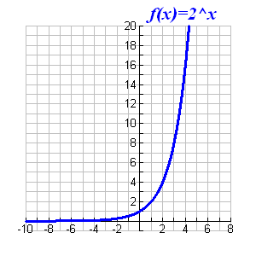
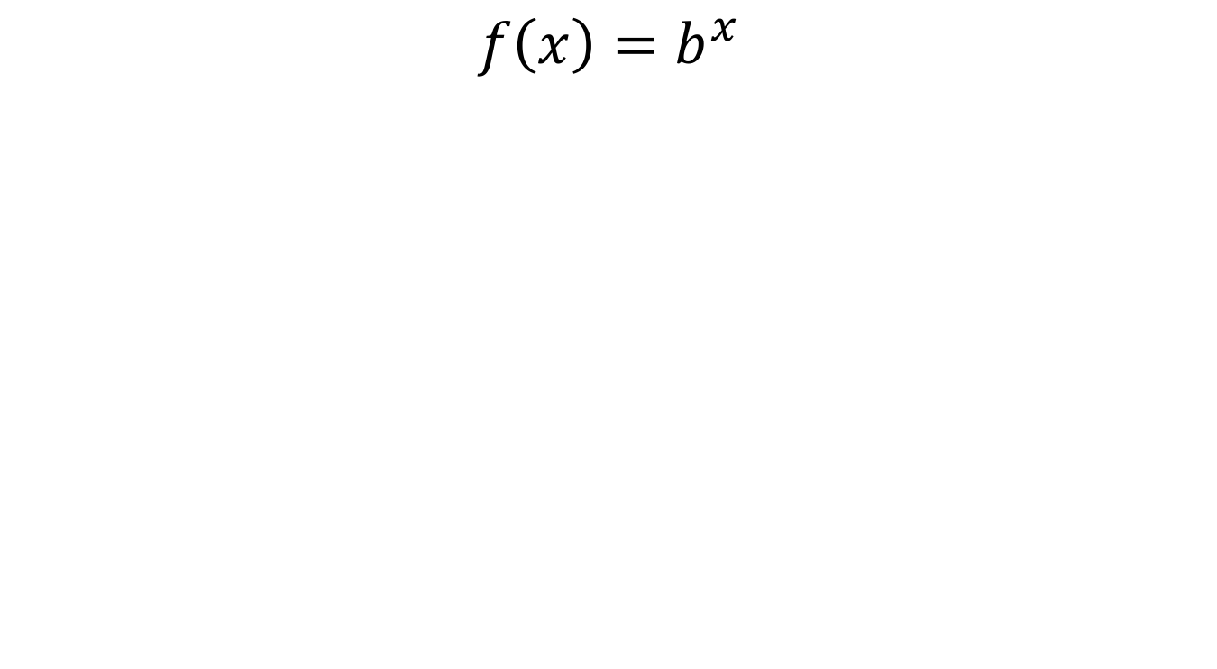
exponential function
$$f\left(x\right)=b^{x}$$
Notes:
11th

Slide 29
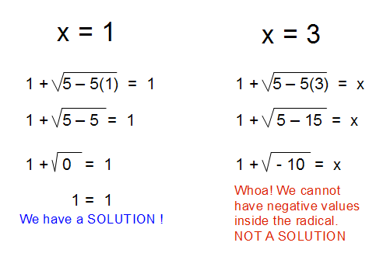
Extraneous Solution
A solution obtained from solving an equation that does not satisfy the original equation.
Notes:
9/10

Slide 30
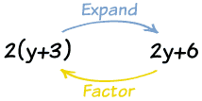
Factoring
Finding what to multiply to get an expression.
Example: 2y+6 = 2(y+3),
so the factors of 2y+6 are: 2 and (y+3)
Notes:
Process is used in grade 8 but not formally referred to as factoring until HS

Slide 31

Function notation
$$f\left(x\right)=y$$
Notes:
9/10

Slide 32
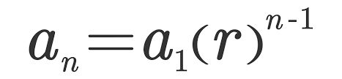
Geometric sequence
a pattern of multiplying a fixed amount from one term to the next
a₁ = first term a_{n} = n^{th} term
r=common ratio n=number of terms
Notes:
(+) standard

Slide 33

Geometric series
Summation of a pattern of multiplying a fixed amount from one term to the next
a₁ = first term r=common ratio n=number of terms
Notes:
(+) standard

Slide 34
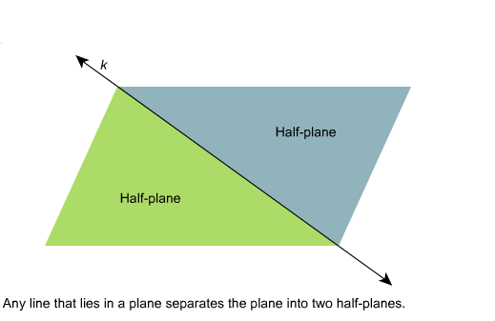
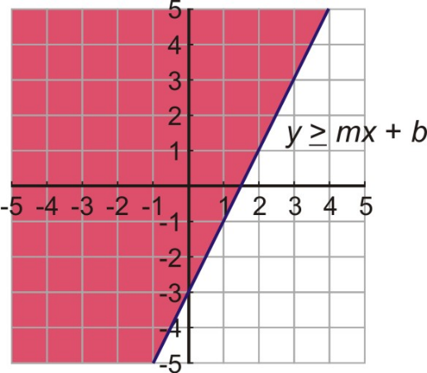
Half-Planes
The two regions into which the boundary line of a linear inequality divides the coordinate plane.
Notes:
9/10

Slide 35
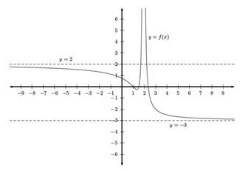
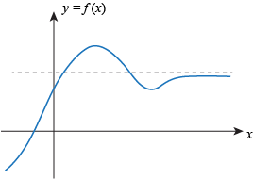
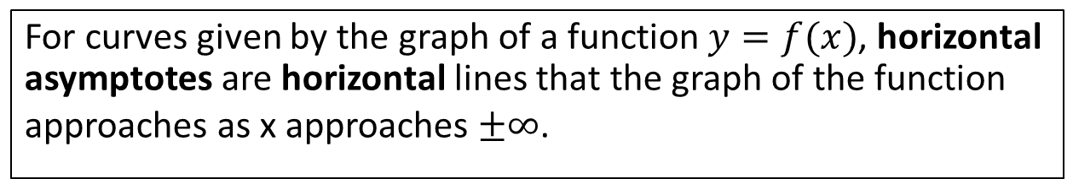
horizontal asymptote
For curves given by the graph of a function $y=f(x)$, horizontal asymptotes are horizontal lines that the graph of the function approaches as x approaches $±∞$.
Notes:
New
(+) standard

Slide 36

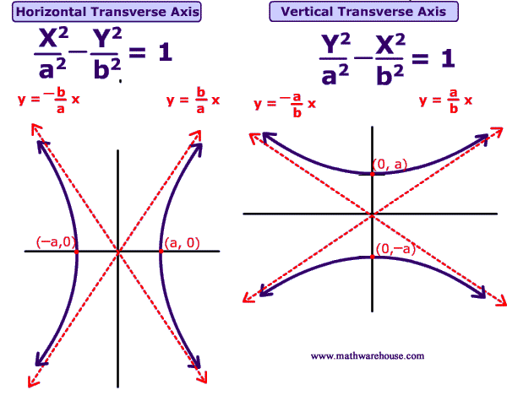
hyperbola
Notes:
New (+) standard

Slide 37

Inscribed figure
To draw a circle on the inside of a figure, touching as many points as possible.
Notes:
+ new

Slide 38
independent events
the probability of one event occurring in no way affects the probability of another event occurring
Notes:
(+) standard

Slide 39
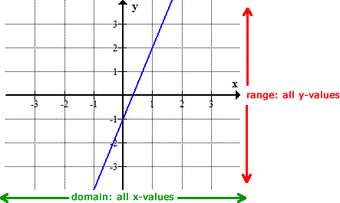
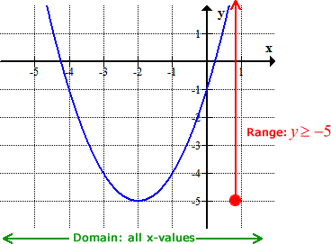
Interval (function)
All the domain/range between two given points on graph.
Notes:
9/10

Slide 40
Inverse (geometry)
Negating both the hypothesis and conclusion of a conditional statement.
For example, the inverse of "If it is raining then the grass is wet" is "If it is not raining then the grass is not wet".
'bedmond3@jccc.edu'
Notes:
New 9/10

Slide 41
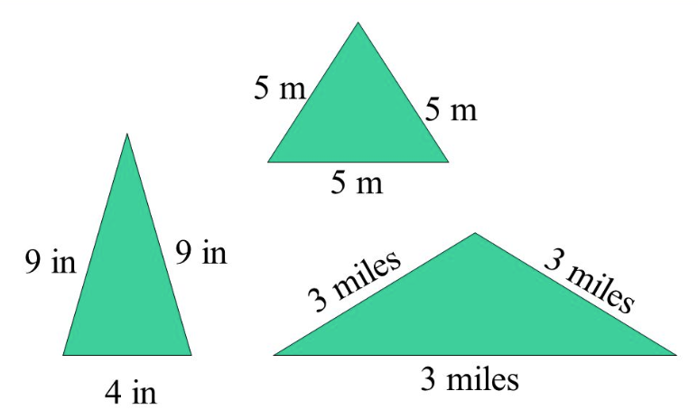
isosceles triangle
A triangle with exactly two sides of equal length (exclusive); a triangle with at least two sides of equal length (inclusive)
Notes:
High School 9/10

Slide 42
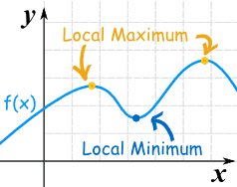
(local) Maxima or Minima
Maxima: The height of the function at "a" is greater than (or equal to) the height anywhere else in that interval.
Minima: The height of the function at "a" is less than (or equal to) the height anywhere else in that interval.
Notes:
9/10

Slide 43
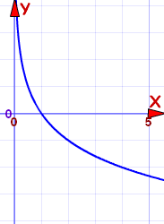
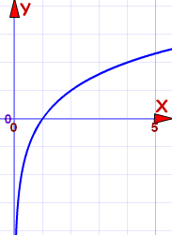
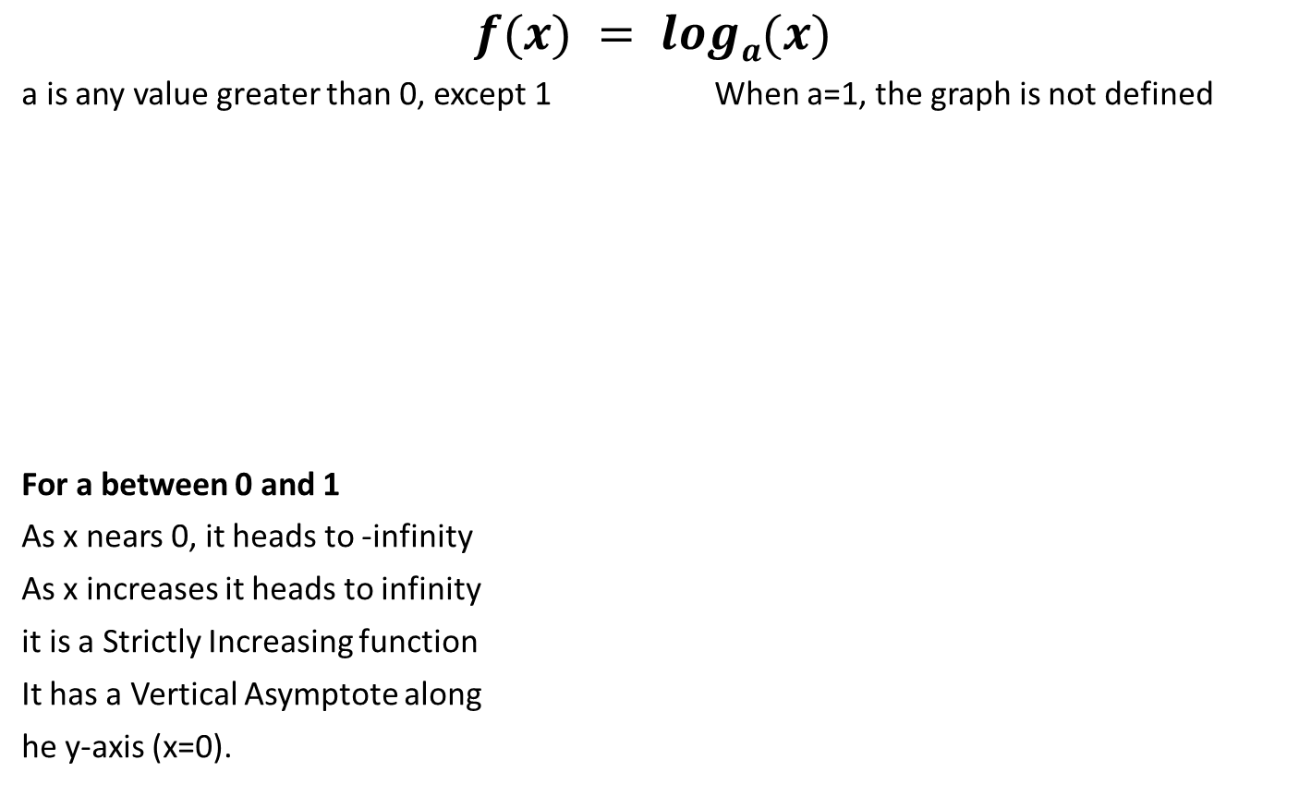
Logarithm (function)
$$f(x) = loga(x)$$
a is any value greater than 0, except 1 When a=1, the graph is not defined
For a between 0 and 1
As x nears 0, it heads to -infinity
As x increases it heads to infinity
it is a Strictly Increasing function
It has a Vertical Asymptote along
he y-axis (x=0).
For a above 1:
As x nears 0, it heads to infinity
As x increases it heads to -infinity
It is a Strictly Decreasing function
It has a Vertical Asymptote along the y-axis (x=0).
Notes:
11th

Slide 44
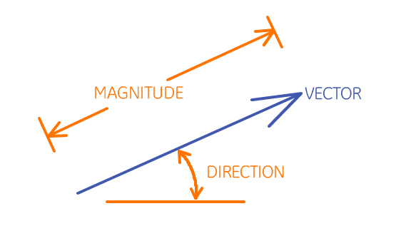
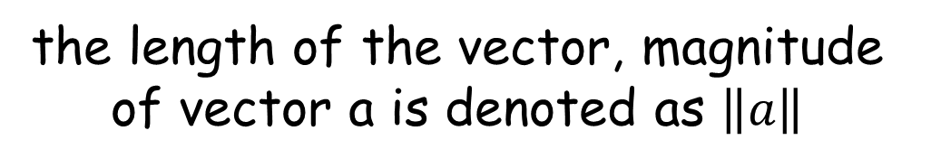
Magnitude
the length of the vector, magnitude of vector a is denoted as $\left\|a\right\|$
Notes:
(+) standard

Slide 45
mathematical modeling
the process of developing a description of a system using mathematical concepts and language
Notes:
Not on assessment but all grades should be familiar with term.

Slide 46

Matrix
a rectangular array of numbers, symbols, or expressions arranged in rows and columns
For example, the dimensions of a 2 × 3 matrix (read "two by three") has two rows and three columns.
Notes:
(+) standard

Slide 47


Maximum
The largest value of a function.
For example, the y-coordinate of the vertex for $y=ax^{2}+bx+c$ when $a<0$ is the maximum.
Notes:
9/10

Slide 48

Median of a triangle
A line segment joining a vertex to the midpoint of the opposing side. The center of these lines is called a centroid.
Notes:
9/10

Slide 49

midpoint
A point on a line segment that divides it into two equal parts.
Notes:
9/10

Slide 50

Minimum
The smallest value of a function.
For example, the y-coordinate of the vertex for when is the minimum.
Notes:
9/10

Slide 51


Modulus
The modulus of a complex number z = a + bi, denoted by $\left|z\right|$, is defined by $\left|z\right|=\sqrt{a^{2}+b^{2}}.$
Notes:
(+) standard

Slide 52

normal distribution
a function that represents the distribution of many random variables as a symmetrical bell-shaped graph
Notes:
(+) standard

Slide 53

number systems
Real
Complex
Irrational
the different subgroups of numbers
Notes:
9/10

Slide 54


parabola
A graph of a quadratic function, y = x².
Notes:
11th

Slide 55

Pascal’s Triangle
a triangular array of numbers in which those at the ends of the rows are 1 and each of the others is the sum of the nearest two numbers in the row above (the apex, 1, being at the top)
Notes:
(+) standard

Slide 56

periodicity
A function whose output contains values that repeat periodically (such as sine and cosine).
Notes:
9/10

Slide 57


permutation
$$\frac{n!}{\left(n−k\right)!}$$
_{n}$P_{k}$=
All possible arrangements of a collection of things, where the order is important.
Notes:
(+) standard

Slide 58

Piecewise functions
A function which is defined by multiple sub-functions, each sub-function
applying to a certain interval of the main
function's domain
(a sub-domain).
Notes:
+ new

Slide 59

Polynomial function
An expression that can have constants, variables and exponents, that can be combined using addition, subtraction, multiplication and division, but:
• no division by a variable.
• a variable's exponents can only be 0,1,2,3,... etc.
• it can't have an infinite number of terms.
Notes:
9/10

Slide 60
procedural fluency
refers to knowledge of procedures, knowledge of when and how to use them appropriately, and skill in performing them flexibly, accurately, and efficiently
Notes:
Not on assessment

Slide 61

Quadratic
a quadratic function, a quadratic polynomial, a polynomial of degree 2, or simply a quadratic, is a polynomial function in one or more variables in which the highest-degree term is of the second degree.
Notes:
11th

Slide 62
Range of a function
All the values that out of a function (y-values, dependent variables, output values).
Notes:
9/10

Slide 63


Rational function
A function that is written as $f\left(x\right)=\frac{P(x)}{Q(x)}$ where $P(x) and Q(x)$are polynomials and $Q(x)≠0.$
Notes:
+ new

Slide 64


radian
The angle made when the radius is wrapped round the circle
Notes:
(+) standard

Slide 65

recursive function
Function in which each term is defined as a function of its preceding term(s). [Each term is found by doing something to the term(s) immediately in front of that term.]
Notes:
(+) standard

Slide 66

rotation
A transformation is where you turn a figure about a given point.
Notes:
9/10

Slide 67

Scalar
a real number by which you multiply a matrix
Notes:
(+) standard

Slide 68
sine
The trigonometric function that is equal to the ratio of the side opposite a given angle (in a right triangle) to the hypotenuse.
Notes:
9/10

Slide 69

Special triangles
Notes:
9/10

Slide 70


Square root function
$$f\left(x\right)=\sqrt{x}$$
Features (of parent function):
increasing function [0,∞)
positive function (0,∞)
no absolute max (graph → ∞)
absolute minimum 0
no relative max/min
end behavior
f (x) → +∞, as x → +∞
f (x) → 0, as x → 0
Notes:
11th

Slide 71

standard deviation
a measure that is used to quantify the amount of variation or dispersion of a set of data values is often abbreviated as SD, s or σ
Notes:
9/10

Slide 72


Step function
A function that increases or decreases abruptly from one constant value to another.
Notes:
+ new

Slide 73
subset
quadrilaterals
rectangles
Rectangles are a subset of all quadrilaterals.
a set within a larger set
Notes:
Not on assessment

Slide 74


System of Equations
A set of two or more equations with the same variables.
Notes:
9/10

Slide 75
tangent
The trigonometric function that is equal to the ratio of the side opposite a given angle (in a right triangle) to the side adjacent to the given angle.
Notes:
9/10

Slide 76

Tangent line
A perpendicular line to the radius drawn to the point of tangency.
Notes:
+ new

Slide 77



theorem
a statement that has been proved on the basis of previously established statements
Notes:
New
MS – grade 8 (specifically Pythagorean Theorem)

Slide 78

transformation
A transformation is a general term for four specific ways to manipulate the shape of a point, a line, or shape:
Translation
Reflection
Rotation
Dilation
Notes:
9/10

Slide 79

translation
A transformation that "slides" an object a fixed distance in a given direction.
Notes:
9/10

Slide 80






Triangle Congruence Theorems
Notes:
HS 9/10

Slide 81


Trigonometric function
Notes:
(+)

Slide 82


Trigonometric laws
An equation relating the lengths of the sides of any shaped triangle to the sines/cosines of its angles.
Notes:
+ new

Slide 83


Vector
a quantity having direction as well as magnitude, especially as determining the position of one point in space relative to another
Notes:
(+)

Slide 84



vertical asymptote
For curves given by the graph of a function $y=f(x)$ vertical asymptotes are vertical lines near which the function grows without bound in either direction.
Notes:
New
(+) standard

Slide 85

zeroes
Where a function equals the value zero (0).
Notes:
9/10

